Slide 1

Student Employment Supervisor Training
Fall 2025

Slide 2


STUDENT EMPLOYMENT PROFESSIONAL TEAM
MARLENE VINCIGUERRA
EMLOYMENT SPECIALIST
PEOPLE OPERATIONS/HR
NORA LEWIS
ASSOCIATE DIRECTOR
PEOPLE OPERATIONS/HR

Slide 3

Mission
The Student Employment Program provides a best practice employment program where students grow in their career and academic pursuits through mentorship and experience as they actively contribute to the University.

Slide 4
Overview
Posting/Application/Selection
Hiring
Federal Work Study
Policies
Safety
International Students
LevelUp Competencies
Payroll
Training Budgets
Fun Stuff
Closing

Slide 5
Posting/Application/Selection

Slide 6

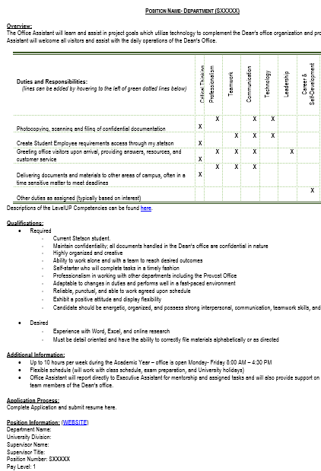
Job Descriptions
Connect tasks to the Level Up Career Competencies
Use resume-ready language
Create functional qualifications
All Job Descriptions must use LevelUp Job Description template
New positions must complete the New Position Request

Slide 7

HatterJobs
HatterJobs is the platform for our Career and Professional Development
Site provides:
  Resume and cover letter templates
  Online resume reviews
  Scheduling appointments with career advisor
  CaPD Calendar of events
We direct all students to review postings on this platform
Students can get to HatterJobs through their MyStetson or www.stetson.edu/career.
Post position through this form
Request position to be taken down through this form

Slide 8
Posting on HatterJobs

Slide 9
Application Process
For many, this is the first time they have ever applied for a job.
Application Process is determined by the hiring supervisor.
Highly suggest using Microsoft Forms (tutorial here)
When possible, communicate with students throughout application/hiring process

Slide 10
Interview
Create a plan:
  Who will participate?
  Setting
  How do you invite a student to interview?
  What questions should you ask?
    Behavior based questions
    Job-function question
    How does student accept feedback?
    Illegal questions

Slide 11
After Selection
Give student a day to consider the job if needed (This is more similar to the real world.)
1
If helpful, request their ID number and schedule availability again.
2
Communicate with students who have not been selected – SO IMPORTANT
3
Update HatterJobs posting
4

Slide 12
EPAF Hiring Process

Slide 13
What is EPAF
Electronic Personnel Action Form
Hiring Supervisors should have access to it through their MyStetson Employee Tab
If access is needed, contact Marlene

Slide 14
EPAF Process
Step 1- Supervisor Submission
Step 2 - Student “Paperwork” Completion
Step 3 - Student Employment Team Processes
Step 4 - Student Works

Slide 15
Step 1: Supervisor Submission
EPAF Instructions available on website (coming soon)
Troubleshooting guide found on the Supervisor Resources page.
Helpful Hints:
Correct approval type is needed
Query date needs to be set as the anticipated start date PRIOR to pressing “Go” on page 1
EPAFs will have a “Pending” transaction status when supervisor completes submission

Slide 16
Step 2: Student Paperwork Completion
ALL STUDENTS
NEW STUDENTS (STUD01)
Receive e-mail instructions upon EPAF submission
Accept position online through MyStetson. Forms include:
  Rights and Responsibilities
  Safety
  Confidentiality
  LevelUp Competencies selection
AFTER job acceptance, student receives e-mail instructions
Completes online form
Makes appointment to meet at satellite office with Student Manager

Slide 17
Step 3: Processing
Processing occurs daily
Once student steps are complete:
STUD01: 3-4 business days
STUD02 & STUD03: 2-3 business days

Slide 18
Step 4: Student Can Work!
“Employment Approved” e-mail is received by student and supervisor

Slide 19
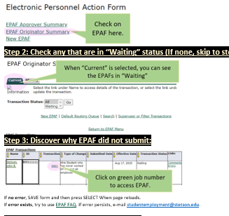
Check where student is in EPAF process
Check EPAF Status- one page.docx

Slide 20
Federal Work Study

Slide 21
Federal Work Study program
Awarded to students who filed a FAFSA
Must have "Need" under federal regulations
Financial Aid program that is limited by the award amount
Student is paid the same way regardless of funding source

Slide 22
Policies

Slide 23
Pay Structure
Created to align student positions and prepare for anticipated annual increases for next one years
Developed through committee process including supervisors and students
All students within a position will be paid the same rate- There is no flexibility in wage rate within each position

Slide 24
Pay Levels
Level 1 - $14/hour:
Requires skills and knowledge that can be learned on the job. Involves the use of some independent decision-making. Exercises some responsibility and judgment for a variety of tasks, tasks may be manual and/or repetitive in nature, sound judgment in supervisor’s absence upon completed training, and general instruction from a supervisor with some follow-up required.
Examples: Clerical Assistants, Helpdesk Employees, Ticket Office (entry-level roles)
Level 2 - $14.25/hour:
Requires skills at a level higher than those that can easily be learned on the job, including skills beyond those typically expected of an undergraduate student. Uses independent problem-solving to complete tasks with moderate accountability. Demonstrates initiative and decision-making in planning and prioritizing workload, moderate analytical abilities, leadership abilities, minimal supervision on routine tasks, and some follow-up on complex tasks.
Examples: Tutors, Lifeguards, Student Employment Managers (not in lead positions)
Level 3 - $14.75/hour:
Independent project management of University initiatives or oversight of student employees which includes coordination of the responsibilities, accountability for the workload of other student employees. Requires highly specialized skills to complete complex tasks, and independent judgment in decisions with high accountability and confidentiality.
Examples: Lead SPI, WELL Team Leads, Lead Managers

Slide 25
Student Allocations
Student limit is $4000
Supervisors can see student’s complete earnings on the bi-weekly budget report
Student or Supervisor may request additional earnings allocation through Marlene
  will only be approved for special circumstances

Slide 26
When Can Students Work?
Not during scheduled classes
Students typically work about 10 hours per week. In special cases, student employees are allowed to work up to a maximum of 20 hours per week at all jobs combined during the academic year. A student’s work schedule will be determined by the student and their supervisor(s).
During periods where classes are not in session, student employees may work up to 29 hours per week.
RA position is considered 10 hours/week

Slide 27
Policies
Student Employee Manual
Stetson’s Organization, Policies, and Procedures Manual
Student Conduct and Community Standards

Slide 28
Safety

Slide 29
Worker’s Compensation-
Contact Public Safety
Should a work-related injury occur, student employees are covered under the University's workers' compensation insurance.
If an employee is injured while performing their required work duties, students should immediately contact Public Safety and their supervisor (after 911, if necessary).
Supervisor will need to complete the Workers' Compensation Incident Reporting Form on the Risk Management website.
Any questions should be referred to Amber Ryan, Director of Risk Management at aryan2@stetson.edu.

Slide 30
International Students

Slide 31
International Students
Are a special population at Stetson
Can and should be hired similar to other students
Should not ask this (or make assumptions) in interview process
Hiring process might take longer depending on Social Security status
Visa limitations – 20 hour per week limit
Must be fully hired before start

Slide 32
Hiring Process a bit different
Social Security Request Process- You will know if your student is an international student who likely needs their Social Security Number because you will see this error appear after you select SUBMIT on your EPAF. (Your EPAF status will also remain in “Waiting”.)
Meet with Nora instead of a student manager
Possible longer wait time in E-Verify process

Slide 33
LevelUp Competencies

Slide 34
COMPETENCIEs
Critical Thinking— Identify and respond to needs based upon an understanding of situational context and logical analysis of relevant information.
Professionalism— Knowing work environments differ greatly, understand, and demonstrate effective work habits, and act in the interest of the larger community and workplace.
Teamwork— Build and maintain collaborative relationships to work effectively toward common goals, while appreciating diverse viewpoints and shared responsibilities.
Communication— Clearly and effectively exchange information, ideas, facts, and perspectives with persons inside and outside of an organization.
Technology— Understand and leverage technologies ethically to enhance efficiencies, complete tasks, and accomplish goals.
Leadership— Recognize and capitalize on personal and team strengths to achieve organizational goals.
Career & Self-Development— Proactively develop oneself and one’s career through continual personal and professional learning, awareness of one’s strengths and weaknesses, navigation of career opportunities, and networking to build relationships within and without one’s organization.
Equity & Inclusion— Demonstrate the awareness, attitude, knowledge, and skills required to equitably engage and include people from different local and global cultures. Engage in anti-racist practices that actively challenge the systems, structures, and policies of racism.

Slide 35
Level UP Competencies
Created an opportunity for us to use a common language across the University
Used to frame job descriptions
Provide Focus for Employee of the Month program
Assist students in articulating their experience

Slide 36
Payroll

Slide 37
Pay Calendar
Where to Find
Minimal variance due to holidays and Fiscal Year change
Every Friday is Green -submit timesheet or get paid

Slide 38
Timesheets
Submission and Approval
All completed online
Payroll Variance Form
Should only be used if necessary
Needs to be fully completed
Students will likely get paid in the next payroll (2-3 weeks)

Slide 39
Paychecks
Direct Deposit
Paper checks
Student has mailbox
Post Office receives check
Communicate with student via e-mail
If not picked up, goes back to Payroll
Student does not have mailbox
Sent home
Held by Payroll
Easiest and most secure
Students find form on our website and submit it to Payroll@stetson.edu

Slide 40
Training and Evaluation

Slide 41
Onboarding
Virtual introductory course for new student employees regarding student employment
Includes timesheet info and competency info
All STUD01 students need to complete the training within the first two weeks of working
Students and supervisors will be communicated with regarding non-completion

Slide 42
Mandatory Student Yearly Training
TITLE IX – October
Training is mandatory and non-completion will result in termination.

Slide 43
Budgets

Slide 44
Position Budgets
Each position has a yearly budget which runs from July 1 – June 30
Student Employment funding can only be used on student wages
Budgets are tracked in Banner
Supervisors receive bi-weekly reports
Position budgets are reset each year

Slide 45
Budget Management
Budgets can be moved between student employment positions by using the Student Employment Funding Transfer Form
Funding can be moved from operating or endowed funds into student employment, but not from student employment to operating or endowed funds.

Slide 46
Fun Stuff

Slide 47
Recognition/Outreach
Employee of the Month
Instagram-studentsatwork
Event sponsorship
Student Employment Week

Slide 48
In Closing

Slide 49
Supervisor Expectations
Follow legal policies
Work in best interest of the student and university
Review communication and take action as necessary. Contact our office with questions.

Slide 50

Thank You
We know this is a lot of information and rules and policies. We want to provide you with the best information as possible.
Thank you for your partnership as we navigate this year together. We know it will be great!

Slide 51

Questions?

