Slide 1
THE AI AGENDA…
USING AI AT STETSON
Discussion Questions | What Is AI?! | What Is Our Policy | Violations | How to Fact Check & Cite AI | The End
Questions
HOW WOULD YOU DEFINE AI?
HOW MANY “R”s ARE IN THE WORD STRAWBERRY?
https://tiermaker.com/create/ultimate-fruit-tier-list---labeled-183857 | https://tiermaker.com/create/candy

Slide 2
Questions
THE AI AGENDA…
HOW WOULD YOU DEFINE AI?
HOW MANY “R”s ARE IN THE WORD STRAWBERRY?
USING AI AT STETSON
Discussion Questions | What Is AI?! | What Is Our Policy | Violations | How to Fact Check & Cite AI | The End
Pull Up Copilot

Slide 3
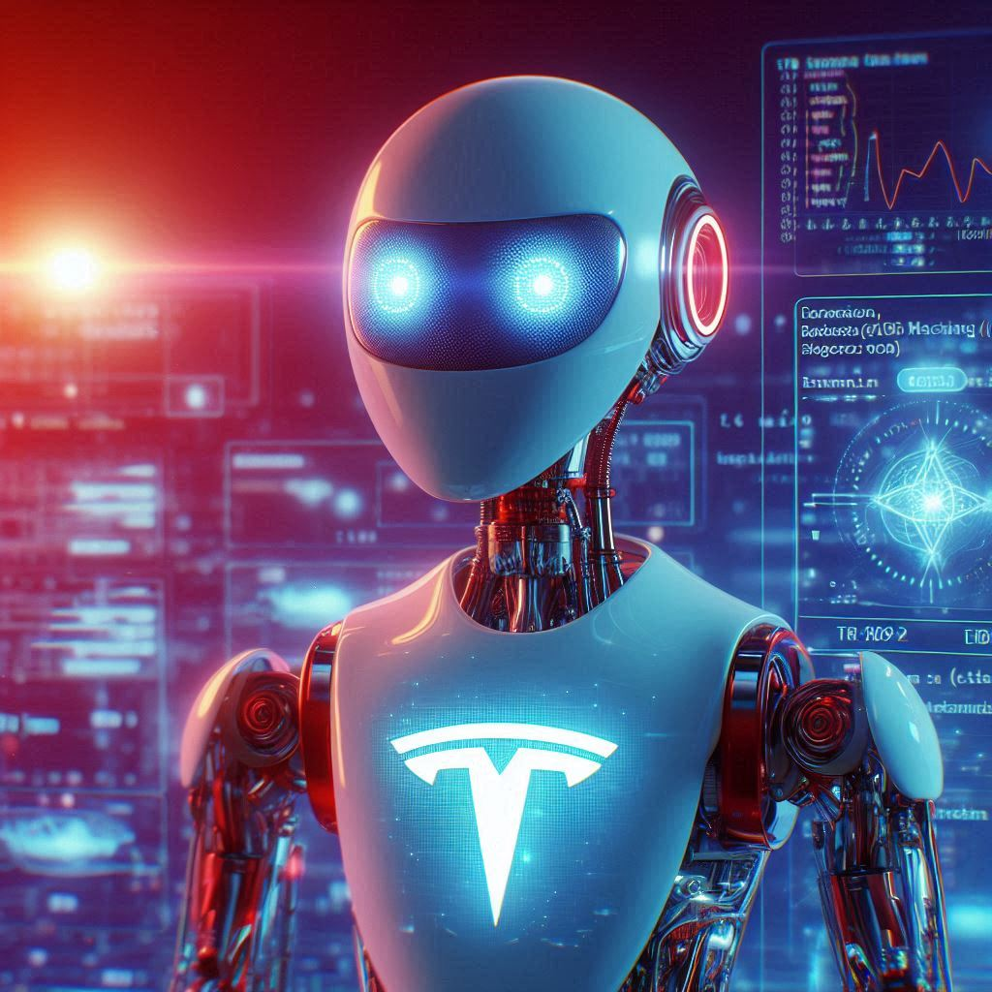
What Is AI?
Artificial intelligence (AI) is the ability of computer systems to perform tasks typically associated with human intelligence, such as learning, reasoning, problem-solving, perception, and language understanding. It uses complex algorithms to analyze data and make decisions ("What is artificial intelligence by Cloudflare).
How Generative AI Works
Putting in a prompt into an AI platform like chat GPT and asking it to generate a response
Biases?
AI tools may lead to content that is not based on reason or is skewed, which may reinforce false or harmful ideas (Heikkilä, 2022)
AI systems are only as good as the data they are trained on - “Quality in quality out” - “Garbage in garbage out”

Slide 4
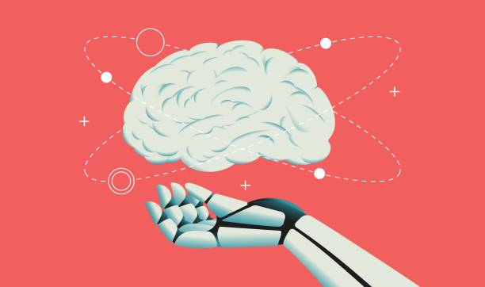
What Are The Different Types?
INSIGHT INTO AI
NLP – Natural Language Process ("What is a Large Language Model?")
These forms of AI are more simplified and can be broken down into many categories
Programmed by humans and are used to identify patterns and become automated based on them
Ex. Chat bots, smart assistants, search results
LLM – Large Language Model, subset of NLP (Stryker and Holdsworth)
These forms of AI are “trained” on information and are constantly processing more data
Used to answer questions, summarize given text, and even create new information
Ex. Chat GPT, Llama, Gemini (word predictors based on data)
Common AI’s:
Copilot
Grok
ChatGPT
Jurafsky and Martin (2023)

Slide 5
What Is Our Policy
INSIGHT INTO THE BASIS OF AI LAW
Stetson’s General Policy:
Follow the professor’s syllabus
What does it say about AI?
AI that is not cited is not allowed
In The Absence of Such Information:
AI is treated like any other source
Must be cited in the way it was used: for paraphrasing or direct quotation
If not cited, it is deemed an act of plagiarism

Slide 6
What’s a Violation?
IT’S TREATED LIKE ANY SOURCE
Using AI without professor permission
Copying extensive information directly without any transformation into what is your own work
If Permitted: Using AI on exams, quizzes, etc. for thoughtless answers (1. xAI, 2025)
Manipulating AI to bypass plagiarism detection software or academic integrity tools
NOT CITING PROPERLY

Slide 7
AI Negligence
THESE ARE EGREGIOUS
Using wrong information in papers
Not fact checking your sources

Slide 8
Violation Examples
INSIGHT INTO THE HONOR SYSTEM COUNCIL
AI Misuse Delays Graduation
A Stetson University student used AI to write their final paper for a course, submitting it as their own work. The professor flagged the paper due to inconsistencies in writing style, and upon investigation, it was discovered that the student had used AI without proper citation. As a result, the student received a failing grade for the assignment, which impacted their overall course grade. The violation led to academic trial and a delay in graduation, as the student was required to complete an academic integrity course before being eligible to graduate.

Slide 9
How To Fact Check AI
SEEK TRUTH WISELY
Read It, Seeking to Understand:
Question AI Output—verify any discrepancies/inconsistencies with what you see and know. AI can “hallucinate” fake facts (2. xAI, 2025)
Cross-Check With Trusted Sources:
Verify claims made with legitimate academic material –books, journals, more than just a Google search (remember Stetson’s library site!)
Stetson’s Standards:
Stetson expects your work to be yours: Fact checking keeps things true to the full extent of your abilities and is evidence of you thinking
Truth matters—wrong information can tank your grade and shows AI negligence
Quick Tips:
Ask: “Where’d AI get this?” If it won’t tell you (and it many times can’t), double-check it yourself—protect your work and Stetson’s honor code
Seek to understand, not just to finish—truth is worth it

Slide 10
How to Cite AI Properly​
General Rules when citing:
AI must be cited when used for ideas, text, or summaries
State how AI was used (brainstorming, summarizing, drafting, etc.)
APA (Brown University Library, 2023)
Author. (Date). Name of tool (Version of tool) [Large language model]. URL
OpenAI. (2023). ChatGPT (Mar 14 version) [Large language model]. https://chat.openai.com/chat
In-text Citation: (OpenAI, 2023)
MLA (Brown University Library, 2023)
"Description of chat" prompt. Name of AI tool, version of AI tool, Company, Date of chat, URL.
"Examples of harm reduction initiatives" prompt. ChatGPT, 23 Mar. version, OpenAI, 4 Mar. 2023, chat.openai.com/chat.
In-text Citation: ("Examples of harm reduction")
Chicago (Brown University Library, 2023)
Author, Title, Publisher, Date, url for the tool.
Text generated by ChatGPT, OpenAI, March 7, 2023, https://chat.openai.com/chat.

Slide 11
Use AI Responsibly!
THE END

Slide 12
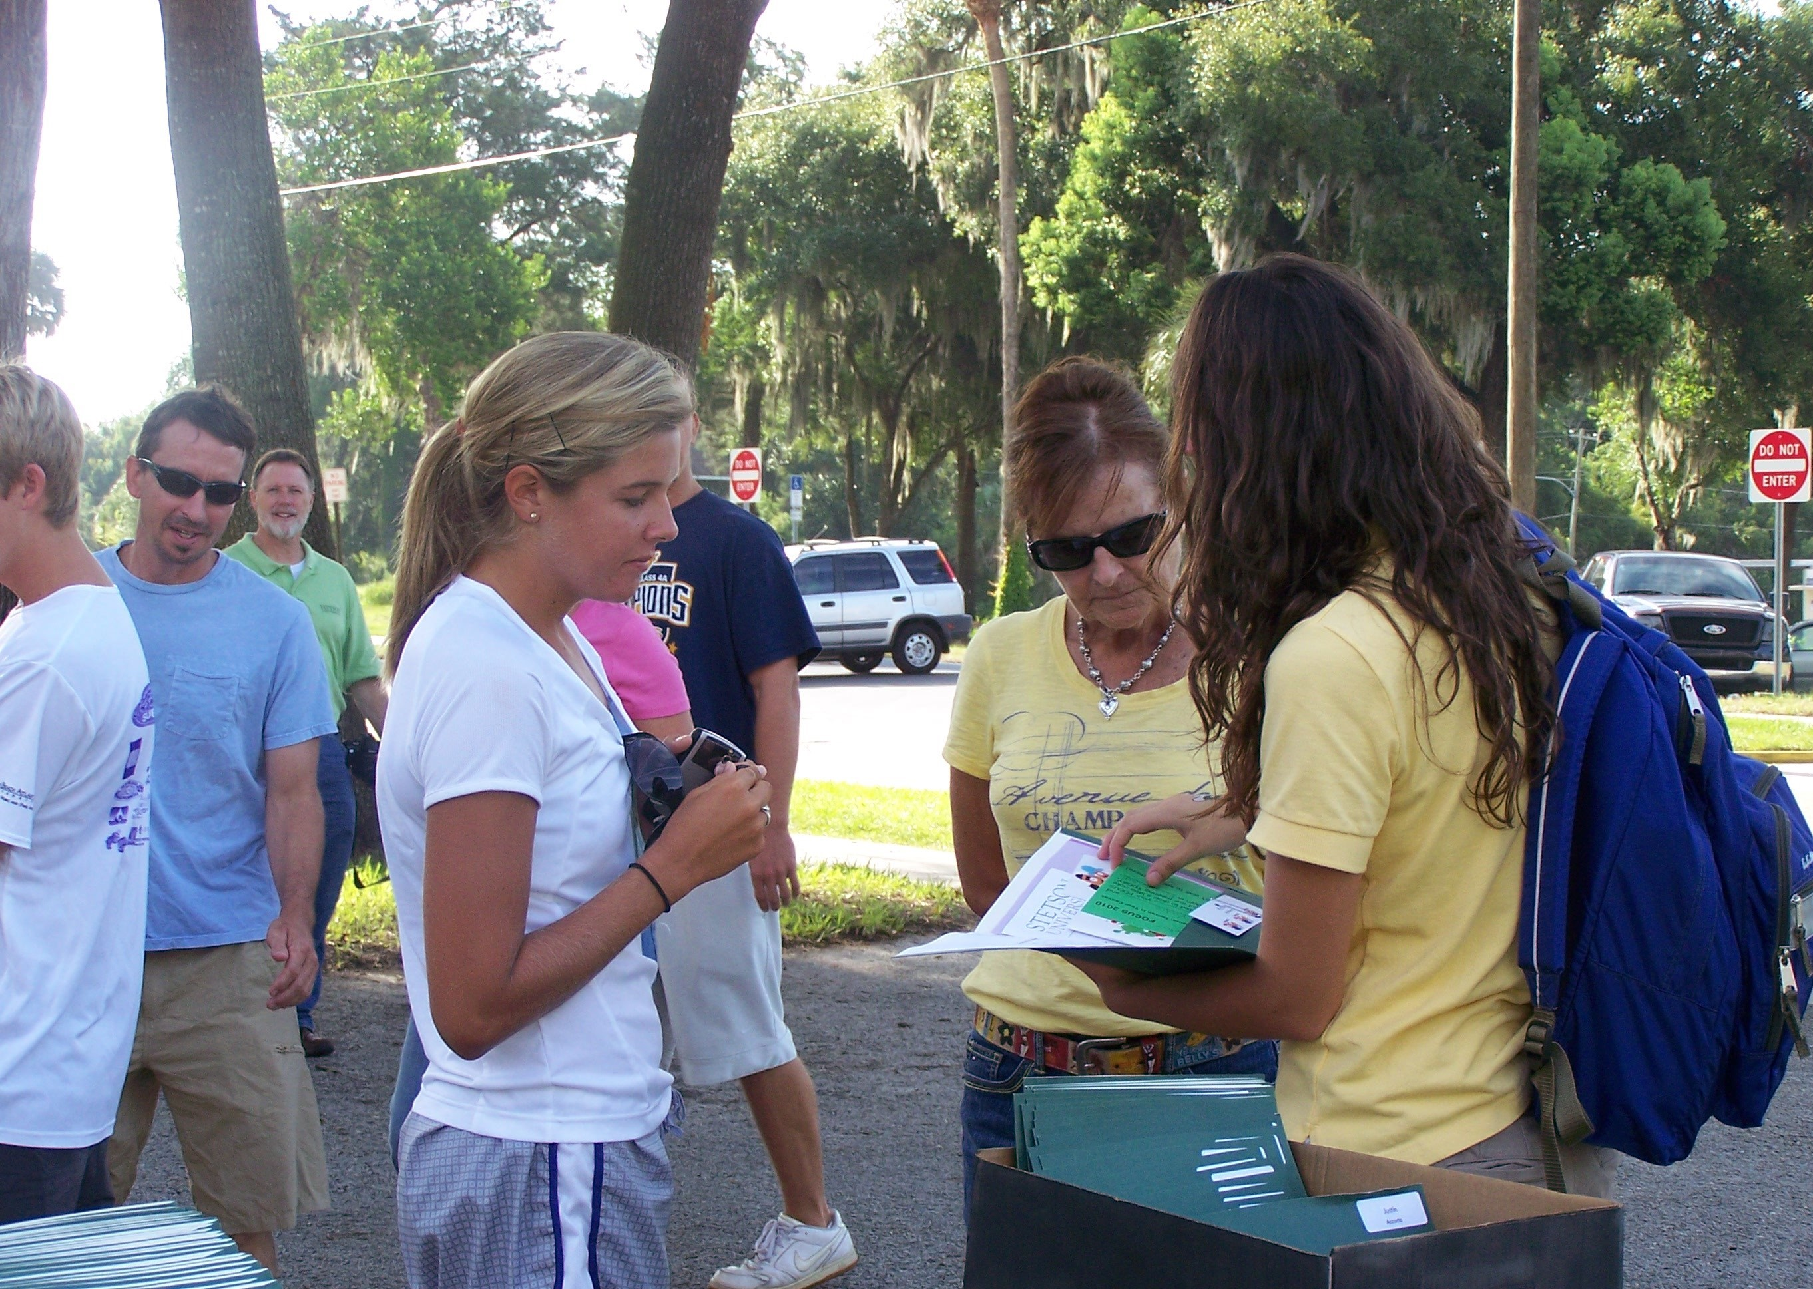
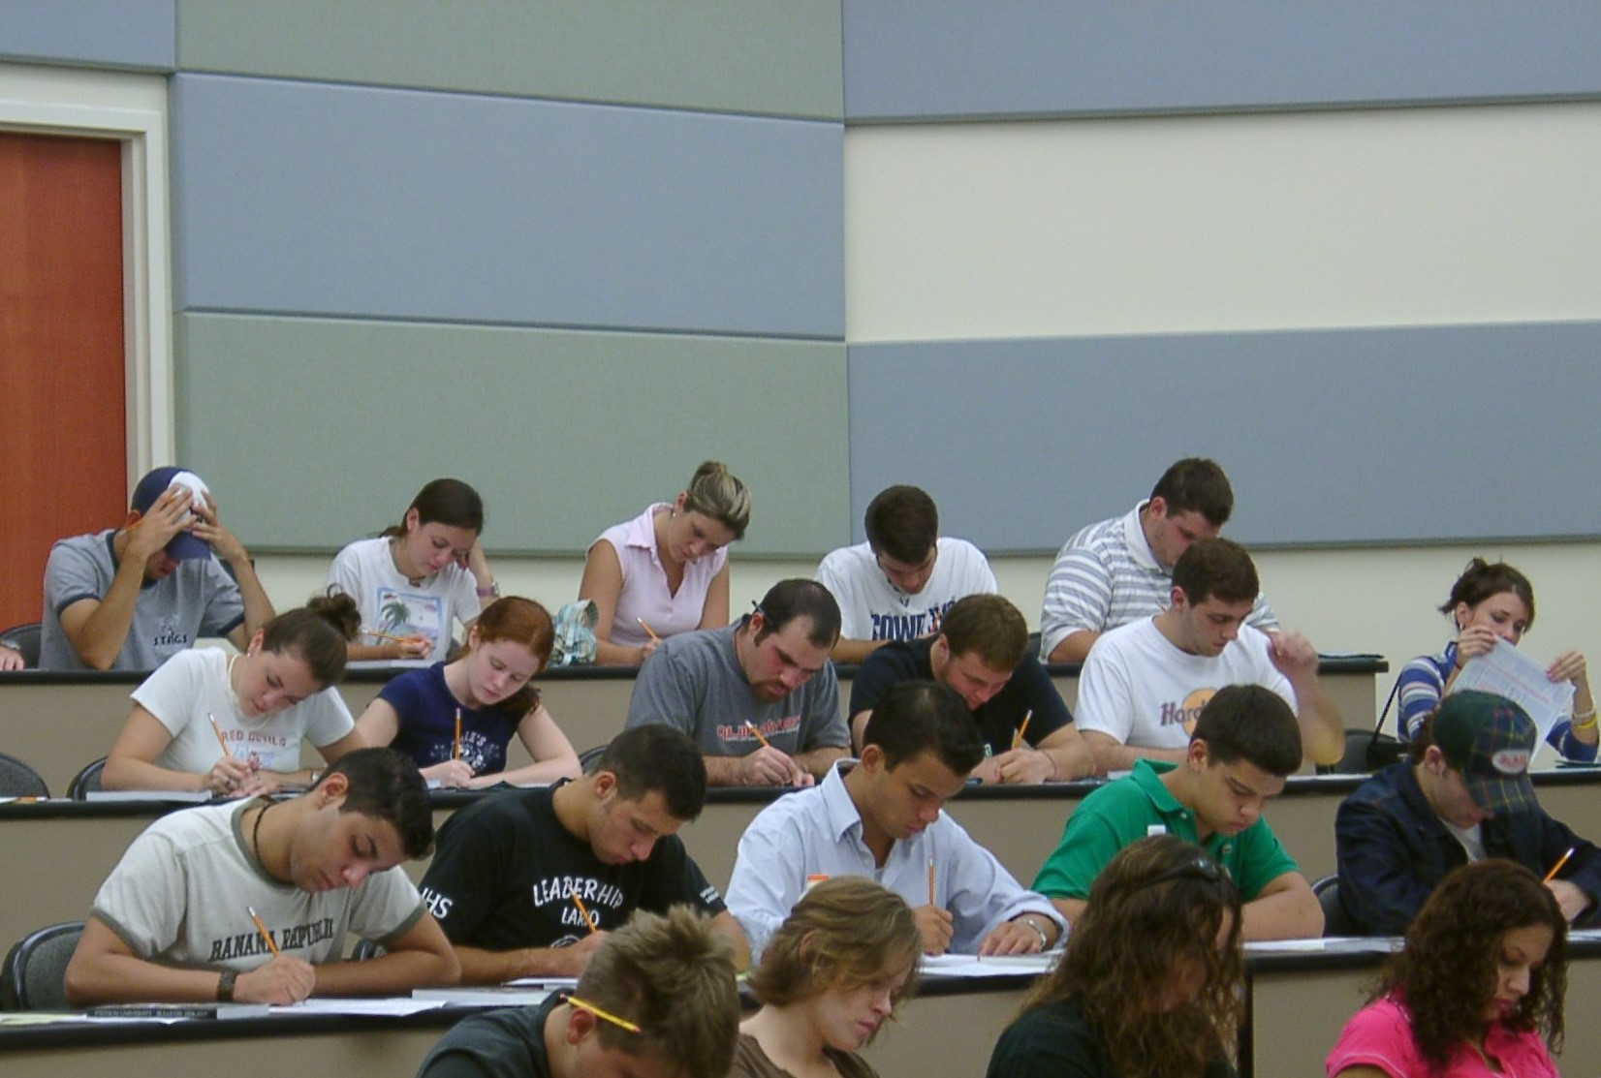
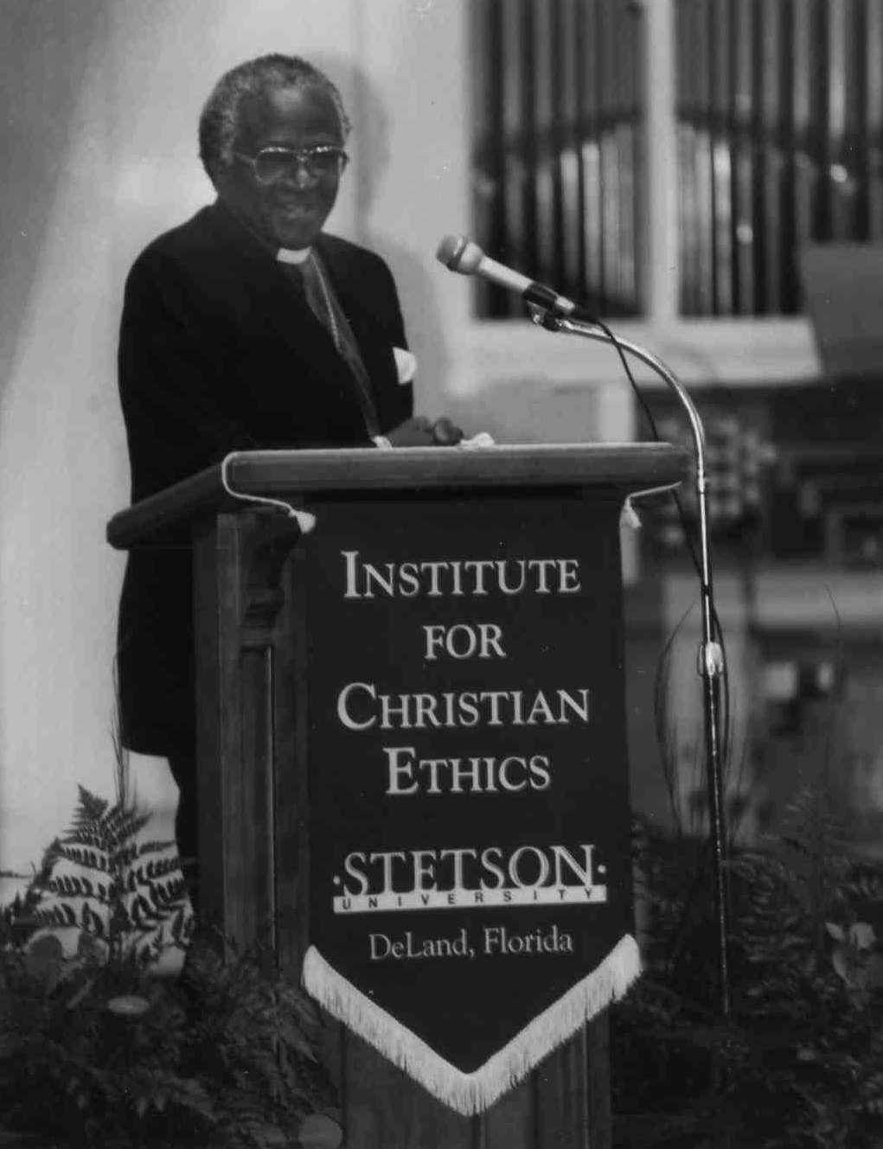
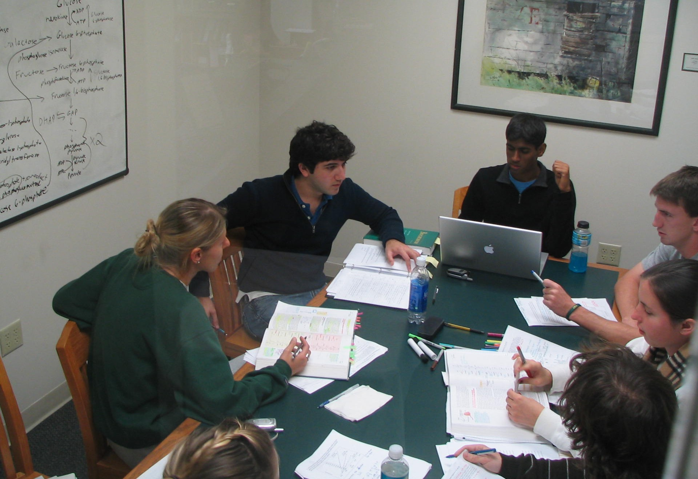
THE END
OR IS IT THE BEGINNING?

Slide 13
References
"Citation and Attribution - Generative Artificial Intelligence - LibGuides at Brown University." Brown University Library, Brown University, n.d., libguides.brown.edu/c.php?g=1338892888&p=9868287. Accessed 14 Mar. 2025.
Heikkilä, M. "The Viral AI Avatar App Lensa Undressed Me Without My Consent." MIT Technology Review, 14 Dec. 2022, sites.psu.edu/digitalshred/2022/12/14/the-viral-ai-avatar-app-lensa-undressed-me-without-my-consent-mit-technology-review/.
Jurafsky, D., and J. H. Martin. Speech and Language Processing. 3rd ed., Stanford University, 2023, web.stanford.edu/~jurafsky/slp3/.
"Image generation for presentation slides." Copilot, Microsoft, 2025, no URL available.
“AI Violations & MLA Sources." Grok, 14 Mar. version, xAI, 14 Mar. 2025, https://x.com/i/grok/share/5jIsaCxeOlKp0mOzdmXMFLGgg.
“Fact Checking AI." Grok, 14 Mar. version, xAI, 14 Mar. 2025, https://x.com/i/grok/share/zMtKte0wSvWJlOYNiM6eQKqpg.
Stryker, Cole, and Jim Holdsworth. "What Is NLP (Natural Language Processing)?" IBM, 24 Jan. 2025, www.ibm.com/think/topics/natural-language-processing.
"Using Sources and AI - Write and Cite - Research Guides at Harvard Library." Harvard Library, Harvard University, n.d., guides.library.harvard.edu/gsd/write/using_sources#sl-lg-box-32660708. Accessed 14 Mar. 2025.
"What Is a Large Language Model (LLM)?" SAP, 1 July 2024, www.sap.com/resources/what-is-large-language-model.

