Slide 1
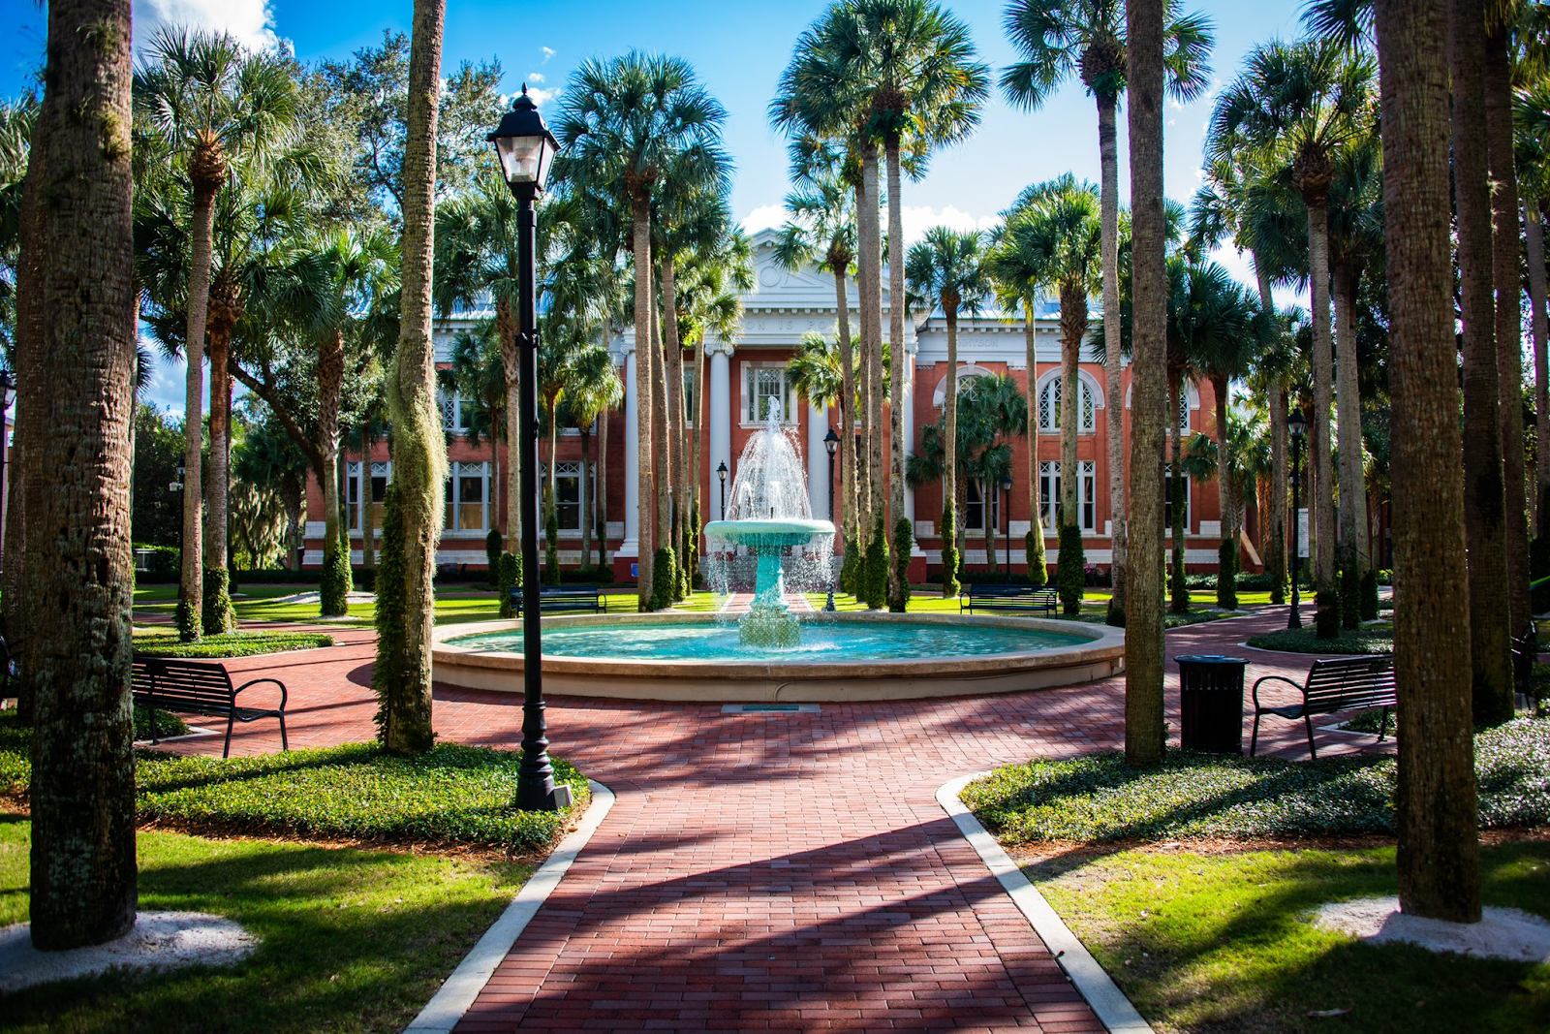
HONOR SYSTEM COUNCIL

Slide 2
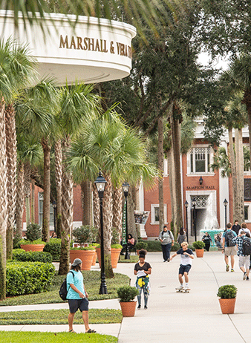
Who is the Honor Council?
A group of 12-16 undergraduate students
Students dedicated to Stetson’s campus community and its values
Individuals who care about academic integrity
We are NOT the “academic police”
We strive to uphold community academic standards

Slide 3
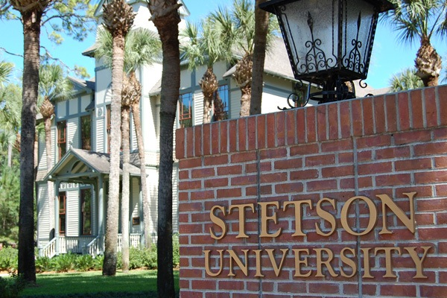
What Do We Do?
Promote and uphold academic integrity
Address potential Honor Code violation
This is done through marketing and education initiatives. These include tablings, workshops, classroom visits and other on-campus activities hosted by the Honor Council.
We address violations through investigating cases. These cases are handled through small claims or hearings.
We make recommendations and implement restorative sanctions by collaborating with students and professors to educate students.

Slide 4
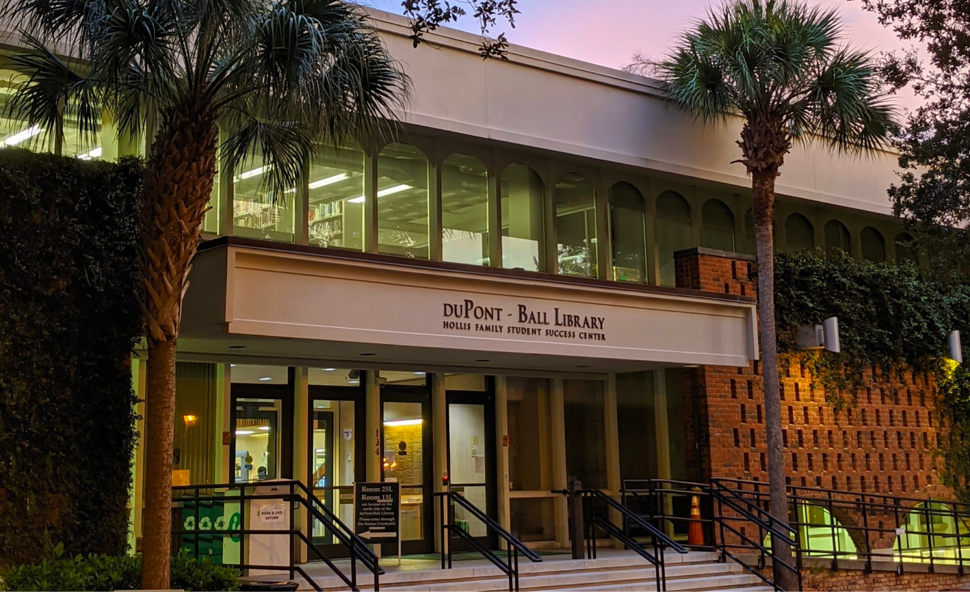
Why does this matter?
Creates Value to any Stetson Degree
Builds and Maintains Professional integrity
Gain an Authentic Learning Experience and Application of Knowledge

Slide 5
What Constitutes as Academic Dishonesty?
Using fraudulent, falsified, or fabricated evidence/material
Taking another's words as your own
Receiving unauthorized aid of any kind on tests, papers or other assignments
Destroying, stealing, or making inaccessible any academic work by another student/academic resource material available to other students
Self-plagiarism, or resubmission of work for which you received academic credit in another course
Unauthorized Collaboration

Slide 6
THE USE OF AI
We know AI is popular for students to use for academic work HOWEVER AI usage is at the discretion of the professor
There are many Honor Council cases we get due to students using AI WITHOUT professor permission
AI includes: Chat GPT, Grammarly GO, Google Assistant, etc.

Slide 7
How can you do your part?
Staying up to date on the Honor Code & encouraging others too
Take efforts to prevent academic dishonesty
Attending Honor Council workshops & marketing efforts to stay informed
Utilizing Stetson’s free educational workshops

Slide 8
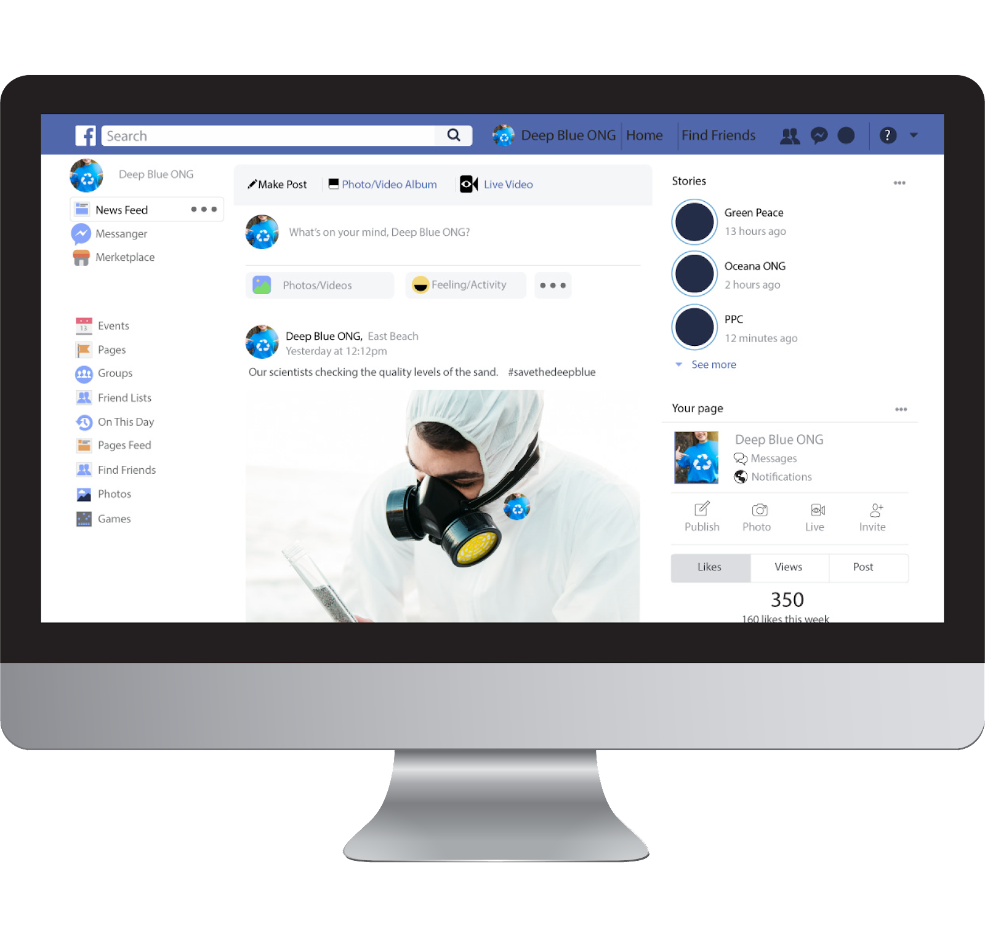
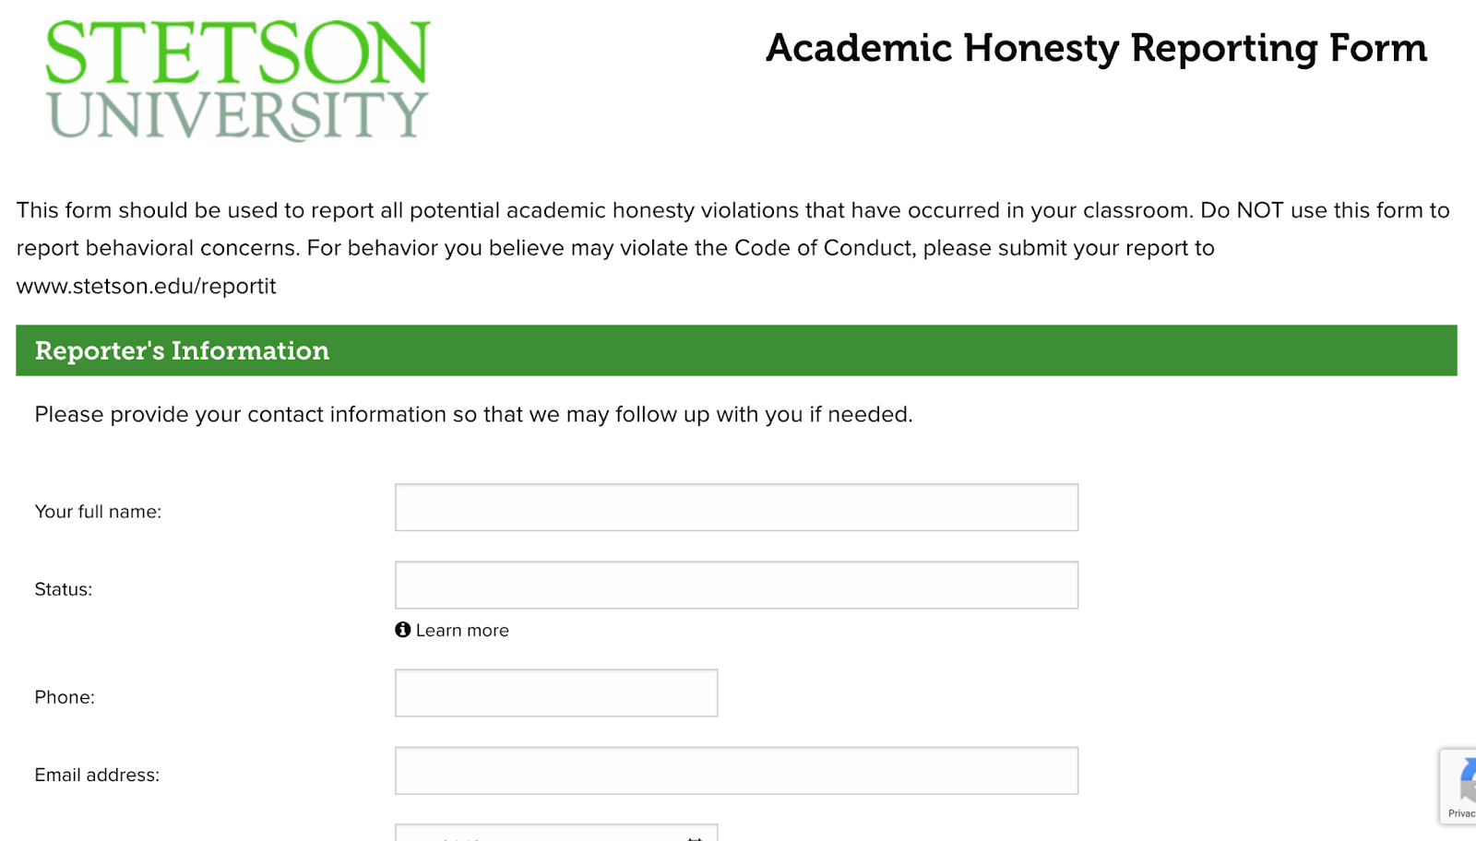
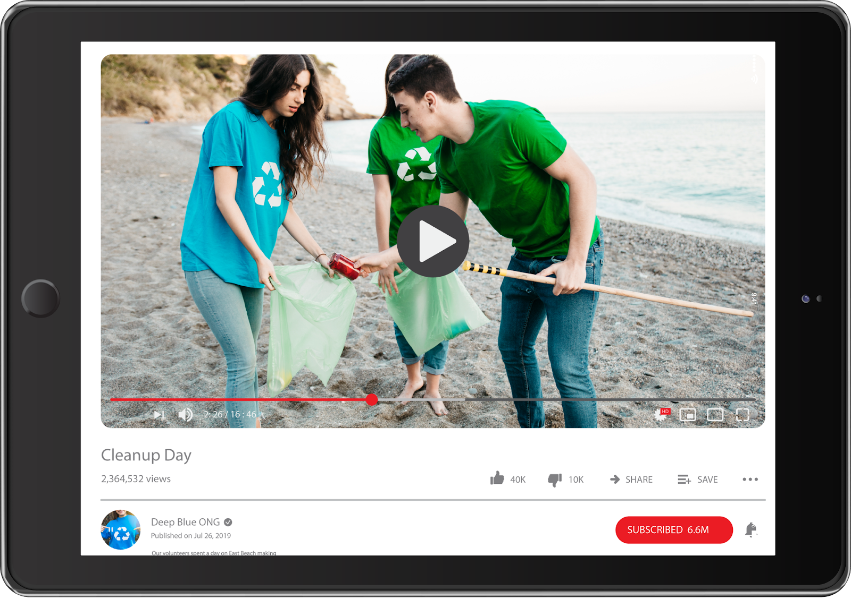
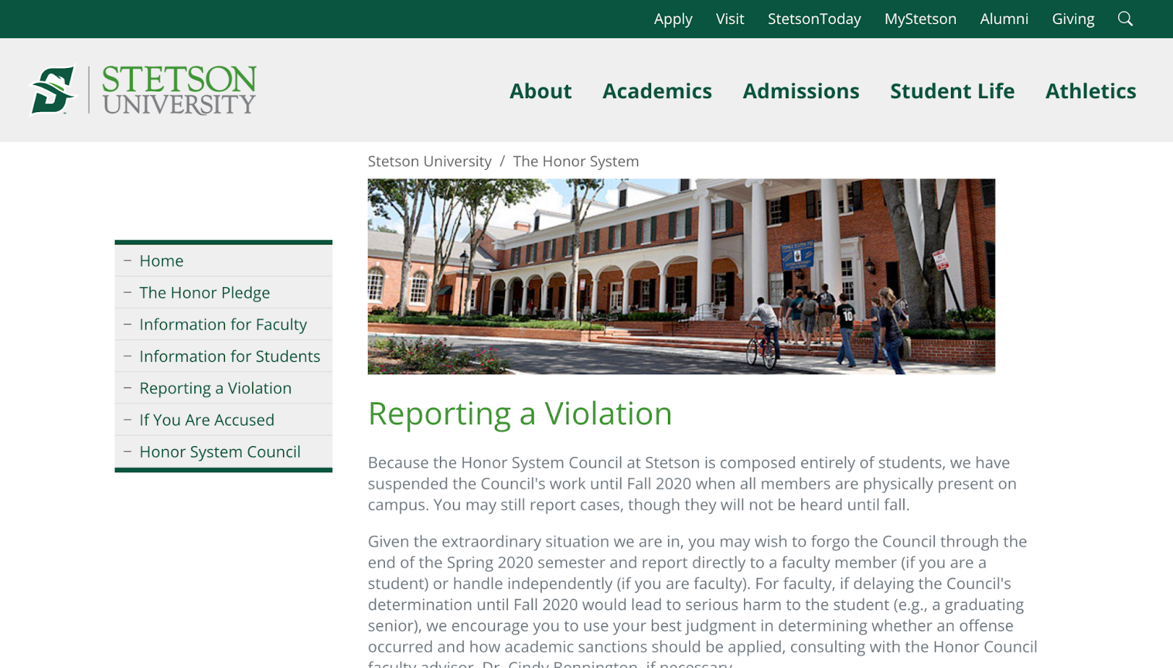
I Think I Witnessed A Violation…
You can report the incident on the SU Academic Honesty Reporting Form (shown below).
The form is also accessible on the Honor Council Stetson website under “Reporting a Violation.”

Slide 9
Want to Join the Council?
Join a group of students who want to help others succeed!
You can apply for the Honor Council though Engage within MyStetson

