Slide 1
Stetson University
Center for Community Engagement
NON-PROFIT LEADERSHIP SUMMIT
Strategic Planning

Slide 2
Intake Survey
Also located inside the
front cover of
your booklet.

Slide 3
1
Laying the Groundwork
Creating SMART Goals
Charting Your Path
Assessing Your Progress
Analyzing Your Resources
SWOT Analysis
Putting it All Together
Additional Resources
Agenda
2
3

Slide 4
What is a Strategic Plan?
The strategic planning process culminates in a document that serves as your roadmap.

Slide 5
Types of Strategic Plans
Standard
Set your goals and then outline specific steps to meet those goals with an ideal timeline
Organic
Relies on the organic flow of activity, planning one step at a time
Issue-Based
Responds to a specific issue or helps reaffirm your vision
Alignment
Helps you focus on streamlining the way your team communicates
Real-Time
Great for responding to a crisis in real time

Slide 6
Your Strategic Priorities
Your strategic priorities are unique to your organization. They are a clear set of priorities that help create your organization’s core culture and purpose. Your strategic priorities make up the overarching framework that guides the work your organization does in the community.

Slide 7
Clarifying Priorities
What is the Key Issue?
Why is it important?
Who does it affect?
What factors shape it?
What edvidence do you have?

Slide 8
Assembling Your Team

Slide 9
Assembling Your Team
Who will be implementing the plan? Management, Staff, Volunteers, etc.
Who will be affected by the plan? People that use your services
Who will monitor implementation?
Leadership or outside consultants
Who else can contribute to the plan ?
People that are tapped into community needs and funders

Slide 10
Your Categories
Your organization's strategic plan will be as unique as your organization. That means that there is no easy answer to what sections and categories your plan will have. In general, your categories will fall into one of two sections:
Administrative
Programs and Services

Slide 11
Plan Categories
Administrative
Programs and Services
The administrative section will contain things like staffing, marketing, and infrastructure goals. Here are a few possibilities of categories your plan might need:
Staffing and Payroll
Major Expenditures
Marketing
Fundraising
Operational
The programs and services section will contain the things you DO. Here are a few ways you might decide to set up your programs and services section:
Virtual vs In-Person
Broken Down by Age of Populations Served
Types of Services
Established Departments

Slide 12
SMART
Goals
Specific
Measurable
Attainable
Relevant
Time based
A SMART goal helps you focus your efforts and stay on track by answering the following questions:
What do you want to do?
How will you know when you've reached it?
Is it in your power to accomplish it?
When exactly do you want to accomplish it?
Can you realistically achieve it in the time allotted?

Slide 13
S.M.A.R.T. Goals
Specific
Clarify the overall context
Example
"Help the Homeless" = Not Specific
vs
"Provide hot meals to area homeless population" = Specific

Slide 14
S.M.A.R.T. Goals
Specific
Clarify the overall context
Measurable
Know exactly what will be measured
Example
--Target number of people served (i.e. 300 people per day)
--A percentage of a measured group (i.e. 50% of all registered students)
--Quantity/frequency of a service (i.e. one meal per day day)

Slide 15
S.M.A.R.T. Goals
Specific
Clarify the overall context
Measurable
Know exactly what will be measured
Attainable
Goals should not be too difficult to achieve
Example
“Eliminate diabetes” = Unattainable
vs
“Provide health education and medical intervention services for diabetes prevention for those individuals that seek services” = Attainable

Slide 16
S.M.A.R.T. Goals
Specific
Clarify the overall context
Measurable
Know exactly what will be measured
Attainable
Goals should not be too difficult to achieve
Relevant
Goal should contribute to your mission
Example
If your mission is to increase access to sustainable transportation,
is a goal to provide backpacks to school children relevant to your mission?

Slide 17
S.M.A.R.T. Goals
Specific
Clarify the overall context
Measurable
Know exactly what will be measured
Attainable
Goals should not be too difficult to achieve
Relevant
Goal should contribute to your mission
Time-Based
Should have a beginning and an end

Slide 18
S.M.A.R.T. Goals
Specific
Measurable
Attainable
Relevant
Time-Based
Example
By the end of the calendar year, the CCE will hold a NPLS on
Strategic Planning for 10 Community Partners.
Based on feedback from partners, Strategic Planning assistance is needed by several area organizations and Stetson has the resources to provide a workshop on Strategic Planning.

Slide 19
Charting Your Path

Slide 20
Now that you have set your goals, how will you achieve them?

Slide 21
Assessment
Assessing the effectiveness of your strategic plan is crucial for making sure your organization is on target to reach its goals.
How will you measure your progress?
When will you review and analyze progress with your team?
What plans will you make to continuously improve?

Slide 22
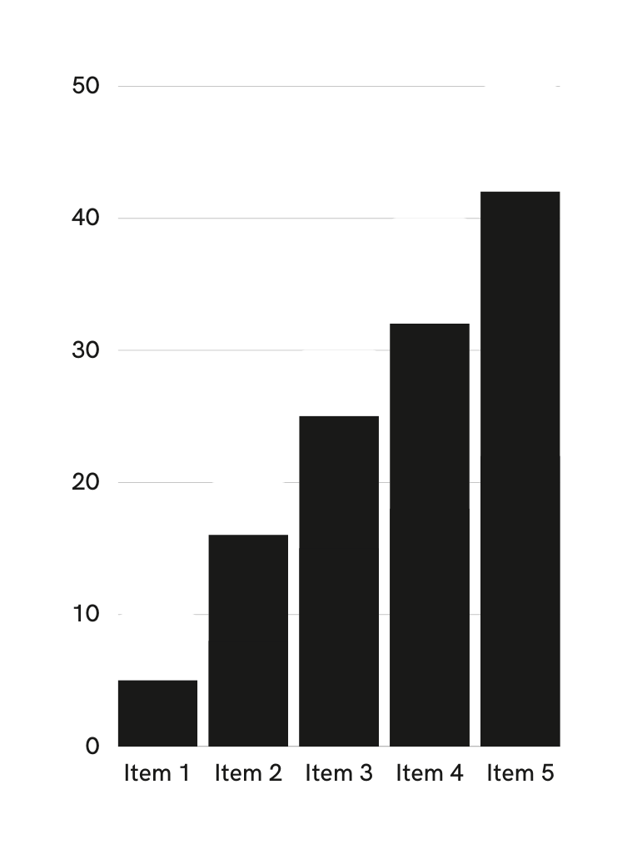
KPIs
Key performance indicators, or KPIs, are metrics that help you measure progress. They should be specific, measurable, and aligned with your goals.

Slide 23
Analyzing Your Resources
Taking time to examine your strengths and weaknesses can help your organization gain insight on areas that need improvement, ways to leverage your strengths better, and prepare you for future projects.

Slide 24
SWOT Analysis
Strengths
Things that your organization does particularly well or distinguishes you from other organizations
Weaknesses
Things that you could improve and practices you should avoid
Opportunities
Openings or chances for something positive to happen
Threats
Anything that can negatively affect your organization from the outside

Slide 25
Putting it all together

Slide 26
Here is a simple list of items to include in your final Strategic Plan packet:
Information about your organization
Executive Summary
Mission, Vision, and Value Statements
Your Team
Strategic Planning Committee Members
Board Members
Strategic Plan and Goals
Strategic Planning Chart
SMART Worksheets for each goal
Assessment Plan
KPIs your team has selected
Assessment Meeting Schedule
SWOT Analysis
Strengths
Weaknesses
Opportunities
Threats
Financial
Fundraising Plan
Approved Annual Budget
Outline

Slide 27
NPLS: Strategic Planning
You can find a copy of this workshop manual on the Stetson Center for Community Engagement website along with the following worksheets:
Strategic Priorities Worksheet
Your Team Worksheet
Category Worksheet
Goal Worksheet
SWOT Analysis Worksheet
5-Year Plan Template

Slide 28
Additional Resources
Community Conversations @ Stetson University
The Rockefeller Foundation DIY Toolkit
Edyth Bush Institute @ Rollins College

Slide 29
Exit Survey
Also located on the
back cover of
your booklet.

Slide 30
Thank you for joining us for the 2023
Non-Profit Leadership Summit
Presented by

