Slide 1


Slide 2


Slide 3

How diversity makes teams more innovative.

Slide 4


Slide 5
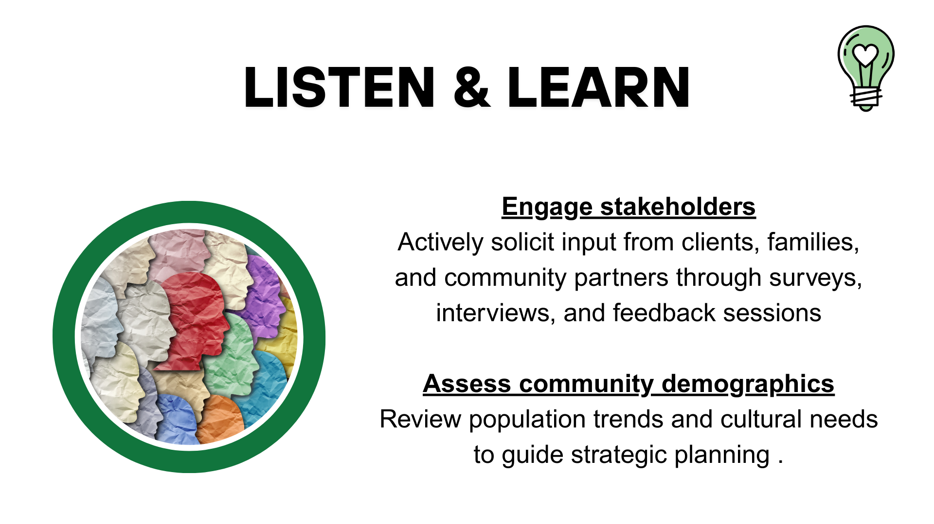

Slide 6
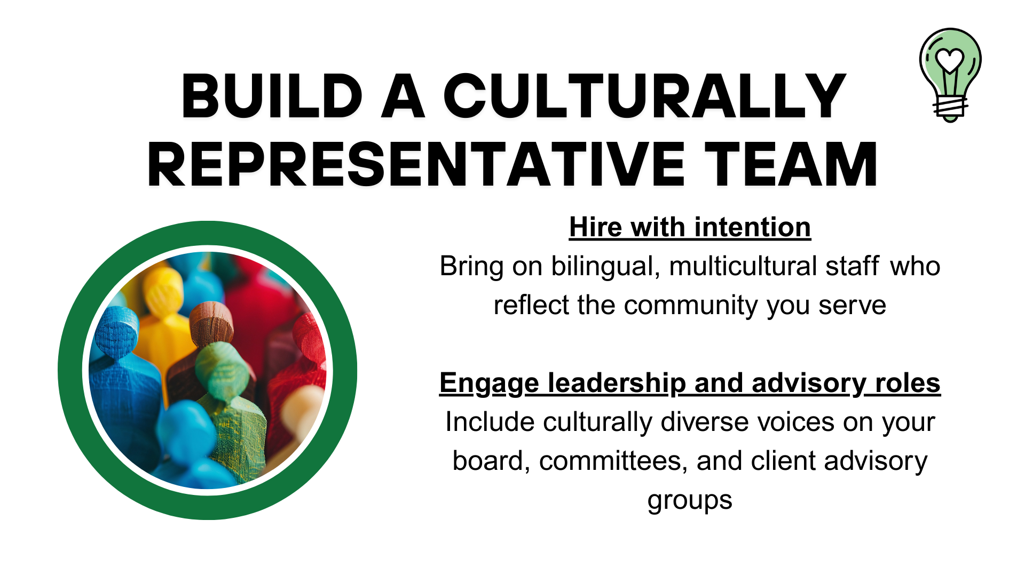

Slide 7
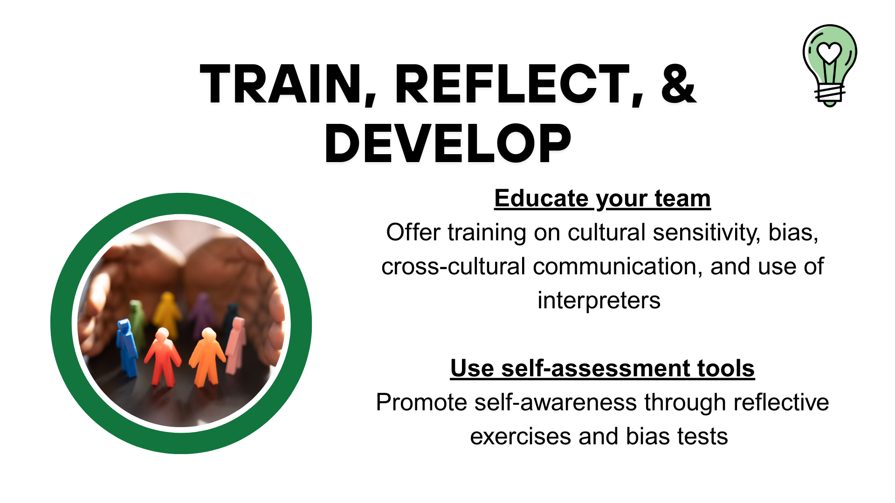

Slide 8


Slide 9


