Slide 1


Slide 2


Slide 3
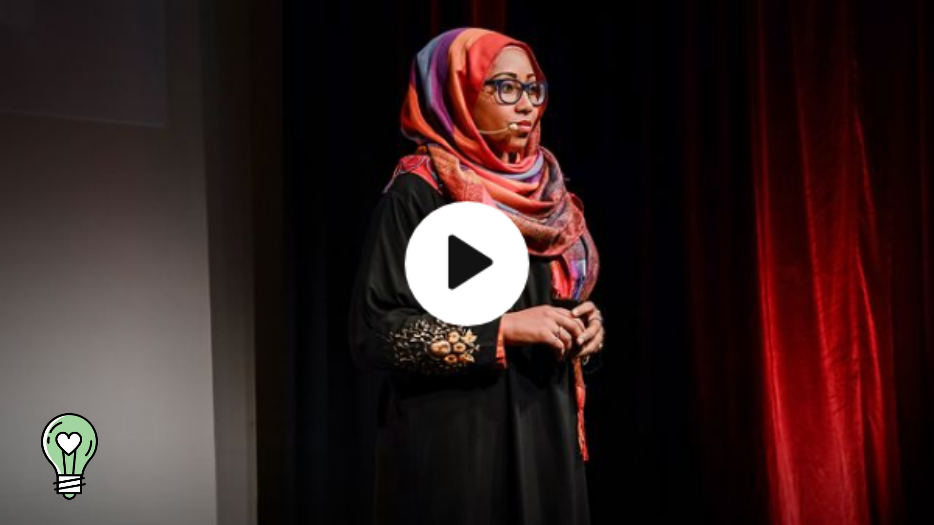
What does my headscarf mean to you?

Slide 4
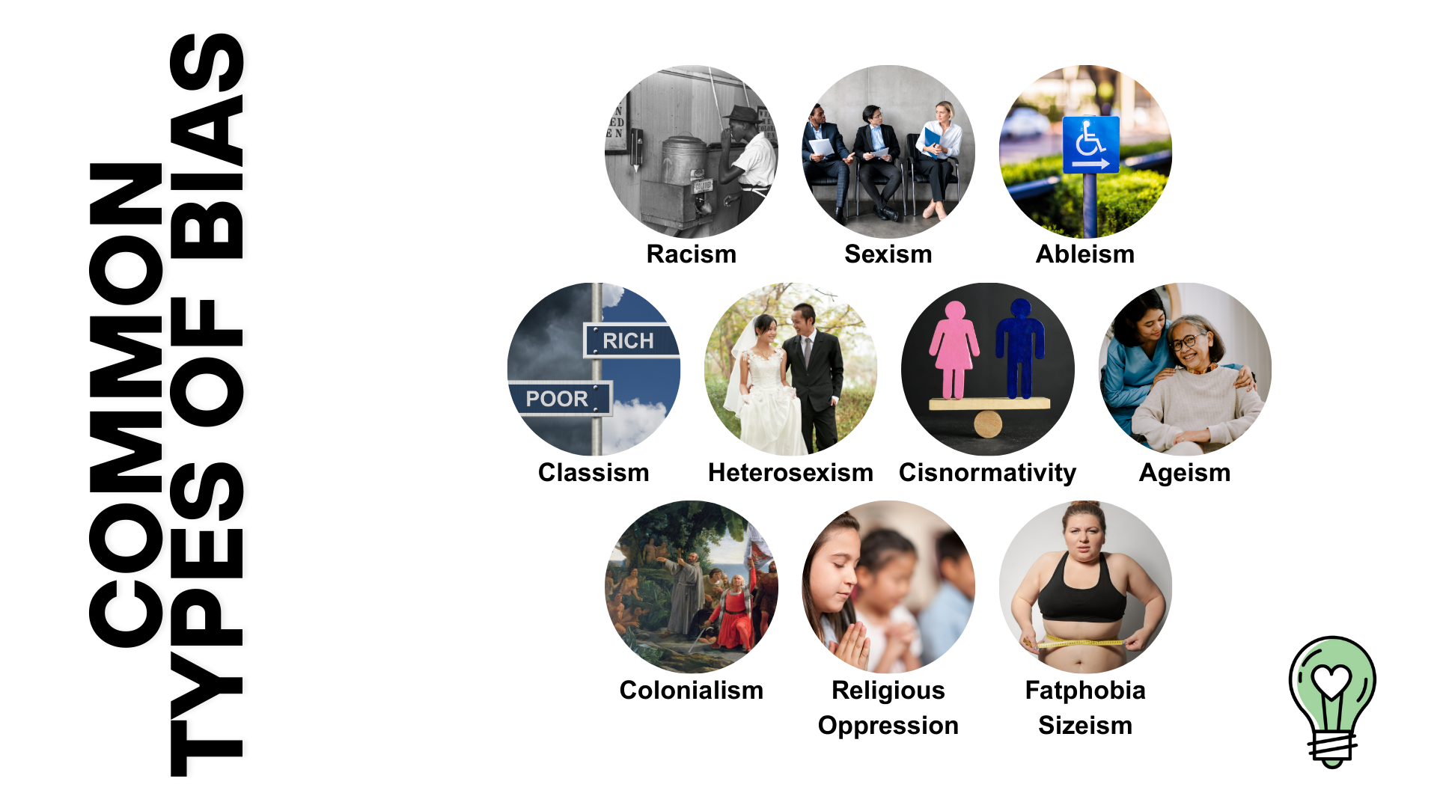

Slide 5
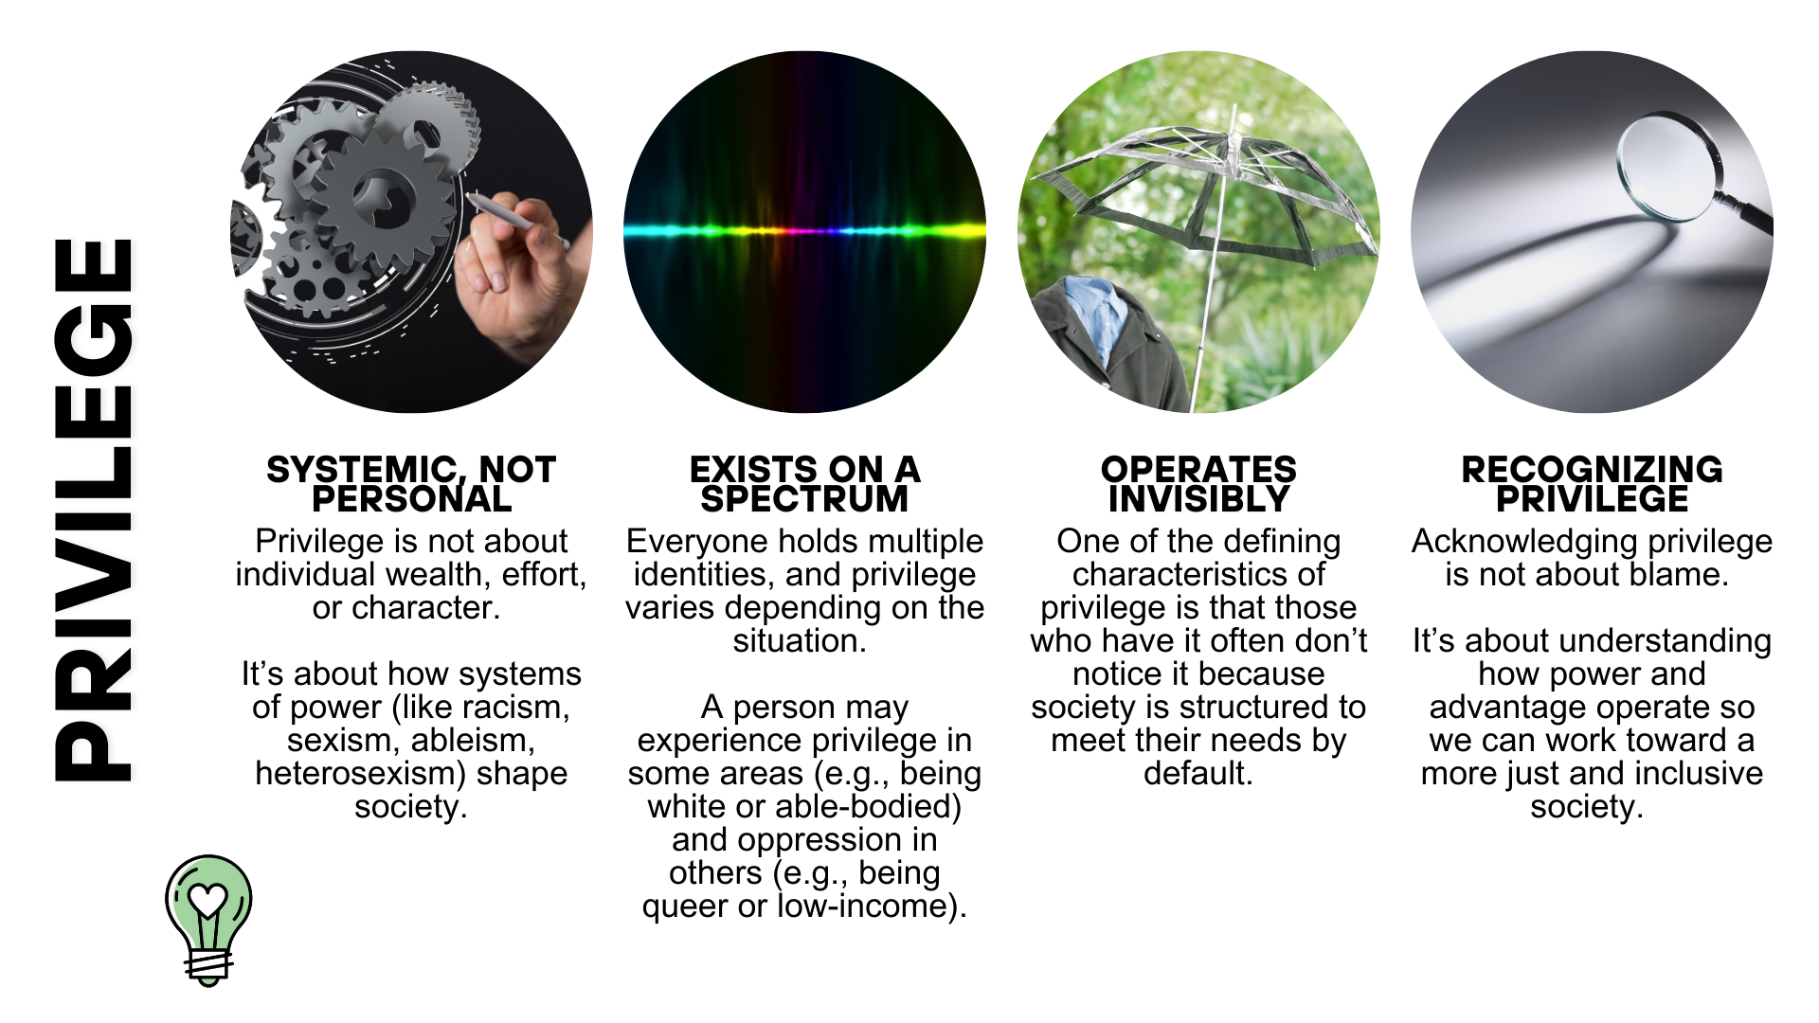

Slide 6
