Slide 1


Slide 2


Slide 3
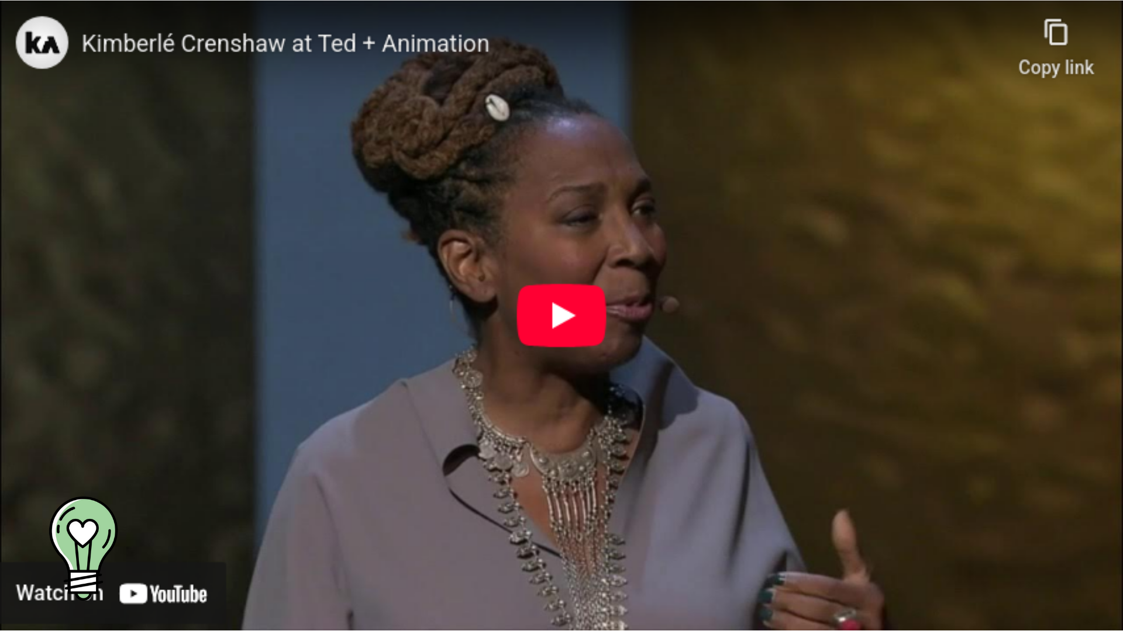
What is Intersectionality?

Slide 4
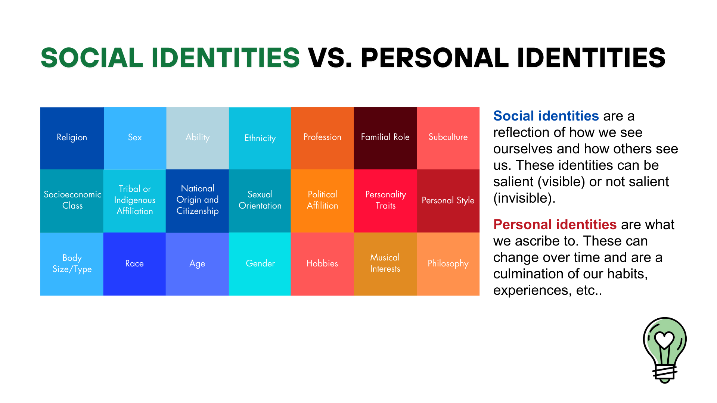

Slide 5
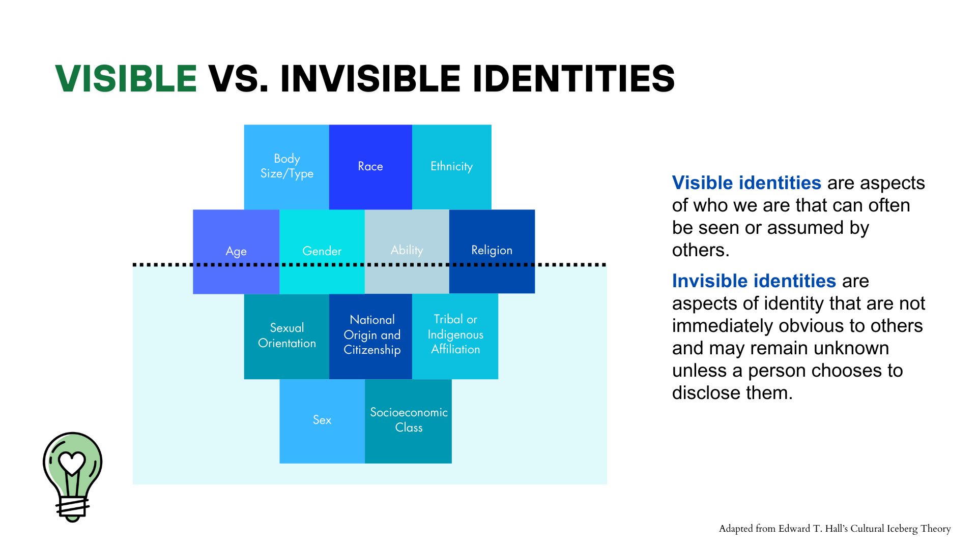

Slide 6


