Slide 1
OPEN ENROLLMENT
January 1, 2025 - December 31, 2025

Slide 2
Open Enrollment – It’s Decision Time!
This is the time of year to review the benefits available to you as members of the Stetson community.
You will have the full month of October to learn more about your benefits and to make your selections.
Things to consider:
Enroll or waive coverage?
Single or family coverage?
Which plan to choose?
In addition to this presentation, the Brown & Brown team will be onsite to help you choose the plan that works best for you, answer your questions, and help you enroll through the Portal.
DeLand: 10/18 9am-4:30pm Lynn Business Center
COL: 10/16 9am-4:30pm SC 201
This is an ACTIVE enrollment which means you must go into the Portal to make your elections. They will NOT carryover to 2025. The deadline to enroll is October 31st, but we encourage you to take action before then.

Slide 3
Medical Plan Overview

Slide 4
Medical Plan Overview
 | Blue Care HMO Plan | BlueOptions PPO Plan
Deductible | $1,000 / $2,000 | $1,500 / $4,000
Coinsurance | 20% | 20%
Out-of-Pocket Max Includes Deductible, Copays, Coinsurance, and Rx | $8,000 / $16,000 | $8,000 / $16,000
Preventive Care | $0 | $0
Primary Care | $25 | $25
Teladoc | $10 | $10
Specialist | $50 | $50
Please note on the Blue Care HMO plan, the deductible only applies to: Ambulance, Dialysis, Hearing Aids, Hospice, and Skilled Nursing. All other benefits are a copay.

Slide 5
Medical Plan Overview
 | Blue Care HMO Plan | BlueOptions PPO Plan
Inpatient Hospital | $1,000 per day (days 1 – 5) | Ded + Coins
Outpatient Hospital | $400 | Ded + Coins
Ambulatory Surgical Center | $400 | $350
Advanced Imaging Services (MRI, CT, PET) | $400 | $300
Routine/Preventive Labs - Quest | $0 | $0
Diagnostic Labs - Quest | $100 | $75
X-Rays at Freestanding Radiology Center | $100 | $75

Slide 6
Medical Plan Overview
 | Blue Care HMO Plan | BlueOptions PPO Plan
Emergency Room | $400 | Ded + Coins
Urgent Care | $75 | $75
Retail Clinics in Pharmacies | $25 | $25
Teladoc | $10 | $10
Know Before You Go
Emergency rooms should be used for emergencies, but for urgent or after hours / weekend treatment go to the urgent care (stitches, x-rays, anything that requires you to have an in-person visit right away), retail clinics in pharmacies or Teladoc (ear infection, eye infection, muscle spasms, or nausea) and you will save hundreds or even thousands of dollars

Slide 7
Pharmacy Overview
 | Blue Care HMO Plan | BlueOptions PPO Plan
Generic (30-day / 90-day) | $5 / $12.50 | $5 / $12.50
Preferred Brand (30-day / 90-day) | $75 / $188 | $75 / $188
Non-Preferred Brand (30-day / 90-day) | $150 / $375 | $150 / $375
Specialty (30-day) | $250 | $250
Know Before You Go
Your pharmacy benefit manager is CVS Caremark, but you can go to a variety of pharmacies including Publix, Walgreens, CVS, and many more for 30-day supplies.
Specialty Medications can be filled through CVS Specialty or Publix

Slide 8
Claims Example #1 – ER Visit
Member: Angela
Scenario: Emergency Room Visit
 | Blue Care HMO | Blue Options PPO
Total Expenses: Emergency Room Visit | $3,000 | $3,000
Plan Deductible – To be paid by Angela | Does Not Apply | $1,500
Expense balance remaining after Angela pays her deductible, if applicable | $3,000 | $1,500
Angela’s Coverage: Blue Care HMO Plan: $400 Copay Blue Options PPO Plan: 20% Coinsurance After Deductible | $400 | 20% x $1,500 = $300
Plan Out-of-Pocket Maximum | $8,000 | $8,000
Angela’s total out-of-pocket expenses for the Emergency Room Visit | $400 | $1,800
Total amount of Emergency Room Visit paid for by the plan (Emergency Room Visit Cost – Angela’s Total out-of-pocket expenses) | $2,600 | $1,200

Slide 9
Claims Example #2 – Outpatient Surgery at a Hospital
Member: Timothy
Scenario: Outpatient Surgery
 | Blue Care HMO | Blue Options PPO
Total Expenses: Knee Surgery | $20,000 | $20,000
Plan Deductible – To be paid by Timothy | N/A | $1,500
Expense balance remaining after Timothy pays his deductible | $20,000 | $18,500
Timothy’s Coverage Blue Care HMO Plan: $400 Copay Blue Options PPO Plan: 20% Coinsurance After Deductible | $400 | 20% x $18,500 = $3,700
Timothy’s Responsibility - (Prior to Out-of-Pocket Maximum) | $400 | $5,200
Plan Out-of-Pocket Maximum | $8,000 | $8,000
Timothy’s total out-of-pocket expenses for the Inpatient Hospital Stay | $400 | $5,200
Total amount of Inpatient Hospital Stay paid for by the plan (Total Expenses – Timothy’s total out-of-pocket expenses) | $19,600 | $14,800

Slide 10
Claims Example #3 – Outpatient Surgery at a Surgery Center
Member: Timothy
Scenario: Outpatient Surgery
 | Blue Care HMO | Blue Options PPO
Total Expenses: Knee Surgery | $20,000 | $20,000
Plan Deductible – To be paid by Timothy | N/A | N/A
Expense balance remaining after Timothy pays his deductible | $20,000 | $20,000
Timothy’s Coverage Performance Plan: $400 Option Plan: $350 | $400 | $350
Timothy’s Responsibility - (Prior to Out-of-Pocket Maximum) | $400 | $350
Plan Out-of-Pocket Maximum | $8,000 | $8,000
Timothy’s total out-of-pocket expenses for the Inpatient Hospital Stay | $400 | $350
Total amount of Inpatient Hospital Stay paid for by the plan (Total Expenses – Timothy’s total out-of-pocket expenses) | $19,600 | $19,650

Slide 11
Claims Example #4 – Inpatient Hospital Stay – 7 Days
Member: Timothy
Scenario: Inpatient Hospital Stay (7 Days)
 | Blue Care HMO | Blue Options PPO
Total Expenses: Specialist Visit In Hospital- $500 Imaging Studies - $4,000 Diagnostic Cardiac Catheterization - $25,000 Coronary Artery Bypass Graft - $70,000 Follow-Up Visit In Hospital- $500 | $100,000 | $100,000
Plan Deductible – To be paid by Timothy | N/A | $1,500
Expense balance remaining after Timothy pays his deductible | $100,000 | $98,500
Timothy’s Coverage Blue Care HMO Plan: $1,000 Copay per day (days 1-5) Blue Options PPO Plan: 20% Coinsurance After Deductible | $1,000 / Day (Days 1-5) = $5,000 Max | 20% x $98,500 = $19,850
Timothy’s Responsibility - (Prior to Out-of-Pocket Maximum) | $5,000 | $19,700
Plan Out-of-Pocket Maximum | $8,000 | $8,000
Timothy’s total out-of-pocket expenses for the Inpatient Hospital Stay | $5,000 | $8,000
Total amount of Inpatient Hospital Stay paid for by the plan (Total Expenses – Timothy’s total out-of-pocket expenses) | $95,000 | $92,000

Slide 12
Employee Rates
Blue Care HMO | Bi-Weekly | 9 Months | Monthly
Employee Only | $133.37 | $356.66 | $266.74
Employee + Spouse / Domestic Partner | $394.68 | $1,052.48 | $789.36
Employee + Child(ren) | $327.95 | $874.52 | $655.89
Family | $497.45 | $1,326.53 | $994.90
Blue Options PPO | Bi-Weekly | 9 Months | Monthly
Employee Only | $185.24 | $493.97 | $370.48
Employee + Spouse / Domestic Partner | $465.29 | $1,240.77 | $930.58
Employee + Child(ren) | $369.25 | $984.67 | $738.50
Family | $565.90 | $1,509.06 | $1,131.80
Annualized premium differential between the plans:
Employee Only: $1,244.88 ES/DP: $1,694.64 EC: $991.32 FM: $1,642.80

Slide 13
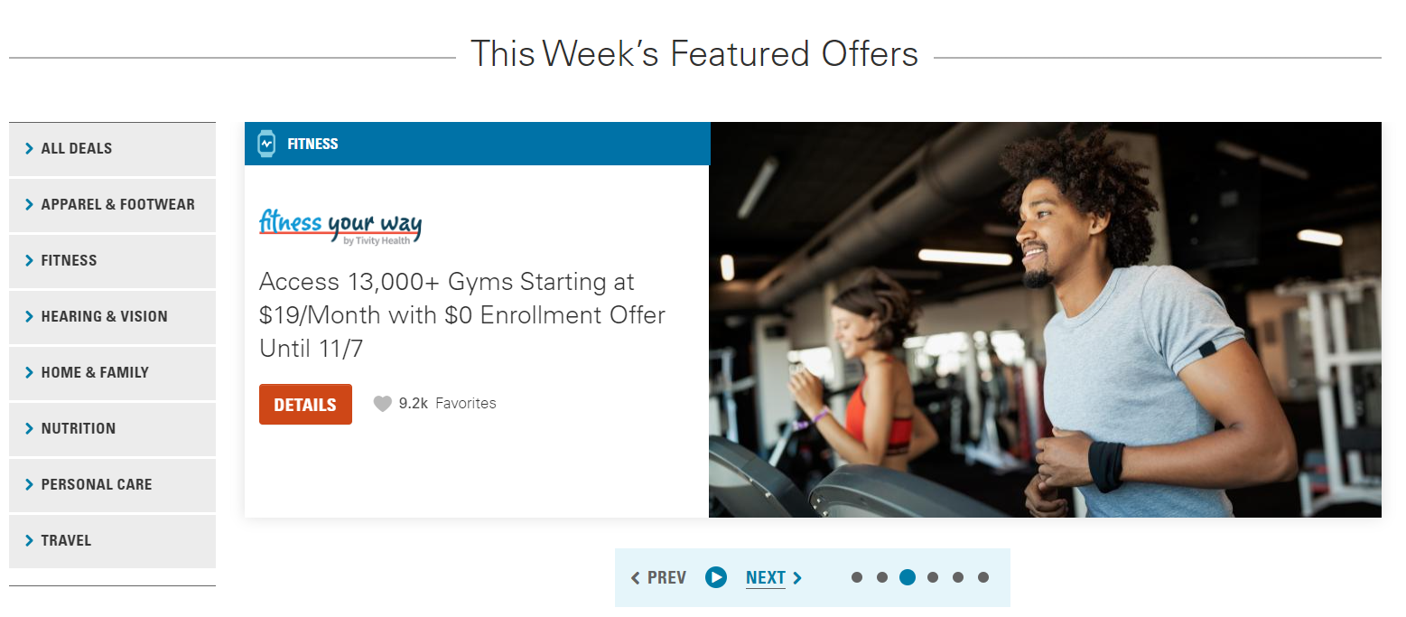
Blue 365 Discount Site

Slide 14
Blue 365 Discount Site

Slide 15
Blue 365 Discount Site

Slide 16
Blue 365 Discount Site

Slide 17
Decisions to Consider this Open Enrollment
Should I enroll or waive coverage?
Should I cover my spouse on my plan, go on my spouse’s plan, or each of us enroll in single coverage through our employer?
Which plan to choose?

Slide 18
What if I Currently Waive Stetson’s Health Insurance?
Things to Consider
Can you afford a $3,000 ER bill, a $20,000 knee surgery, or a $100,000+ hospital stay?
The annual cost of Stetson’s premiums for single coverage is $1,600 on the HMO plan and is even less for those earning below a certain salary
Benefits you would likely use and are missing out on
Wellness incentives up to $300
$10 Teladoc visits
Free preventive care
Discounts on a variety of things including travel, home and family products, nutrition, and apparel & footwear
Fitness your Way Gym Discounts
Access 13,000+ gyms starting at $19/month

Slide 19
Should I Cover My Spouse?
Things to Consider
If your spouse has coverage available through his or her employer, many times it is cheaper in premiums to have 2 single plans rather than employee spouse coverage
Example:
Single coverage Stetson’s HMO plan $266
Single Coverage at Spouse’s Employer $250
Total Monthly Premium: $516
Employee + Spouse Stetson’s HMO $789
If your spouse does not have coverage through an employer, he or she may be able to find coverage on the marketplace (healthcare.gov) for a lower monthly premium
Recent changes to subsidy rules make coverage more affordable for those without coverage through their own employer

Slide 20
What if I am or My Spouse Is Medicare Eligible?
Things to Consider
Many times Medicare plans provide better coverage at a lower premium
This is the time of year to review your options
You have paid into Medicare for a reason, so when your medical needs become more costly with age, Medicare is there to cover your expenses
There are Medicare supplement plans and Advantage plans that bring out of pocket costs down in many cases
Consult a Medicare advisor for information

Slide 21
Which Health Plan to Choose?
Blue Care HMO
Copay based plan
Lower deductible than PPO
Open Access – no referrals needed, but you must select a Primary Care Physician
Florida-based network, narrower than the PPO plan
Emergencies are covered throughout the US at the in-network copay
Urgent Care is also covered throughout the US at the in-network copay
For those with dependents outside of FL, there is an Away from Home program
Lower cost per paycheck
Blue Options PPO
Deductible & Coinsurance based plan
Larger and national network
Includes Mayo Clinic
Includes out of network coverage
The HMO plan is the richer plan and is the better option for most
70% of Stetson’s employees are enrolled in this plan
The PPO plan is the best choice for employees needing the broader network (Mayo Clinic or out of state hospitals for example, or for FL doctors not in the HMO network)

Slide 22
AFLAC Plans Overview

Slide 23
Stetson Aflac Group Benefits
Group Hospital
Group Critical Illness
Group Accident
For all group products
No pregnancy waiting period, mothers covered from day one (can enroll and be paid benefits on plan if currently pregnant)
Babies covered day one and separate benefits paid if admitted to NICU
Includes admission benefit
Child(ren) covered at no additional cost
Includes over 17 different recognized critical illnesses
Skin cancer benefit
Covers childhood conditions, including Autism
24-hour coverage (on and off the job)
Includes initial ER visit benefit and hospital benefits
Includes chiropractic visit benefits
Wellness benefit per covered employee, spouse and dependent
Guaranteed Issue for all, every open enrollment, late entrants, indefinitely
Fully portable, employees can take these plans with them. No reduction of benefits at any age
No maximum benefit limit on accident policy

Slide 24
Aflac – Accident, Critical Illness, Hospital Indemnity
Aflac pays cash benefits directly to you, unless otherwise assigned. This means that you will have added financial resources to help with medical costs or ongoing living expenses.
Keep your finances on track. Here’s How AFLAC Insurance Works:
1. You have a claim. Your health insurance covers some costs, after you meet your deductible. But you still may have copays and a lot of out-of-pocket expenses. | 2. They send you a check. Complete claim form, found www.Aflac.com or by visiting your Digital Benefit Guide. Aflac will send a check to you – not your medical providers – upon approval of your claim. You decide how to spend the money. | 3. You focus on getting better. With Aflac helping you handle the unexpected expenses, you get to pay attention to what matters most – your health.

Slide 25
Aflac – Accident
Having Aflac on your side means you can be better prepared financially to deal with what happens after an accident.
Here’s an example of benefits
paid for a covered accident:
You fall of the ladder while hanging
holiday decorations. You break your leg,
get a concussion, and have to stay 3 days
in the hospital.
Benefits Paid to You | Benefit Amount
Ambulance | $100
Emergency Room | $150
X-Ray | $50
MRI | $225
Concussion | $500
Broken Leg | $1,000
Hospital Admission | $1,000
Hospital Confinement | $125 x 3 = $375
Crutches | $100
Physician Follow-Up Appt | $100
6 Physical Therapy Appt | $50 x 6 = $300
TOTAL | $3,900

Slide 26
Aflac – Accident
Having Aflac on your side means you can be better prepared financially to deal with what happens after an accident.
Here’s an example of benefits
paid for a covered accident:
You’re in a motorcycle accident. You
are rushed to the hospital and are
in the ICU for 70 days, then the hospital
for another 30 days.
Benefits Paid to You | Benefit Amount
Air Ambulance | $300
Emergency Room | $150
CT Scan | $225
Coma | $10,000
32 Centimeters Laceration | $400
Hospital Admission | $1,000
100 Days Hospital Confinement | $125 x 100 = $12,500
ICU Confinement | $250 x 30 = $7,500
Physician Follow-Up Appt | $100
2 Physical Therapy Appt | 2 x $50 = $100
TOTAL | $32,275

Slide 27
Aflac – Critical Illness
Aflac group critical illness insurance pays a lump sum to you upon diagnosis of:
Full $10,000 Benefit
Cancer
Heart Attack
Stroke
Kidney Failure
Bone Marrow / Stem Cell Transplant
Sudden Cardiac Arrest
Major Organ Transplant
Coma
Paralysis
Loss of Sight
Loss of Hearing
Loss of Speech
Benign Brain Tumor
Type 1 Diabetes
Coronary Artery Bypass Surgery
Advanced Alzheimer’s Disease
Malaria
Polio
Tuberculosis
Cerebrospinal Meningitis
Diphtheria
Huntington’s Chorea
Legionnaire’s Disease,
Muscular Dystrophy
Myasthenia Gravis
Necrotizing Fasciitis
Osteomyelitis
Rabies
Sickle Cell Anemia
Systemic Lupus
Systemic Sclerosis (Scleroderma)
Tetanus,
ALS (Lou Gehrig’s Disease)
Sustained Multiple Sclerosis
$2,500 Benefit
Advanced Parkinson’s Disease
COPD
Crohn’s Disease
Addison’s Disease
$5,000 for these Childhood Conditions
Cystic Fibrosis
Cerebral Palsy
Cleft Lip or Palate
Down Syndrome
PKU
Spina Bifida
$3,000 upon diagnosis with Autism
See certificate of coverage for details

Slide 28
Aflac – Hospital Indemnity
If you are confined to the hospital, major medical insurance will help with many medical expenses, but you could be left with out-of-pocket expenses. You could also lose pay while you’re out of work. And you can be sure that the bills will keep coming. Aflac is here to help.
Here’s an example of benefits paid for a covered hospital stay:
Ruptured Ulcer: Kim is out of town on a business trip when she experiences abdominal pain and a racing heartbeat. She goes to the hospital, is admitted and taken into surgery. She ends up being hospitalized for 10 days.
Here's what your plan
would cover for this example:
Hospital admission | $1,250
Hospital confinement (10 days of $100 per day) | $1,000
Total paid to you | $2,250

Slide 29
Aflac – Wellness Benefit - $50 for Wellness Screenings on the Critical Illness and Accident Plans
There could be cash waiting for you.
Covered tests include, but are not limited to, the following:
Non-Diagnostic Vascular Screening
Pap Smear
PSA Test
Serum Cholesterol Test
Serum Protein
Skin Cancer Screening
Spinal CT Screening
Stress Test on Bicycle or Treadmill
Thermography
Ultrasound
Urinalysis
Annual Physical
Biometric Screening
Blood Screening
Blood Test for Triglycerides
Bone Marrow Testing
Breast Ultrasound
CA 125
CA 15-3
CEA
Chest X-Ray
Colonoscopy
DNA Stool Analysis
Eye Examinations
Fasting Blood Glucose
Flexible Sigmoidoscopy
Hemoccult Stool Analysis
HIV (Human Immunodeficiency)
HPV (Human Papillomavirus)
HSN Strains
Human Coronavirus Testing
Immunizations
Mammogram

Slide 30
Aflac Rates
Monthly Rates | Accident | Hospital Indemnity
Employee Only | $7.98 | $16.11
Employee + Spouse / Domestic Partner | $13.65 | $32.75
Employee + Child(ren) | $17.02 | $25.34
Family | $22.69 | $41.98

Slide 31
Aflac Rates – Critical Illness
Employee Only Monthly Rates Age Banded | $5,000 | $10,000 | $15,000 | $20,000
18-25 | $1.43 | $2.86 | $4.29 | $5.72
26-30 | $1.87 | $3.75 | $5.62 | $7.49
31-35 | $2.35 | $4.69 | $7.04 | $9.38
36-40 | $2.98 | $5.96 | $8.94 | $11.92
41-45 | $3.83 | $7.67 | $11.50 | $15.34
46-50 | $4.99 | $9.97 | $14.96 | $19.95
51-55 | $7.65 | $5.30 | $22.95 | $30.61
56-60 | $9.20 | $18.40 | $27.61 | $36.81
61-65 | $14.82 | $29.65 | $44.47 | $59.29
66+ | $23.50 | $46.99 | $70.49 | $93.99
Employee + Spouse Rates shown in the Portal, Children are covered for free

Slide 32
Aflac – Cancer Protection Assurance
Aflac Cancer Protection Assurance can help with cancer-associated cost, such as deductible, copays, lost work time or even travel. Benefits are paid directly to you, unless assigned, when you need them most.
Here’s an example of benefits
paid for a cancer associated cost:
You’re recently diagnosed with stage 2
breast cancer.
Benefits Paid to You | Benefit Amount
Mammogram & Needle Biopsy | $150
Initial Diagnosis Benefit | $5,000
Radical Mastectomy | $700
Anesthesia (for mastectomy) | $175
Chemo Treatment | $4,800
Radiation Treatment | $3,200
Transportation $0.40/Mile (400 miles) | $400 x 0.40 = $160
TOTAL | $14,185
To enroll in this benefit, contact Jennie Hawkins at 386-547-3265 or via email jennie_hawkins@us.aflac.com

Slide 33
Dental Plan Overview

Slide 34
Dental Plan Overview – DHMO vs PPO Plans
Dental HMO Plans
A DHMO provides lower cost coverage with a focus on preventive care. Any out-of-pocket costs are clearly defined, and most DHMO plans do not have exclusions for pre-existing conditions or missing teeth.
Benefits
Lower premiums than PPO plans or other types of dental insurance plans
No deductible
Set copays; often minimal or no copay for diagnostic and preventive care
Typically, no annual maximum for covered benefits
Limitations
Smaller dentist network size
Must select a primary care dentist
Referral required by primary care dentist in order to receive specialist care
No out of network coverage
Dental PPO Plans
A PPO dental plan has a larger network of dental providers, and you’ll be able to switch dentists or see a specialist without a referral from a primary care dentist.
Benefits
Larger network of dentists
Greater flexibility overall when selecting a dentist or dental facility
Referral not required in order to receive treatment from a specialist
Coverage or reimbursement for out-of-network dentists
Limitations
Deductible applies to non-preventive services
Annual limit on coverage
Higher premiums

Slide 35
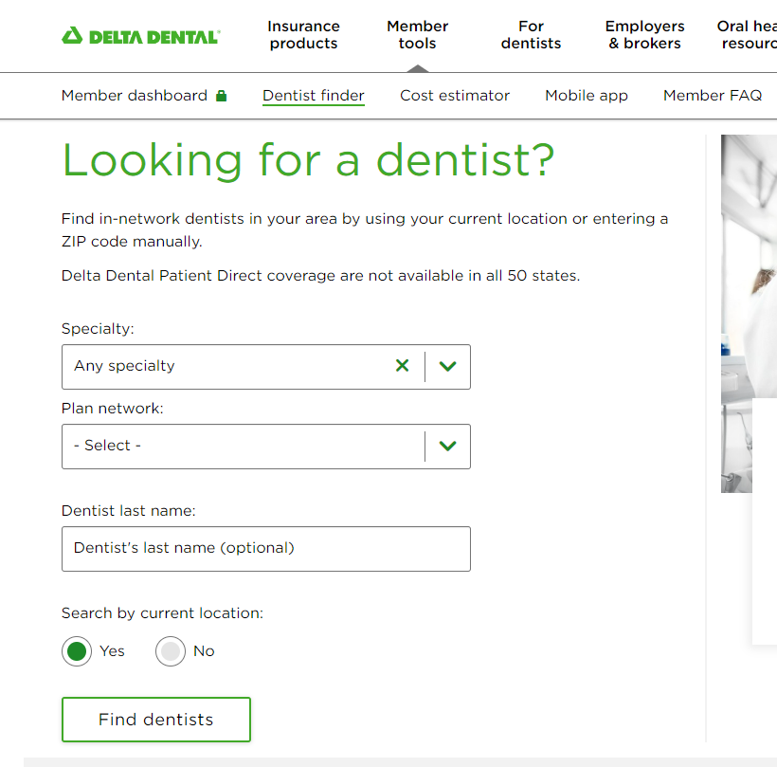
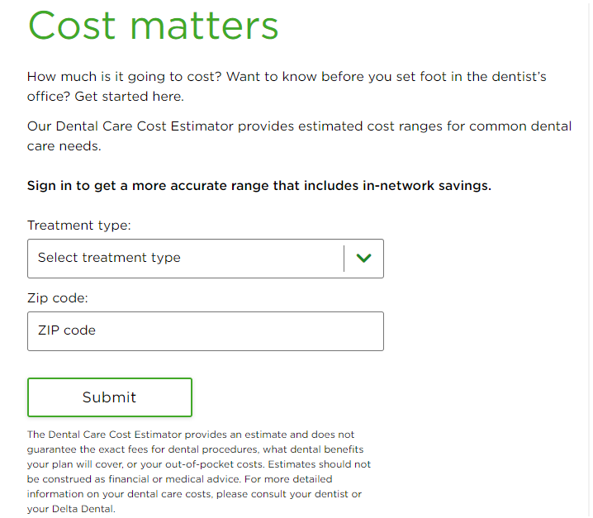
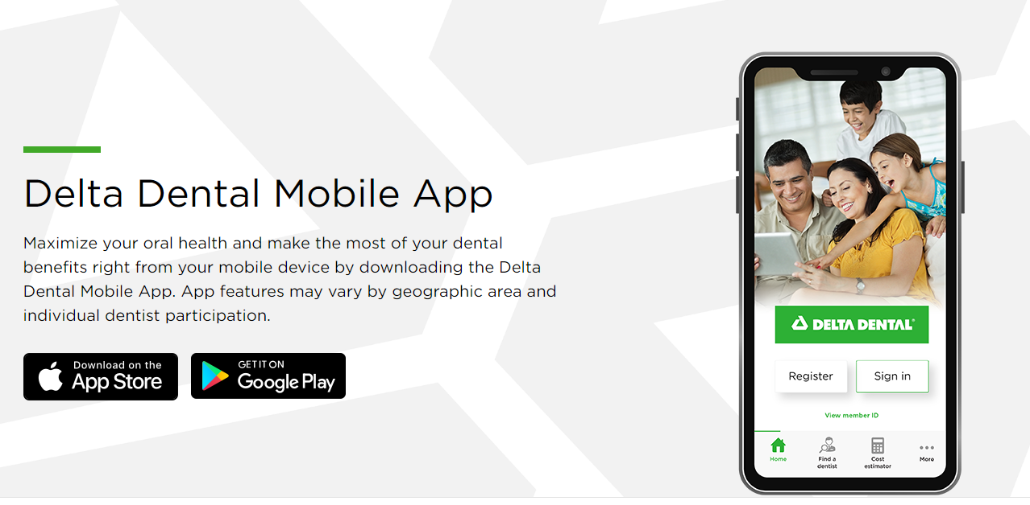
Delta Dental Member Tools
Please note when searching for a dentist, the network for the PPO plans is Delta Dental PPO (or save even more by choosing a dentist from the Premier network) and for the DHMO it is the DeltaCare USA network.

Slide 36
Dental Plan Overview
PPO Dental Services | Standard Plan | Enhanced Plan
Annual Maximum Benefit Calendar Year Deductible: Individual / Family | $1,000 | $1,500
 | $50 / $150 | $50 / $150
Preventative Procedures | Deductible Waived
Routine Exams
Teeth Cleaning Bitewing/Full Mouth X-rays Fluoride Treatments | Plan pays 100% | Plan pays 100%
Basic Procedures: | Deductible Applies
Sealants Periodontal Scaling/Surgery Root Canal Therapy Fillings | Plan pays 80% | Plan pays 80%
Major Procedures: | Deductible Applies
Crowns Fixed Bridges & Repairs Full & Partial Dentures & Repairs Oral & Periodontal Surgery | Plan pays 50% | Plan pays 50%
Orthodontic Procedures: | Deductible Waived
Lifetime Maximum *Dependent Children to Age 19 | 50% up to $1,000 | 50% up to $1,500
Out Of Network: | Based on 80th percentile
Deductible (Individual / Family) | $100 / $300 | $50 / $150
Preventive/Basic/Major/Orthodontic | 80%/60%/40%/50% | 100%/80%/50%/50%

Slide 37
Dental Plan Overview
DHMO Plan
DHMO Dental Services | In-Network Only
Office Visit Copay | $0
Preventative Procedures:
Teeth Cleaning | No Charge
Fluoride Treatments | No Charge
Bitewing X-Ray | No Charge
Full Mouth X-Ray | No Charge
Sealant (per tooth) | No Charge
DHMO Plan
Basic Procedures:
Fillings (permanent teeth):
Amalgam (1 surface) | No Charge
Amalgam (2 surfaces) | No Charge
Amalgam (3 surfaces) | No Charge
Simple Extraction | $45 Copay
Surgical Extraction | $30 Copay
Major Procedures:
Single Root Canal-Anterior | $110 Copay
Periodontal Deep Scaling | $50 Copay
Osseous Surgery | $285 Copay
Crowns | $410 Copay
Bridges | $465 Copay
Denture | $510 Copay
Orthodontic Procedures:
Dependent Children | $2,100 Copay
Adult Children | $2,250 Copay
Full Schedule of Benefits available on the Portal

Slide 38
Vision Plan Overview

Slide 39
Vision Plan Overview
Routine Eye Exams Have Saved Lives
Did you know an eye doctor can be the first to identify more than 270 health conditions, including diabetes, before other healthcare providers?
Vision Services | Base | NEW - Enhanced | Out-of-Network – Both Plans
Eye exams | $10 Copay | $10 Copay | Up to $45
Frequency | Every Calendar Year | Every Calendar Year | Every Calendar Year
Basic Lenses
Frequency | Every Calendar Year | Every Calendar Year | Every Calendar Year
Single vision | $30 Copay | $30 Copay | Up to $30
Bifocal vision | $30 Copay | $30 Copay | Up to $50
Trifocal vision | $30 Copay | $30 Copay | Up to $65
Frames
Frequency* | Every Other Calendar Year | Every Other Calendar Year | Every Other Calendar Year
Benefit | $130 Allowance (20% off balance) | $200 Allowance (20% off balance) | Up to $70
Contacts
Frequency* | Every Calendar Year | Every Calendar Year | Every Calendar Year
Benefit | $130 Allowance | $200 Allowance | Up to $105

Slide 40
VSP Vision Care
Additional Savings
Vsp.com/offers
20% savings on unlimited pairs of prescription or non-prescription glasses/sunglasses from VSP Provider within 12 months of last Exam
Average 15% off regular price Laser Vision Correction
Save up to 60% on digital hearing aids through TruHearing. Visit vsp.com/offers/special-offers/hearing-aids
VSP Choice Network
Visit www.vsp.com
Call 1-800-877-7195
Call Provider directly and verify they are a participating provider with VSP
Choose a Premier Edge Location and See the Difference
Getting the most out of your VSP benefits has never been easier.
VSP members get more and save more through Premier Edge
There are offers that are exclusive to Premier Edge locations.
Locations that participate in Premier Edge set the standard by providing the personalized attention you deserve and carrying the latest in lens technology.
Plus they have a wide selection of featured frame brands you know and love.
Buy Contacts Online
Eyeconic® is the preferred VSP online retailer where you can shop in-network with your vision benefits. See your savings in real time when you shop over 70 brands of contacts, eyeglasses, and sunglasses.

Slide 41
Life and Disability Overview

Slide 42
Life and AD&D Overview
Employer Paid Term Life Insurance
Stetson University provides basic life insurance of 1x Salary to a maximum of $250,000 through USAble at no cost.
Voluntary Life and AD&D Insurance
You can purchase increments of $10,000 between $10,000 and $350,000 or 5x’s salary (whichever is less)
Guaranteed Issue of $200,000 (under 70) – applies to New Hires Only
You can purchase coverage for your spouse in increments of $5,000 between $5,000 and $100,000 or 100% of employees amount (whichever is less)
Guaranteed Issue of $50,000 – applies to New Hires Only
You can purchase $10,000 in coverage for your child(ren) to age 26 ($1,000 for child(ren) birth to 6 months)
Evidence of Insurability (EOI) required for any amount in life benefit exceeding the guaranteed issue amount outside the initial offering or without a qualifying event
Employees may increase their coverage and/or coverage for their spouse by one or two increments during open enrollment each year up to GI amount without EOI
Employees – increase by up to $20,000
Spouses – increase by up to $10,000

Slide 43
Disability Overview
Stetson University provides Short-Term AND Long-Term Disability coverage through USAble to all eligible full-time employees The cost of the provides Short-Term and Long-Term Disability benefit is paid entirely by Stetson.
Employer Paid Short-Term Disability
Benefits can begin on the 31st day following an accident or illness
Replaces up to 80% of your basic weekly earnings
Maximum weekly benefit of up to $2,309
Receive short-term disability benefits for up to 60 days.
Employer Paid Long-Term Disability
Benefits begin after you have been unable to work for 90 days due to a covered sickness or accident
Replaces up to 60% of your basic monthly earnings
Maximum monthly benefit of up to $10,000
Receive long-term disability benefits for up to 2 years if you are disabled and cannot work in your own occupation and until age SSNRA if you are unable to work in any occupation
This LTD Policy includes a 3-month pre-existing limitation clause

Slide 44
Employee Assistance Program (EAP)
Real life support for real life provided by New Directions.
A no-cost-to-you benefit for you or anyone in your household available 24/7, 365 days a year
100% confidential
Access to coaching, counseling, legal/financial specialists, work/life, and online services
Includes Counseling in a variety of ways:
Online
Face-to-face
Over the phone
In-the-moment
EAP services can help with:
Personal Achievement
Difficulties in relationships
Emotional Well-Being
Child Care and Elder Care
Grief and loss
Substance Abuse
Stress and Anxiety with work or family
Contact
Support Line: 800-624-5544
Website: eap.ndbh.com
Code: Stetson
Mobile App: Search for New Directions EAP

Slide 45
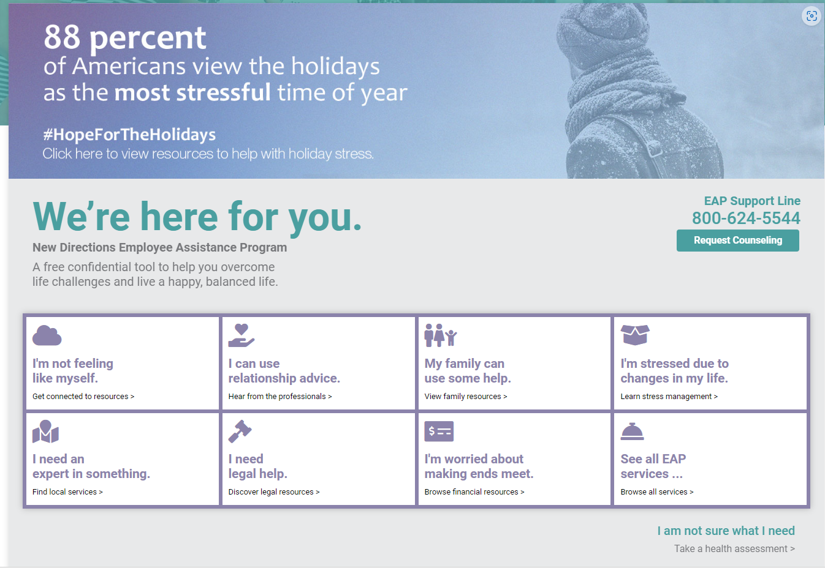
Employee Assistance Program (EAP)
Website: eap.ndbh.com
Code: Stetson

Slide 46
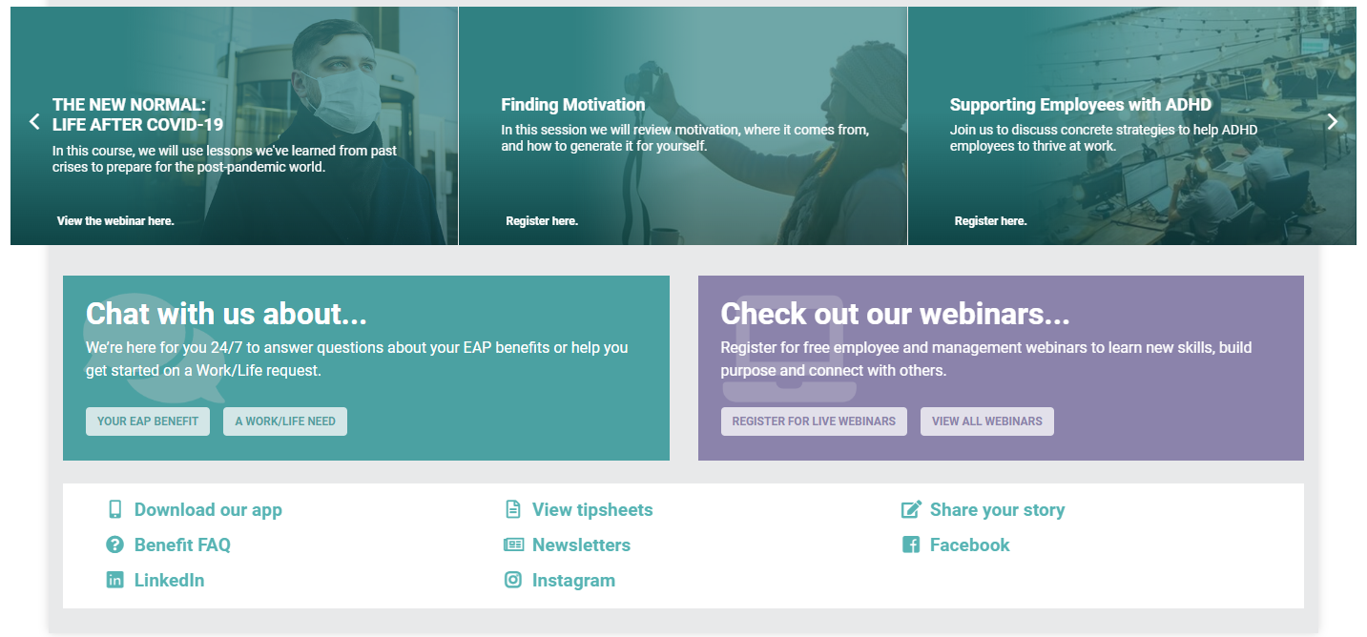
Employee Assistance Program (EAP)

Slide 47
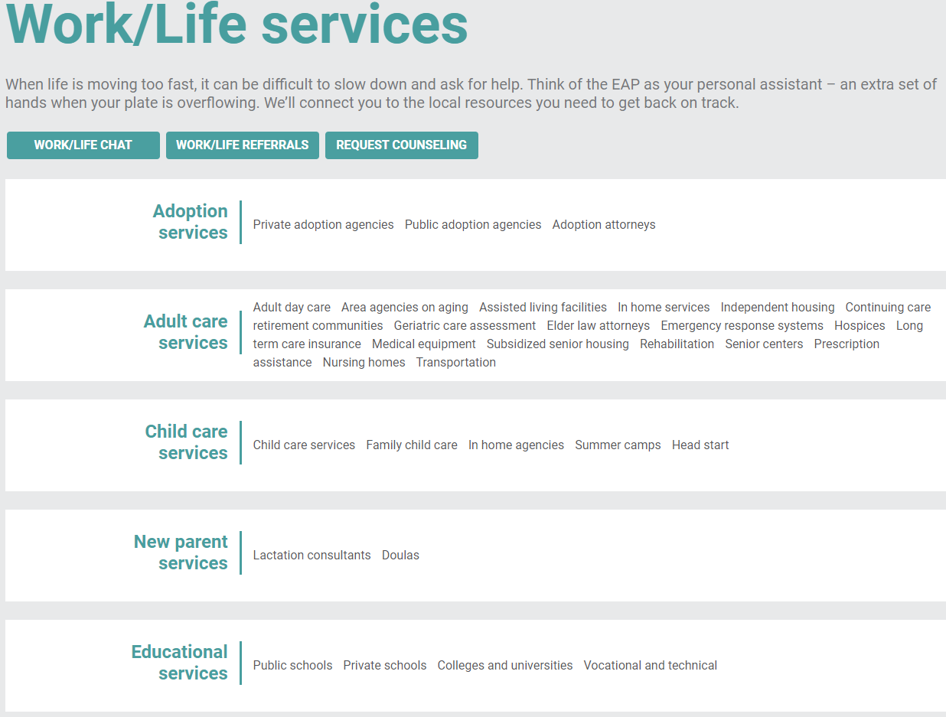
Employee Assistance Program (EAP)
Website: eap.ndbh.com
Code: Stetson

Slide 48
Travel Assistance Program
Provided by USAble through AXA Travel Assistance
No cost benefit to employees and your dependents when traveling more than 100 miles away from home
Support services 24 hours a day, 365 days a year
Travel Services:
Lost documents and luggage assistance
Emergency cash/bail assistance
Telephone interpretation
Legal referrals
Pre-trip and cultural information
Vaccination recommendations
Medical Transportation / Assistance Services:
Medical and dental referrals
Medical evacuation or repatriation
Hospital admission and critical care monitoring
Dispatch of prescription medications
Contact Information
1 (866)-384-2786
OR
1 (630)-616-4536 (collect)
Medassist-usa@axa-assistance.us

Slide 49
Flexible Spending Account – Changing to Medcom for 2025
You will get a new debit card in the mail
Medical FSA
Contribute up to $4,300 pre-tax to spend on any qualified medical expenses in 2025
Deductibles, copays, coinsurance, Rx
Dental and vision expenses
Some expenses not covered by health insurance (see publication 502 on irs.gov for full list)
For yourself and any of your tax dependents regardless of whether they are on your plan
Roll over up to $640 to use in 2026
Dependent Care FSA
Contribute up to $5,000 pre-tax to spend on any qualified child care expenses in 2025
Note: Due to the change in FSA administrators, 2024 rollover funds will not e available until late April 2025

Slide 50
Reminders
Take your time to review your options this open enrollment.
You will have the full month of October to learn more about your benefits and to make your selections.
The Brown & Brown team will be onsite to help you choose the plan that works best for you, answer your questions, and help you enroll through the Portal.
DeLand: 10/18 9am-4:30pm Lynn Business Center
COL: 10/16 9am-4:30pm SC 201
This is an ACTIVE enrollment which means you must go into the Portal to make your elections. They will NOT carryover to 2025. The deadline to enroll is October 31st, but we encourage you to take action before then.

Slide 51
Thank you
13

