Slide 1
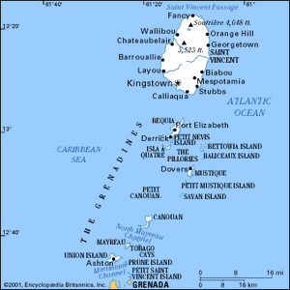

St Vincent and The Grenadines
© 2024
D. McDaniel
SUCOL - ICLP

Slide 2

Overview
Saint Vincent and the Grenadines is an island country lying within the Lesser Antilles, in the eastern Caribbean Sea. It consists of the island of Saint Vincent and the northern Grenadine Islands, which stretch southward toward Grenada. Independence was attained in 1979. The capital and major port is Kingstown, on Saint Vincent. The country is a member of the Commonwealth; a voluntary association of 56 independent countries, almost all of which were formerly under British rule.
As of 2024, the population is 112,000. Some seven-tenths of the inhabitants are descended from Africans who were enslaved and brought to work on the sugar plantations, and nearly one-fourth of the population is of mixed African, European, and Carib ancestry. The official language is English. However, an English patios is commonly spoken and referred to in some academic quarters as “nation language” (a postcolonial version of a language that was imposed by colonizers that incorporates underground language codes from formerly suppressed languages).
There are approximately 100 practicing lawyers in Saint Vincent and the Grenadines. Practice areas include Criminal law, Civil Law, International law, Corporate Law, Real Estate & Probate Law, etc.

Slide 3

Justice/Court System https://legal.gov.vc/legal/
Saint Vincent and the Grenadines’ court system consists of a lower and an upper judiciary. The lower courts include magistrates’ and family courts; the High Court and the Court of Appeal form the upper level. The judiciary consists of district courts, which appeal to the Eastern Caribbean Supreme Court and the Privy Council.
The Magistracy comprises three magisterial districts. All magistrates exercise co-ordinate jurisdiction. Magistrates hear and determine:
  All complaints and information for summary conviction offences, i.e. to be tried in the Magistrate’s Court or indictable offences, i.e. to be tried by a Judge and Jury in the High Court.
  Such civil matters as provided by statue.
The Chief Magistrate is both the Accounting Head and Administrative Head of the Magistracy.
There are five magistrates attached to the magistracy: Chief Magistrate- Serious Offences Court, Senior Magistrate - Kingstown Court No 1- Kingstown Magistrate's Court, Magistrate - District 2 Court, and Magistrate - District 3 Court.
There are three districts: District I, District II, and District III.
District I has two (2) Courts: Serious Offences Court and Kingstown Magistrate's Court.
District II has four (4) Courts: Georgetown, Colonaire, Biabou, and Mesopotamia.
District III has seven (7) Courts in total of which the Grenadines is a part of- four on mainland Chateaubelair, Calliaqua, Layou, and Barrouallie. Whilst the Grenadines has three (3) Courts: Bequia, Union Island, and Canouan.
  There are no separate divisions within the District Court System.
  Various Matters are heard – Traffic, Criminal, Civil, and Application for Liquor Licences in the District Court system.

Slide 4

Judicial Process
The Eastern Caribbean Supreme Court was established (as the West Indies Associated States Supreme Court) in 1967 with its headquarters in Castries in St Lucia and is responsible for the administration of justice in its member states. It comprises the High Court of Justice and the Court of Appeal. The member states are Antigua and Barbuda, The Commonwealth of Dominica, Grenada, Montserrat, St. Kitts and Nevis, Saint Lucia, St. Vincent and The Grenadines, and associate members Anguilla, The British Virgin Islands and Martinique. The Eastern Caribbean Supreme Court consists of two divisions, a Court of Appeal and a High Court of Justice.
https://www.eccourts.org/
  The Court of Appeal is itinerant, traveling to each Member State and Territory, where it sits at various specified dates during the year to hear appeals from the decisions of the High Court and Magistrates Courts in Member States in both civil and criminal matters.
  The Court of Appeal hears appeals from all subordinate courts (High Courts, Magistrates Courts and the Industrial Court in Antigua and Barbuda). Appeals from the Magistrates Courts might be heard from “any judgment, decree, sentence or order of a Magistrate in all proceedings.” In respect of the High Court, the Court of Appeal has jurisdiction to hear and determine “any matter arising in any civil proceedings upon a case stated, or upon a question of law reserved by the High court or by a judge.” This is, however, subject to “any power conferred in that behalf by a law in operation in that State.” Subject to certain exceptions, the Court of Appeal is empowered to “hear and determine the appeal from any judgment or Order of the High Court in all civil proceedings.” For the purposes of determining any issues incidental to an appeal and the remedies, execution, and enforcement of any judgment or order made thereto, the Court of Appeal is endowed with “all the powers, authority and jurisdiction of the High Court.”
  Each Member State has its own Court Office, which, in addition to the High Court Registry, houses the office of the local High Court judge(s). Filing in the Registries commences the proceedings in matters before the High Court in each of the nine territories and the Court of Appeal.
  The trial Courts sit throughout the year. Criminal Assizes convene in each jurisdiction on specified dates.

Slide 5
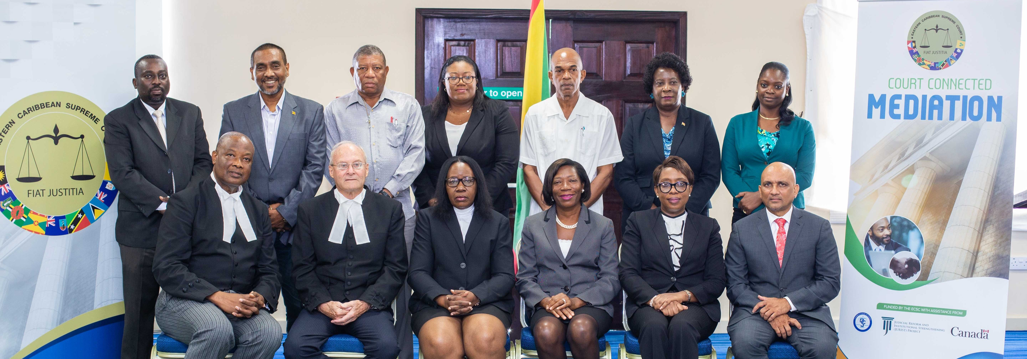
ADR
Alternative Dispute Resolution (ADR) such as Mediation and Arbitration is a popular method of resolving conflicts outside of court in Saint Vincent and the Grenadines. ADR provides parties with a more efficient, cost-effective, and collaborative way to settle disputes. The ADR process is generally less formal than traditional court proceedings and allows for more flexibility in reaching a resolution. In Saint Vincent and the Grenadines, ADR Mediation & Arbitration is regulated by the Arbitration Act (https://www.newyorkconvention.org/media/uploads/pdf/6/3/639_san-vicente-granadinas-arbitration-act.pdf
That legislation outlines the procedures and rules for conducting arbitration, as well as the enforcement of arbitral awards. It is important to familiarize yourself with the local laws to ensure compliance and a successful ADR process. The duration of the ADR process can vary depending on the complexity of the dispute and the willingness of the parties to cooperate. Mediation is generally faster than arbitration, but both methods can lead to a quicker resolution compared to court litigation.
Notes:
What, Agreements, Why ADR

Slide 6
ADR
In Saint Vincent and the Grenadines, the legal framework for handling labor disputes consists of two main avenues: Labor Courts and Arbitration Panels. https://www.rivermate.com/guides/saint-vincent-and-the-grenadines/dispute-resolution
Labor Courts are specialized courts within the judicial system that primarily adjudicate labor disputes. These disputes can arise between employers and employees or between employers and trade unions. On the other hand, Arbitration Panels offer an alternative dispute resolution mechanism outside of the formal court system. These panels are formed on a case-by-case basis, typically consisting of neutral arbitrators agreed upon by the parties involved.
The primary legal sources governing labor relations and dispute resolution in Saint Vincent and the Grenadines include the Labour Code Act (2001), which provides the foundation for labor rights, regulations of working conditions, and procedures for resolving labor disputes. The Trade Unions Act (1933) governs the formation, registration, and activities of trade unions. The Arbitration Act sets out the framework for arbitration procedures.
In Labor Courts, a case is initiated by filing a complaint. The court will typically attempt to facilitate a mediation or conciliation process between the parties. If mediation fails, the court will proceed with a formal hearing and issue a judgment, which may be appealed to a higher court.
In Arbitration Panels, the parties agree upon the formation of a panel and the selection of arbitrators. The arbitration process is generally less formal than court proceedings. The panel hears evidence and arguments and issues a binding decision.
Labor courts and arbitration panels in Saint Vincent and the Grenadines handle a range of disputes, including wrongful dismissal, discrimination, breach of contract, wage and hour disputes, and issues related to collective bargaining agreements.
Notes:
What, Agreements, Why ADR

Slide 7

Legal Aid
Legal aid is available for indigent Defendants on trial (at the High Court) for murder. There is a Legal Aid Register from which the Court selects legal counsel. The Legal Aid Register is populated by legal counsel who volunteer to be so listed. At the Court of Appeal level, legal indigent appellants can apply for legal aid in the conduct of their appeals pursuant to section 51 of the Eastern Caribbean Supreme Court (Saint Vincent and Grenadines) Act, which authorises the Court of Appeal to do so, as the interest of justice requires. Both legal aid streams are funded by the State of Saint Vincent and the Grenadines.
Persons accused of serious crimes are duly informed of their right to legal representation upon arrest and are afforded opportunities to retain legal counsel of their choice. https://ccprcentre.org/files/documents/G1909826.pdf
Notes:
What, who is eligible, Cost, Process, when it is denied

Slide 8
Education https://education.gov.vc/education/
Primary education is free but not compulsory. Most primary schools are administered by the government, and a small number are private. Secondary education begins at age 11. Most secondary schools are government controlled, with a few run by the Catholic and Anglican religious organizations with government assistance.
Other educational institutions include technical and vocational schools, a school for children with special needs, and Saint Vincent Community College. https://svgcc.vc/
Notes:
Primary, Secondary, Territory, Law school

Slide 9

Law School in St Vincent & the Grenadines https://www.facebook.com/svgbar/
The Council of Legal Education was created by an Agreement signed in 1971 by Barbados, Dominica, Grenada, Guyana, Jamaica, Trinidad and Tobago, the University of the West Indies, and the University of Guyana. The Council was established in order to provide training in the Region (rather than in Britain) for Lawyers wishing to practise in The West Indies.
Students interested in studying law must complete their Bachelor of Law (LLB) at a University of West Indies campus; Trinidad & Tobago, Jamaica or Barbados, and then pursue their Legal Education Certificate at one of the three law schools; the Norman Manley Law School in Jamaica, the Hugh Wooding Law School in Trinidad, or the Eugene Dupuch Law School in the Bahamas.

Slide 11

Legal News
Courts SVG appeals tax case to Privy Council https://www.iwnsvg.com/2024/04/22/courts-svg-appeals-tax-case-to-privy-council/
  Unicomer St. Vincent Ltd., owners of Courts furniture and appliance store, on Monday said it will appeal to the London-based Privy Council the judgement of the Court of Appeal in relation to EC$12 million in taxes that the Government of St. Vincent and the Grenadines says the company owes.
  On April 17, the Eastern Caribbean Supreme Court, in its appellate jurisdiction, ruled against the company in the case that it brought after the government said in 2015 that it owed the Inland Revenue Department EC$12.66 million, inclusive of interest and penalties.

