Slide 1
Building Resilience in Homeless Children 2014
Donald h. whitehead, jr.
national coalition for the homeless
Board member
September 15, 2014

Slide 2
Resilience
Resilience in children has been defined as "achieving desirable outcomes in spite of significant challenges to adaptation or development” (Masten & Coatsworth, 1996, p. 737).
The prerequisite for evidencing resilience is to have faced a major adversity of some sort.

Slide 3
How Many Children are Homeless?

Slide 4
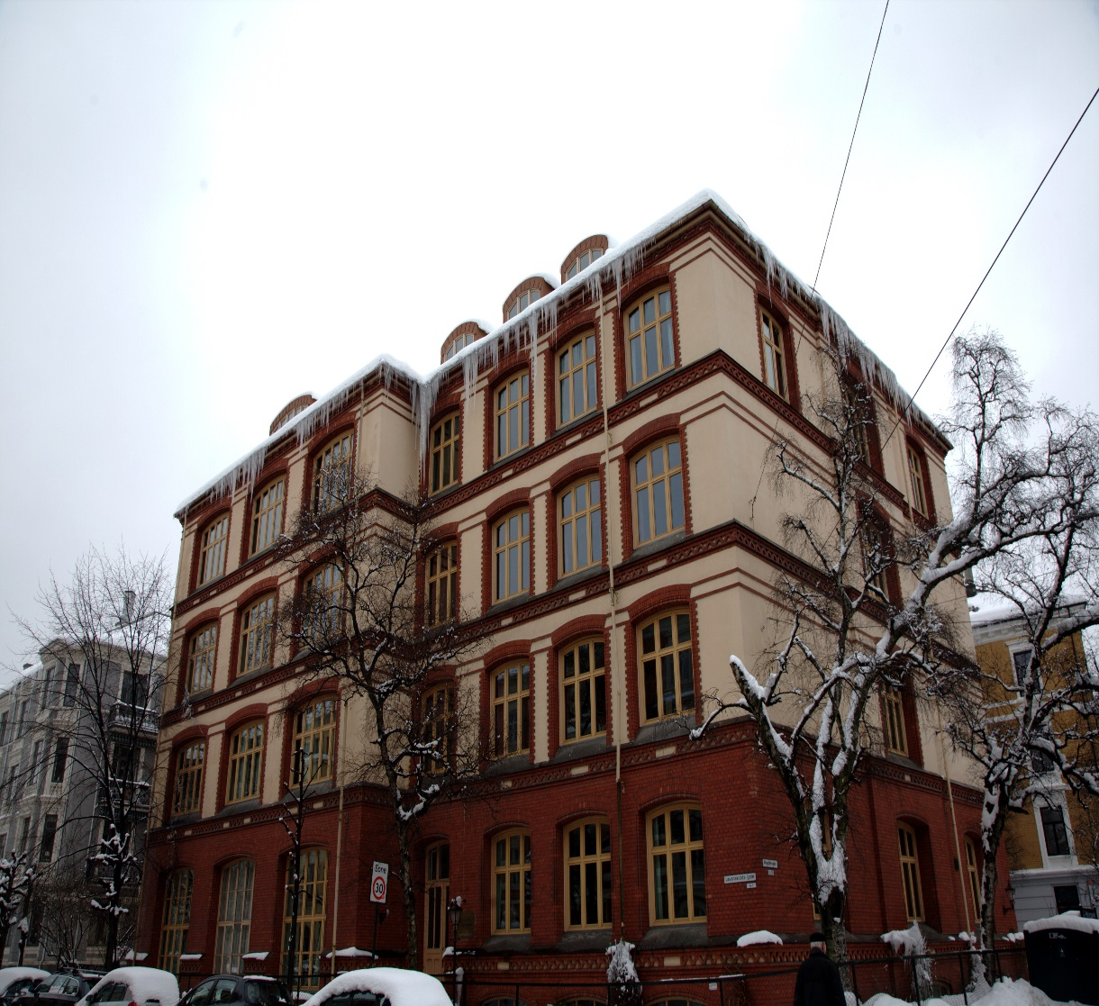
In the 2011-2012 school year, 1,166,339 homeless children and youth were enrolled in public schools.
This is a 71 percent increase since the 2006-2007 school year.
Between 1.6 and 2.8 million youth runaway and/or are homeless in a year
NATIONAL ASSOCIATION FOR THE EDUCATION OF HOMELESS CHILDREN AND YOUTH
Office of Juvenile Justice and Delinquency Prevention, 2002; Research Triangle Institute, 1995
Notes:
It is important to note that this number is not an estimate of the prevalence of child and youth homelessness; in fact, it is an underestimate, because not all school districts reported data to the U.S. Department of Education, and because the data collected represents only those children identified and enrolled in school. Finally, the number does not include all preschool-age children, or any infants and toddlers

Slide 5
The Department of Housing and Urban Development
On a Single Night in January 2013 There were nearly 200,000 homeless children and youth on a single night in January 2013, about one-third of all homeless people.
There were 46,924 unaccompanied homeless children and youth in the United States on a single night in January 2013, roughly 8 percent of the total homeless population.
Just under 87 percent of (40,727 people) were between the ages of 18 and 24, and 13 percent were under the age of 18 (6,197 people).
About two-thirds of people age 18 to 24 experiencing homelessness were unaccompanied (66 percent or 40,727).

Slide 6
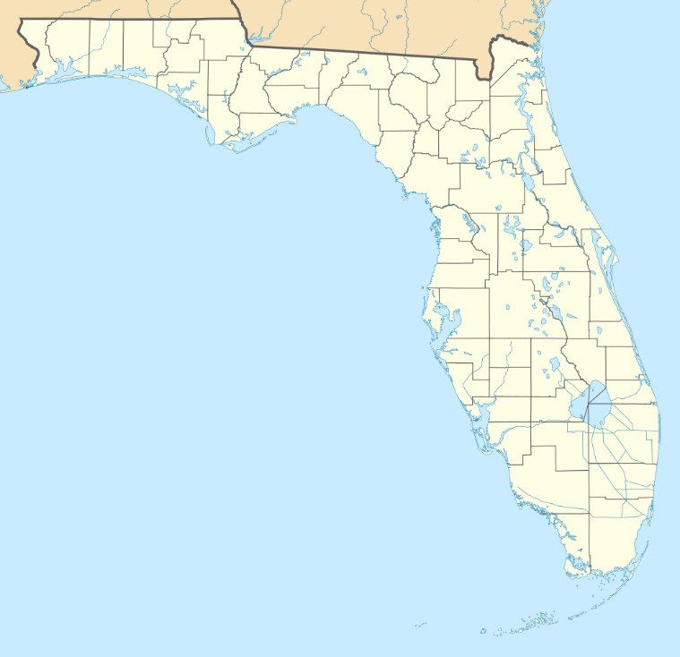
Florida
During the 2012-2013 school year, the Florida school districts identified 70,215 children
and youth who were homeless. This is a 10% increase from 2011-2012. Of those
identified, 6,658 (9%) were “unaccompanied youth.” An “unaccompanied youth” is defined
as one who is not in physical custody of a parent or guardian.
The majority, 52,673 (75%)were reported as homeless and temporarily sharing the housing of other persons due to the loss of their housing or economic hardship; a one percent increase from the previous school year.

Slide 7

Homeless Students Reported in Florida Public Schools
2008 - 2009 | 56,680 +15%
2009 - 2010 | 41,286 +20%
2010 - 2011 | 49,112 +19%
2011 - 2012 | 63,685 +12%
2012 - 2013 | 70,215 +10%
Source: 2008-2013 Survey 5 Student Demographic Format and Federal State Indicator Format. Florida Department of
Education, Automated Student Database System.

Slide 8
What is the impact of Homelessness
on children?

Slide 9
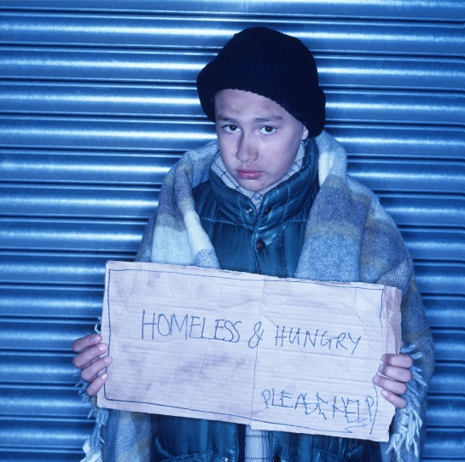
Experiences of Violence among low-income and formerly homeless school-age children:
53% have heard gunshots
17% have seen someone get shot
17% have seen a dead body outside
14% have seen someone stabbed
Experiences of abuse:
8% have experienced physical abuse
8% have experienced sexual abuse
Sources: The National Center on Family Homelessness. (1999). Homeless children: America’s new outcasts. Newton, MA The National Center on Family Homelessness; Buckner & Bassuk (2004). Exposure to violence and low-income children’s mental health: Direct, moderated and mediated relations. American Journal of Orthopsychiatry. 74(4): 413-423

Slide 10

Disrupted relationships
Separations:
22% separated from immediate family.
5 years after entering shelter, 44% of mothers separated from children.
60% homeless women had minor children; only 66% lived with them.
Within a single year:
97% move
More than 30% are evicted from their homes
22% are in foster care or with relatives
Shinn M & Bassuk EL. (2004). Families. In S Barrow et al. (Eds.) Encyclopedia of Homelessness. Sage.

Slide 11
Children experiencing
homelessness are sick
FOUR times more often
than other children.
.
1 in 7 have
moderate to severe
HEALTH PROBLEMS.
America’s Youngest Outcasts: State Report Card on Child Homelessness. (2009). Newton, MA: The National
Center on Family Homelessness.

Slide 12
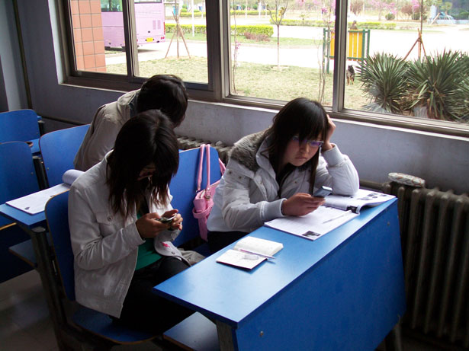
The constant barrage
of stressful and
traumatic experiences
has profound effects
on children’s
development and
ability to learn.

Slide 13
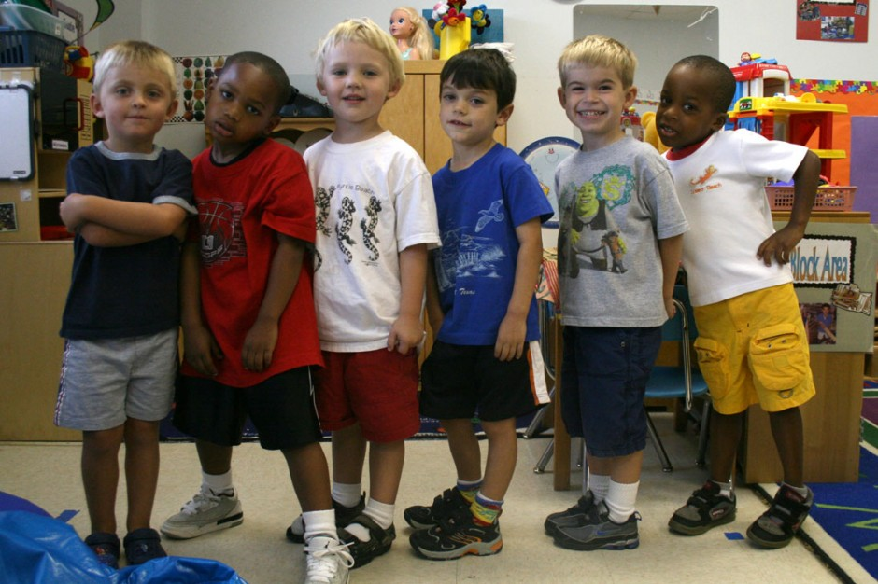
15% of homeless children attend preschool vs. 51% of
housed low-income kids.
Four times more likely to show
delayed development.
Twice the rate of learning
disabilities
•

Slide 14

16% are less proficient at
reading and math than their peers.
Fewer than 25% graduate from
high school
Over 50% perform below grade level.
36% repeat a grade.
America’s Youngest Outcasts: State Report Card on Child Homelessness. (2009). Newton, MA: The National
Center on Family Homelessness.
Notes:
Not all children do poorly.

Slide 15

Strategies
Foster control, choice, and autonomy
Educate parents and staff about child development and the impact of stress on children
Model healthy interactions
Create opportunities to build the parent-child relationship
Care for the caregiver

Slide 16
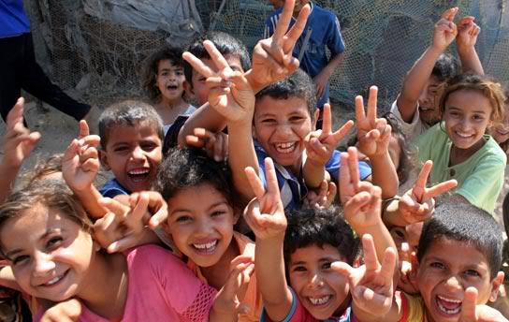
Strategies
Include resilience concepts into your approach to working with children and families
Include resilience concepts into program planning
Learn more
Notes:
“Play gives children a chance
to practice what they are
learning. They have to play
with what they know to be true
in order to find out more, and
then they can use what they
learn in new forms of play.”
- Fred Rogers

Slide 17
Individual and Parent-Child Approaches
Trauma-specific therapies. To learn more: www.nctsn.org
Play therapy. To learn more: www.a4pt.org
Parent-Child Interaction Therapy (PCIT) is an empirically-supported treatment for young children that places emphasis on improving the quality of the parent-child relationship and changing parent-child interaction patterns. To learn more: http://pcit.phhp.ufl.edu.

Slide 18
Group Approaches
Strengthening Family Coping Resources (SFCR) explores the role of constructive, naturally occurring family rituals as a vehicle for strengthening a family’s protective functions and for accomplishing many of the treatment objectives outlined in the family trauma treatment literature (Kiser, L, 2008). SFCR uses family rituals, routines, and traditions to support family coping and posttraumatic recovery and growth. To learn more: http://fittcenter.umaryland.edu/AboutUs.aspx.
PEACH (Physical and Emotional Awareness for Children Who Are Homeless) is an innovative curriculum that teaches young children about good nutrition, physical activity, and how to deal with the stress of being homeless. Each of the 16 sessions follow a consistent, predictable format that help children feel at ease. At the heart of PEACH are sessions on emotional health that help children understand their bodies’ reactions to stress and what to do about it. These sessions help children identify and feel comfortable with a range of emotions and learn strategies that help them feel safe. To learn more: http://www.familyhomelessness.org/node/41.

Slide 19

Innovative Programs From Across America

Slide 20

GLAD House
GLAD House is a certified mental health and prevention agency where at-risk children come to receive the therapy, skills and support they need to build stronger lives.
Since 1998, GLAD House has provided comprehensive solutions to the complex problems of substance abuse in the family.
GLAD House is a unique combination of best practices, national standards and research-based methods.
The GLAD House model was created by a group of local community leaders, pediatric specialist, prevention experts, mental health professionals and members of drug and alcohol treatment centers.

Slide 21

For More Information About GLAD House, contact:
Mary Schwaderer, Interim Executive Director
GLAD House
1994 Madison Road
Cincinnati, Ohio 45208
Tel: (513) 641-5530 / Fax: (513) 482-7042
Email: marys@gladhouse.org

Slide 22
Resources
National Child Traumatic Stress Network / www.nctsn.org
Project Joy / www.projectjoy.org
PBS’ This Emotional Life / http://www.pbs.org/thisemotionallife/topic/resilience
Helping Traumatized Children Learn (2005) / http://www.massadvocates.org/download-book.php
Homeless Children: Update on Research, Policy, Programs, and Opportunities / http://aspe.hhs.gov/hsp/10/HomelessChildrenRoundtable/index.shtml

Slide 23

The Center for Women and Families (CWF)
Located on the Coalition’s main campus, can accommodate 240 individuals. The CWF is made up of three distinct sections – a single women’s dorm; a dorm for single mothers with young children; and individual family rooms for intact families, single mothers with older children, and single fathers with children.

Slide 24
The Coalition’s main campus has a fully-licensed daycare and a Voluntary Pre-Kindergarten (VPK) classroom, which help eliminate the huge cost of childcare for parents who work, are looking for work, or take classes during the day.
Art By Coalition Children (ABCs) is a volunteer-based program that pairs professional artists in the community with children living at the Coalition.
Artists work with the kids to create a wide variety of art, from black and white photography to sculpture and painting.
The Coalition is the first shelter in the nation with an onsite Boys & Girls Club. Known as “The Positive Place for Kids,” the club provides character development programs on a daily basis for children 6-18 years old.

Slide 25
The most important way element to building resiliency in homeless children is to provide the resources necessary for escaping homelessness.
It is unconscionable that millions of children are homeless in the richest country in the history of the world.

Slide 26
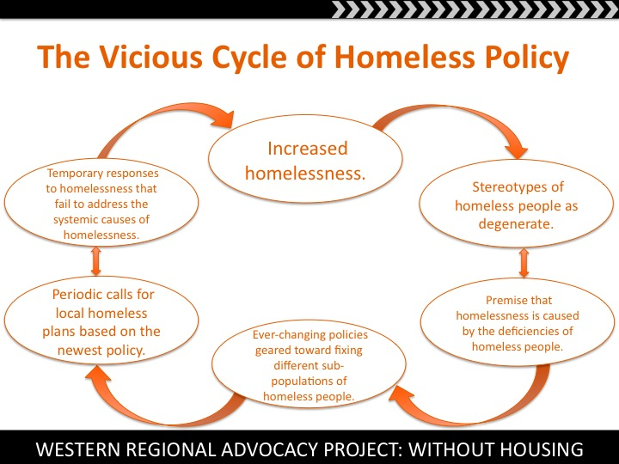

Slide 27


Slide 28

SUCCESSFUL ADVOCACY FOR THOSE EXPERIENCING HOMELESSNESS
Mitch Snyder on 51st day of hunger strike
Notes:
Snyder undertook a hunger strike, lasting 51 days, forcing Ronald Reagan to donate a decrepit federal building for the 1,400-bed Federal City Shelter, run by the CCNV.

Slide 29
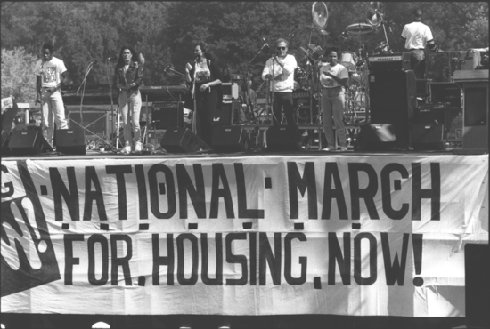
SUCCESSFUL ADVOCACY FOR THOSE EXPERIENCING HOMELESSNESS
Washington DC 1989
Notes:
n October 1989 NUM help organize a Housing Now! march on Washington, D.C., in 1989. The event would be co-organized by the National Coalition for the Homeless, National Low-Income Housing Coalition, and Voices for Creative Non-violence NUH wanted militant nonviolent disobedience to push issues of the homeless to forefront. However

Slide 30
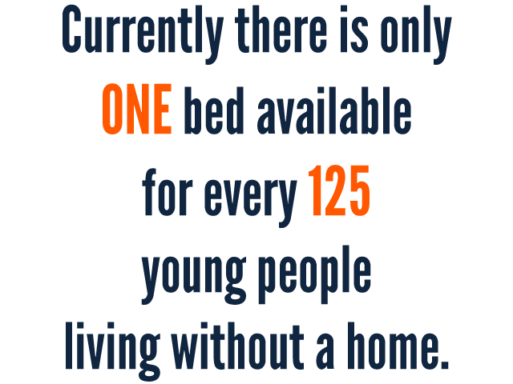
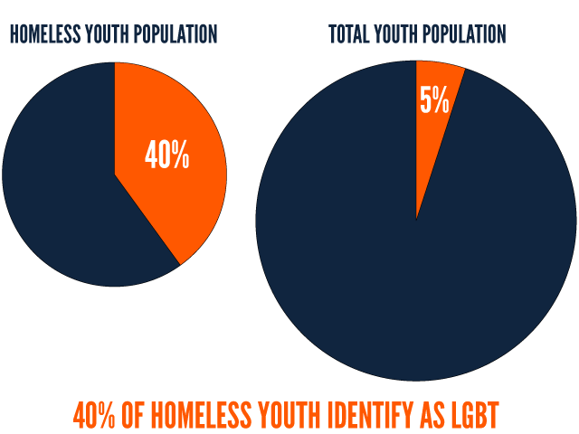
Youth Homelessness
There are only 4,000 youth shelter beds in the United States, yet as many as 500,000 unaccompanied youths experience homelessness each year.
Many homeless young people have fled abusive situations, left the foster care system with no resources, or been rejected by their families because of sexual orientation or gender identity.
LGBT youth are disproportionately over-represented in the homeless youth population, with as many as 40% of the nation’s homeless youth being LGBT, while only 5% of the overall youth population is LGBT

Slide 31

What we ARE CALLING FOR:
A federal commitment to provide ALL young people, ages 24 and under, with immediate access to safe shelter, affirming the principle that no young person in the United States should be left homeless in the streets.
An immediate commitment to add 22,000 shelter beds along with appropriate services - a five-fold increase over the current level of resources.
A more accurate and comprehensive effort to count the number of homeless youth in the nation in order to determine the number of beds that are needed over the next decade.

Slide 32
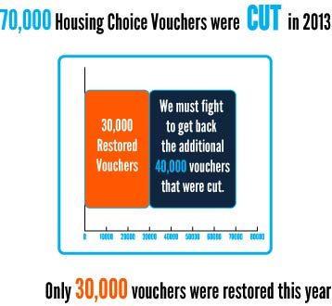
Rental assistance through Section 8 housing vouchers allows low-income households to go into the private market.
Less than one in four of those eligible for that assistance – legitimately, legally eligible – receive help because there are very few dollars in the program for new participants.
With thousands of people on the waiting lists already, most cities in America aren’t even accepting additional names. Wait times for those lucky enough to be on the list can stretch for many years.
Congress cut 70,000 housing vouchers last year as part of the so-called sequester.
The loss of these vouchers shrunk the Section 8 program and froze progress on waiting lists. If you’re one of the majority of low-income households paying most of your income on rent, there is virtually no help
Notes:
At a time when the supply of public housing has been shrinking for years, vouchers for private apartments are the primary federal program that provides housing assistance to families and individuals at risk of homelessness.
The scarcity of affordable housing is one of the root causes of homelessness.
The Joint Center for Housing Studies of Harvard University reports that 71% of extremely low-income renters spend over half of their income on housing, a huge cost burden that squeezes out money for other items in the household budget. Meanwhile, rent subsidies are only available to 24% of households who are eligible to receive them.
Families cope with excessive housing costs by overcrowding, “doubling up,” and choosing between their basic necessities. For households on the brink of homelessness, almost any financial setback can be enough to result in the loss of housing. High rents and the lack of available subsidies are also the main hurdles in solving homelessness for many people who are currently in the emergency shelter system.
Given these harsh realities, it is nearly impossible to envision a pathway to end homelessness without significant expansion of rental assistance. Based on research by Apt Associates, nearly 9 million low-income households are in critical need of help with their housing costs. Yet current programs assist less than a third of this total number.

Slide 33
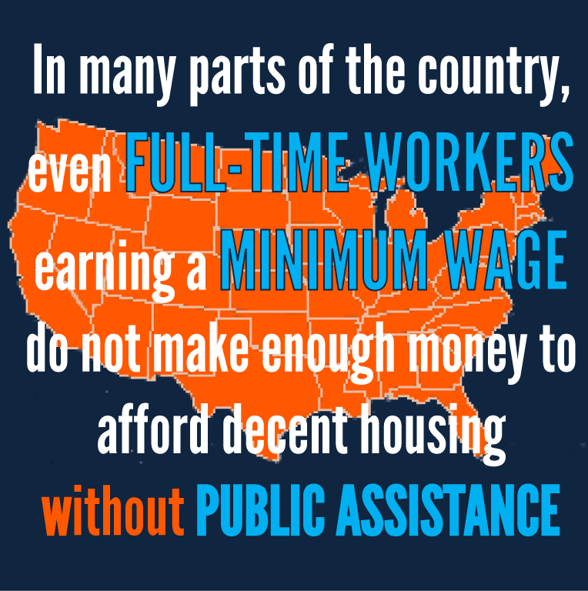
Notes:
Advocates need to do two things: First, we need to tell Congress to put back every penny it cut from housing vouchers in 2013. Cutting 70,000 vouchers in the middle of a housing crisis was irresponsible – we can’t allow that reduced number to become the new baseline for the program. This year’s budget needs to replace those lost vouchers and bring the program up to the same scale as it would have been without the so-called sequester.
Second, we need to build a stronger grassroots network that is ready to demand action for the millions of people who need housing assistance and aren’t getting it. We need bold new thinking that goes beyond the current programs, like a renter’s tax credit and full funding of the National Housing Trust Fund. We need a lot more organizing. Most of all, we need to challenge the parameters of what Washington feels is possible right now –demanding resources that match the scale of the problem and that offer real solutions to homelessness in America.

Slide 34



HELP US GET THE WORD OUT!
We support the National Campaign for Youth Shelter because EVERYONE deserves a bed.
#Act4Youth http://ow.ly/wWlJJ
LGBT youth are disproportionately over-represented in the homeless youth pop. We need safe shelter now! #Act4Youth http://ow.ly/wWlJJ
Kids who grow up on the streets are in real danger and so is the society that allows them to do so.
#Act4Youth http://ow.ly/xIKlS

Slide 35
Action Needed
Please act today to support the Homeless Children and Youth Act:
Please write a letter to your U.S. Senators and U.S. Representative urging them to sign on as a co-sponsor of the Homeless Children and Youth Act (H.R. 5186 and S. 2653). Visit http://www.helphomelesskidsnow.org/take-action/ to send a letter online.
To send a letter on agency letterhead, download a Senate template letter | House of Representatives template letter.
Add your organization’s name to a national sign-on letter in support of the legislation by visiting http://tinyurl.com/sign-on4homelessyouth.
For More Information
Contact Barbara Duffield, Director of Policy and Programs, at bduffield@naehcy.org or (202) 364-7392

Slide 36
Advocacy Resources
National Coalition for the Homeless –www.nationalhomeless.org
National Association for the Education of Homeless Children and Youth –www.naehcy.org
National Center on Homeless Education – www.serve.org/nche
National Center on Family Homelessness – www.familyhomelessness.org
National Law Center on Homelessness & Poverty – www.nlchp.org
National Low-Income Housing Coalition www.nlihc.org

Slide 37
Additional Resources
National Child Traumatic Stress Network - www.nctsn.org
Project Joy - www.projectjoy.org
PBS’ This Emotional Life blog
http://www.pbs.org/thisemotionallife/topic/resilience
Helping Traumatized Children Learn (2005)
http://www.massadvocates.org/download-book.php
Homeless Children: Update on Research, Policy, Programs, and Opportunities
http://aspe.hhs.gov/hsp/10/HomelessChildrenRoundtable/index.shtml

Slide 38


