Slide 1
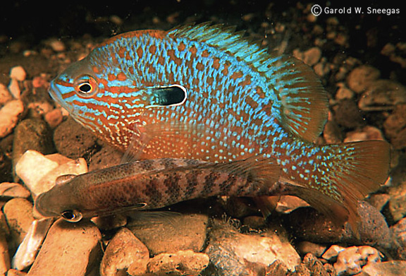
Freshwater introduced species
What’s the difference between an exotic, an introduced, and an invasive species?

Slide 2
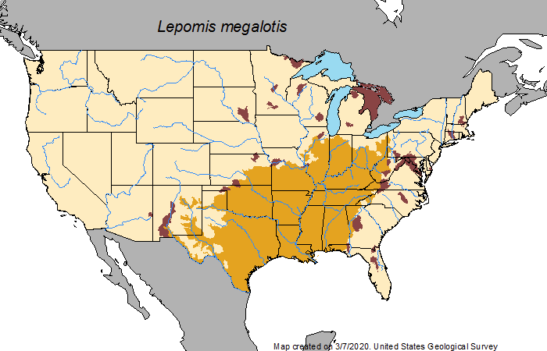
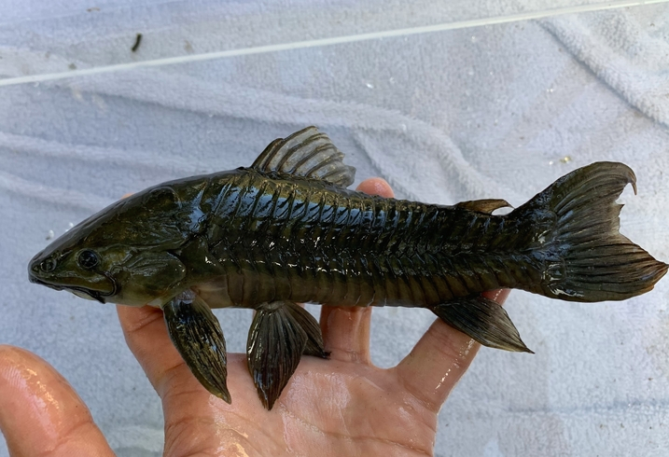
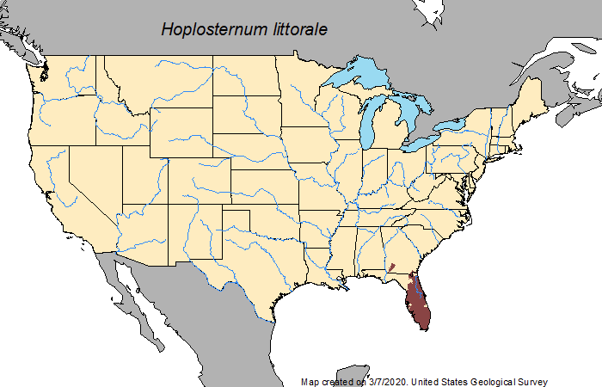
Introduced species have a range on the continent, but are introduced outside of this range
Exotic species come from another continent
Either can become invasive if they spread extensively

Slide 3
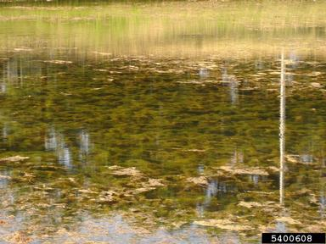
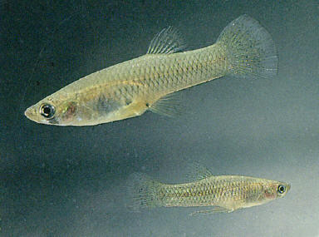
Is an exotic species worse than an introduced species?
Water milfoil (Myriophyllum spicatum, exotic) may completely change an ecosystem
It all depends upon the impact!
Western mosquitofish (Gambusia affinis) hybridize with native gambusia in the western US and wipe out their genetic diversity
Graves Lovell, Alabama Department of Conservation and Natural Resources, Bugwood.org

Slide 4
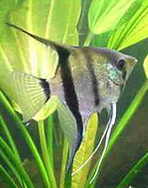
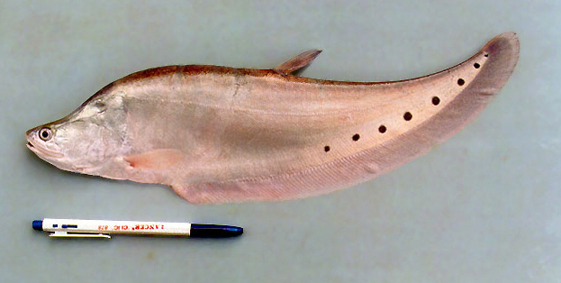
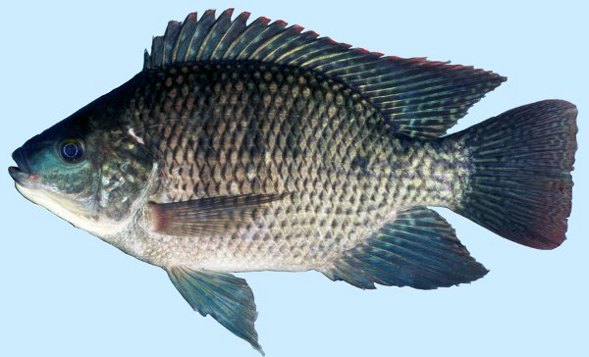
If a species is introduced, is the story over?
Pterophyllum scalare
Angelfish
Chitala ornata Clown Knifefish
Oreochromis aureus Blue tilapia
Species that
are introduced
Again, it depends!
Species that
establish
Species that become invasive
Known introductions failed in California (1964), Florida (1979), and Kentucky (1984)
Established in FL, but
failed elsewhere
Superabundant throughout peninsular Florida and occurs in systems in the east coast and southwest

Slide 5
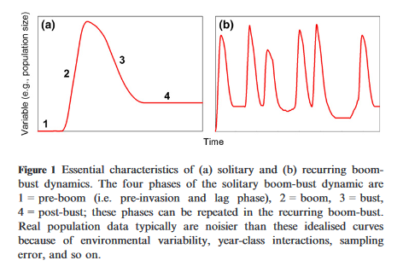
And Some species boom and then bust, and some boom and bust and boom and bust…
Strayer et al.

Slide 6
How many invasive species are we talking about?
These data are just for species moving between Europe and North America. Where do most originate?

Slide 7
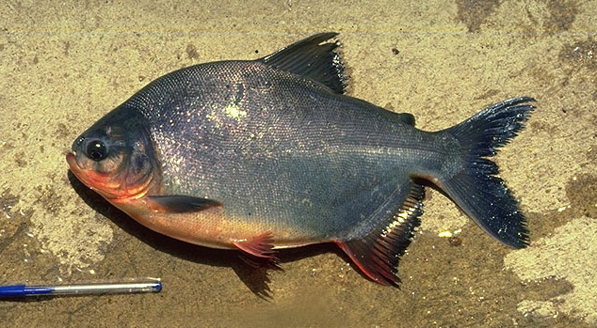
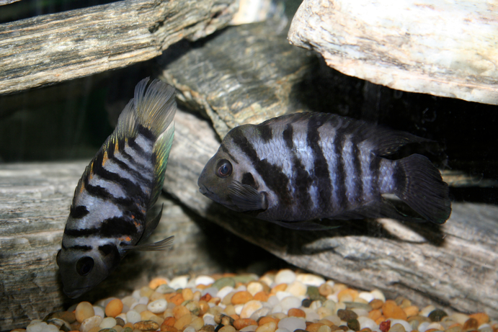
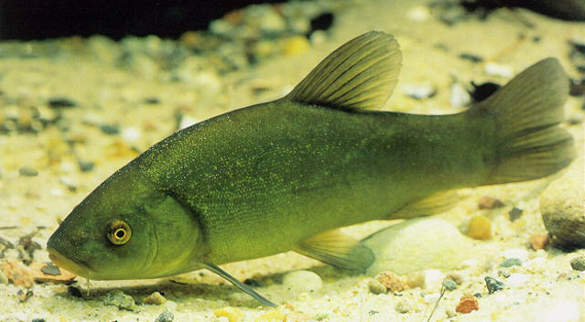
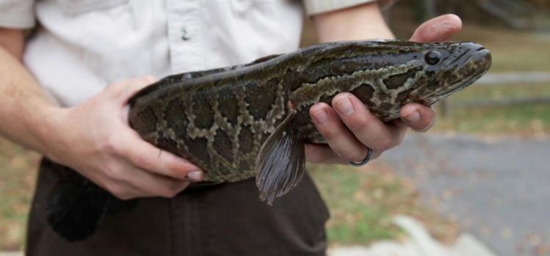
S. America:
Catfish (armored or not), piranhas and relatives, cichlids
Region | Percent
South America | 22
Asia | 20
Eurasia | 16
Europe | 13
Africa | 12
Central America | 6
Australia | 2
South Pacific | 1
Atlantic Ocean | 1
Pacific Ocean | 1
Unknown | 4
C. America:
Cichlids, tetras, mollies, swordtails, platyfish
Africa:
Cichlids
Asia, Eurasia:
Snakeheads, eels, carps, knifefish, gouramis, danios, barbs
Europe:
Big cyprinids
From: Claudi and Leach (1999)
https://nas.er.usgs.gov

Slide 8
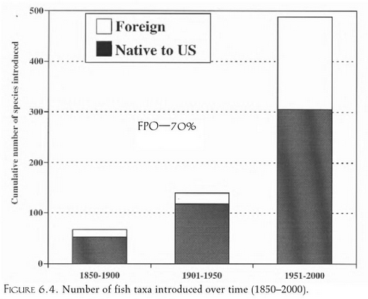
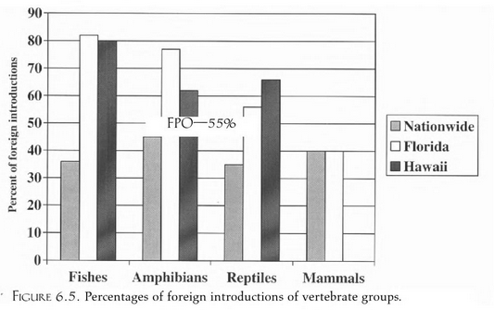
How many species are we talking about?
A lot!
Especially in FL and HI (and CA)
Ruiz and Carlton (2003) Invasive Species: Vectors and Management

Slide 9
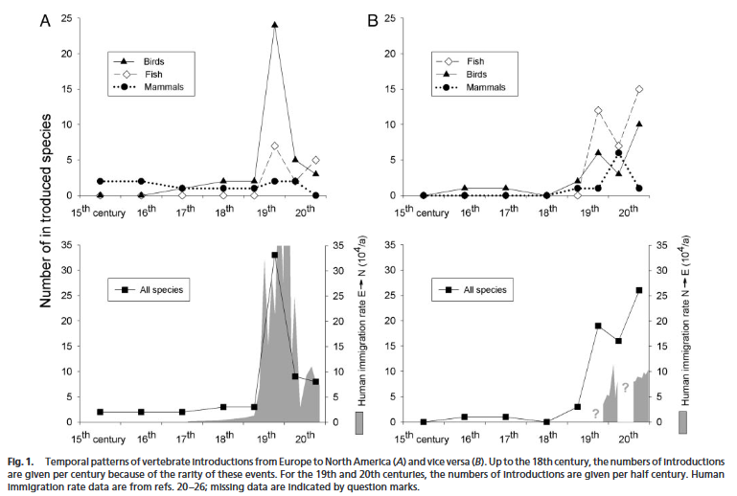
How are the species moving around?
To a large degree, with people

Slide 10
how do freshwater Vertebrates move around?
Pathway | Intentional
Sportfishing | 114
Bait bucket | 84
Aquariums | 81
Forage | 47
Stocked (commercial) | 21
Conservation (released outside range for new habitat) | 21
For food (farming) | 23
Ornamental | 18
Biocontrol | 14
Pathway | Unintentional
Aquaculture | 50
Canals | 41
Stock contamination | 31
Unknown | 15
Ballast water | 4
Imported live food | 3
From: Claudi and Leach (1999)

Slide 11
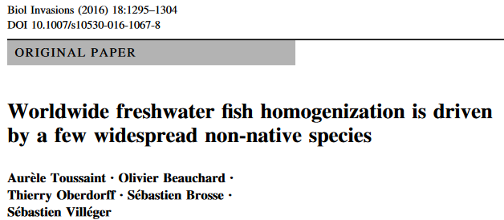
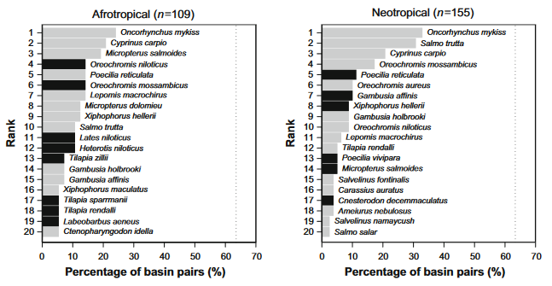
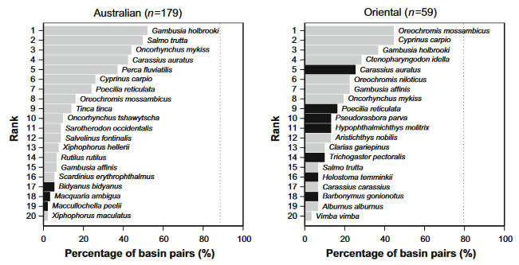
How big of a problem is this?
“The 20 most frequently introduced species account for 28.6(in the Neotropics) to 45.5 % (in the Afrotropics) of the number of species introduced in each realm.”
The 20 most frequently introduced species account for “74 % (691/1222) of the introduction events in the Neotropics, 76 % (113/149) in Oriental, 82 %(128/156) in Afrotropical and 91 % (369/406) in Australian realms”

Slide 12
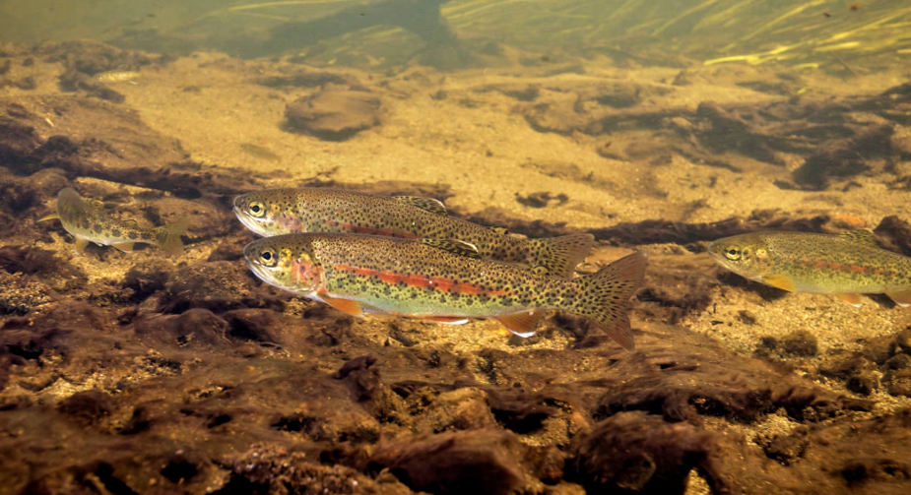
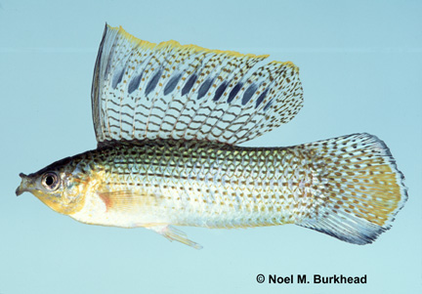
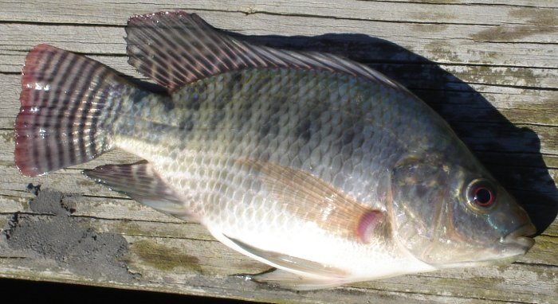
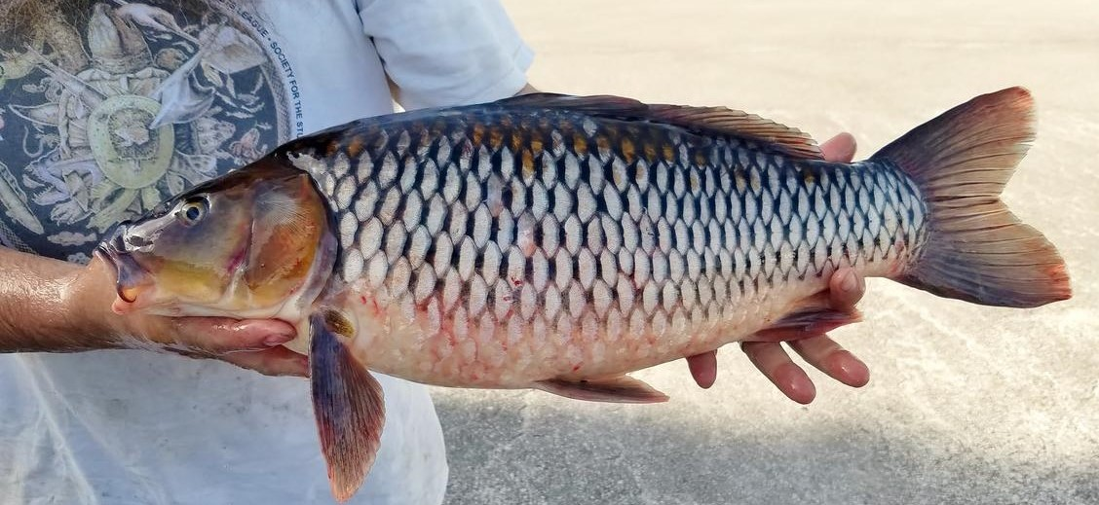
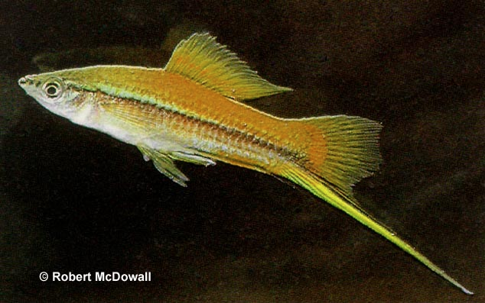
What species are we talking about?
Onchorhynchus mykiss/
other Oncorhynchuys/
Salmo trutta
Gambusia/
Poecilia
Oreochromis niloticus/
other Oreochromis/
Tilapia
Cyprinus carpio
Xiphophorus helleri
https://nas.er.usgs.gov

Slide 13
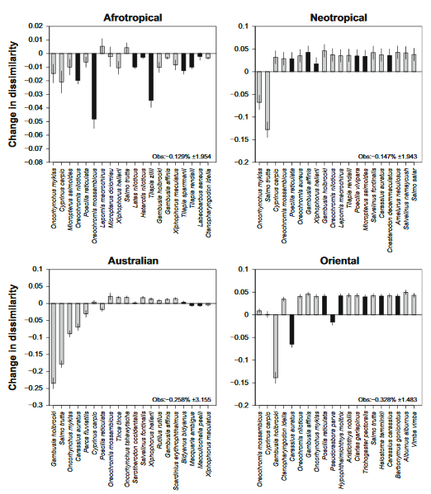
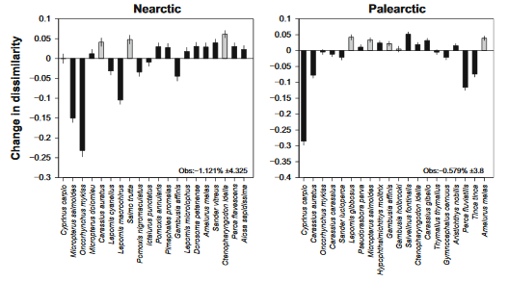
In many cases, the introductions cause systems to become more similar to each other

Slide 14
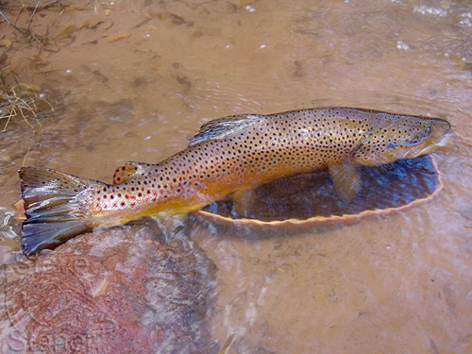
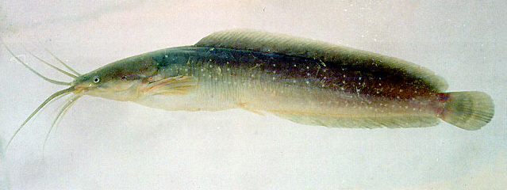
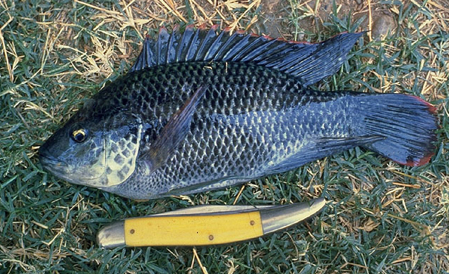
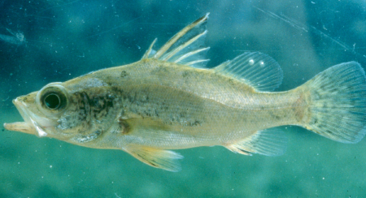
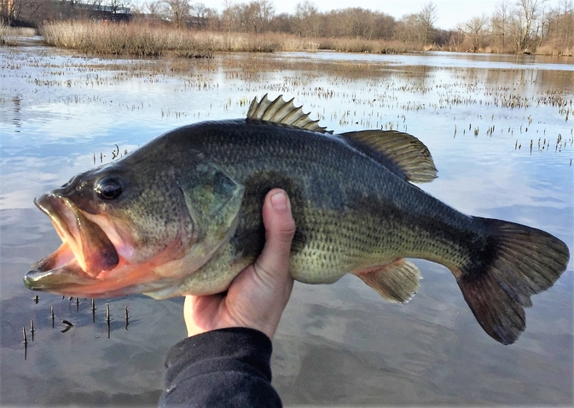
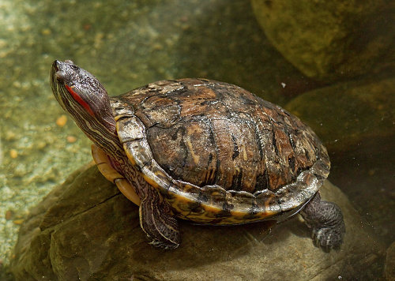
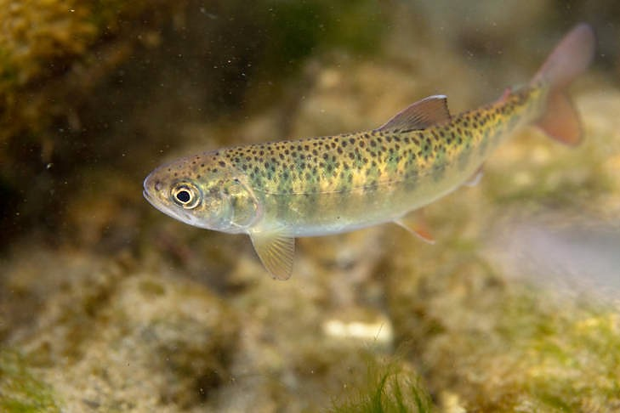
The IUCN’s worst 100
Salmo trutta
(brown trout)
Clarias batrachus
(walking catfish)
Oreochromis mossambicus
(Mozambique tilapia)
Cyprinus carpio
(common carp)
Gambusia affinis
(western mosquitofish)
Lates niloticus (Nile perch)
Micropterus salmoides
(largemouth bass)
Trachemys scripta
(red-eared slider)
Oncorhynchus mykiss
(rainbow trout)
https://nas.er.usgs.gov

Slide 15
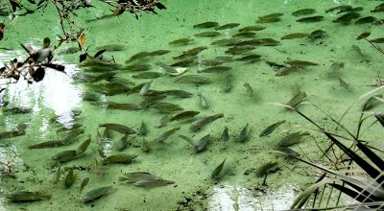
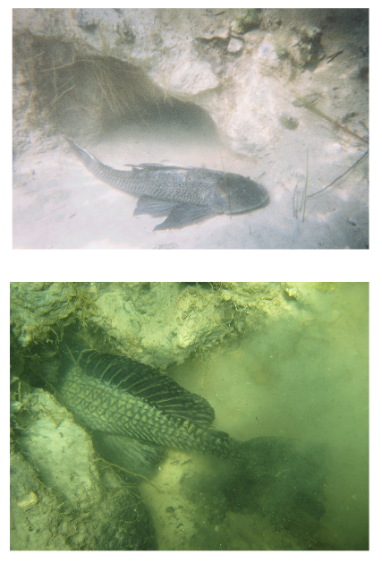
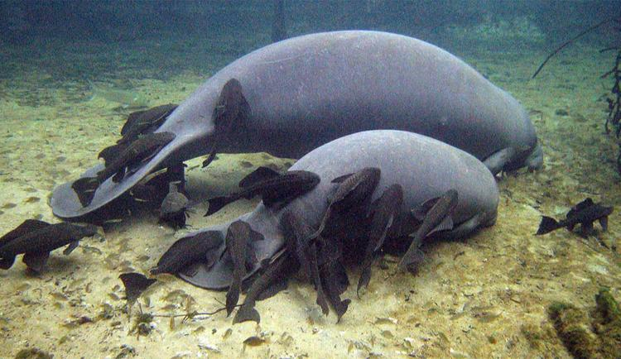
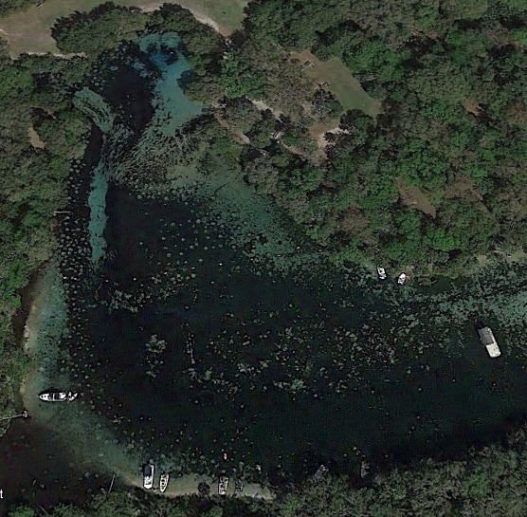
Nonindigenous species can become superabundant
Google Earth
https://www.reabic.net/journals/mbi/2015/3/MBI_2015_Hill_Sowards.pdf
http://www.virginislandsdailynews.com/ap/manatees-face-new-challenge-in-florida-from-harassing-non-native/article_0abe0101-88ba-5b35-af1c-0d43ba38a329.html
https://sites.google.com/site/ocklawahamanpaulnoscareports/snook-and-tarpon-at-silver-springs-near-ocala?tmpl=%2Fsystem%2Fapp%2Ftemplates%2Fprint%2F&showPrintDialog=1

