Slide 1
No differences in taste reactivity and neural responses in the amygdala in rats to 1.0 M NaCl following sodium deprivation
Andrew MacNeil
Dr. King

Slide 2
Importance of Sodium
Sodium is an essential ion in the body
Must be closely regulated for homeostasis – Renin-Angiotensin Aldosterone system
Sodium deprivation studies provide insight to the functioning of the gustatory system
Decreased responsiveness to salt following deprivation (Contreras and Frank, 1979)

Slide 3
Sodium Deprivation Studies
Various hypotheses proposed to explain changes in rats’ consumption patterns following deprivation
Taste neophobia (Lin et al., 2012) – unlikely
Perceptual taste change (St. John, 2017) – unlikely
Sodium appetite (Lundy, 2008)
Hedonic value (Lundy, 2008)

Slide 4
Chemoreception Pathway
Oral Cavity
Rostral Nucleus of the Solitary Tract
Parabrachial Nucleus
Lateral Hypothalamus
Amygdala
Gustatory Cortex
Reticular Formation

Slide 5
Amygdala
Responsible for emotional and behavioral responses
13 subnuclei divided into functional groups
Central Amygdala (CeA)
Basolateral Amygdala (BLA)
Has been linked to sodium appetite (Tandon et al., 2012)
Increased neural activity in rostral areas of brain from salt consumption after deprivation (Patuskovas et al., 2003)

Slide 6
Hypothesis
If rats are deprived of sodium:
Their behavioral response to 1.0 M NaCl infusion would be ingestive because the deprived rat is less sensitive to higher concentrations of sodium
Neural stimulation of the amygdala would be greater in sodium-depleted rats because of the amygdala’s involvement in signaling for sodium ingestion

Slide 7
Animals and Surgery
8 male Wistar rats (N’s = 4)
Sodium-deprived (0.01% NaCl) vs. control (0.3% NaCl)
Surgical implantation of intra-oral cannulas
One week recovery period

Slide 8
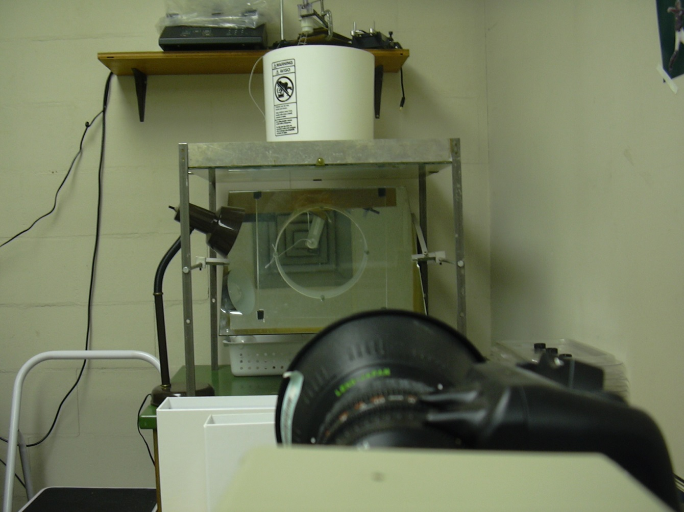
Taste Reactivity
Taste reactivity – most reliable test
Eliminates binary decision making and post-ingestive feedback (Curtis et al., 2001; Grill and Norgren, 1978)
Ingestive vs. Aversive behaviors (Spector et al., 1988)
5 minute testing period with 1.0 M NaCl dispensed at 0.233 mL/min

Slide 9
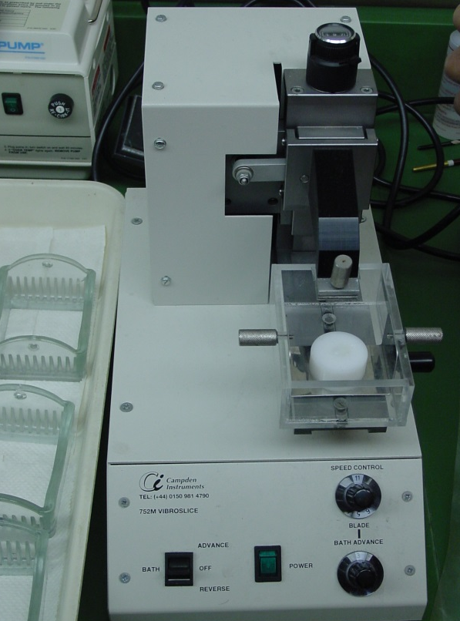
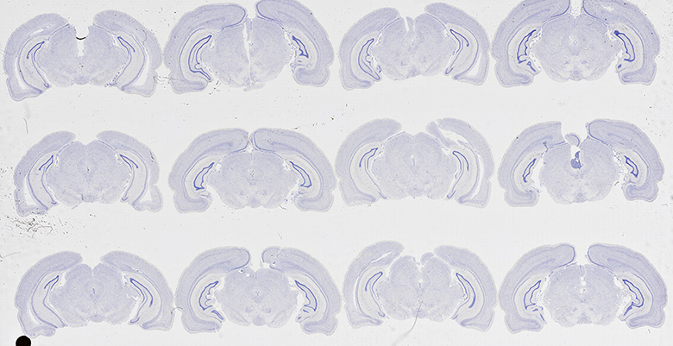
Immunohistochemistry and Histology
Rats sacrificed via sodium pentobarbital (80 mg/kg)
Vibratome used to make 75 µm thick coronal sections
Half of the sections treated with series of antibodies and KPBS rinses
c-Fos rabbit polyclonal IgG
Biotinylated goat anti-rabbit IgG
Alternate sections were Nissl stained with 0.1% thionin

Slide 10
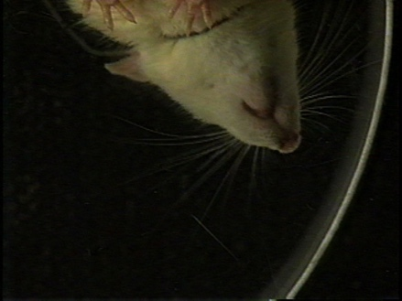
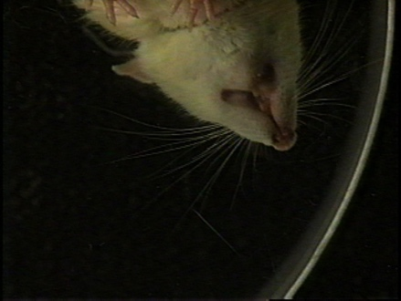
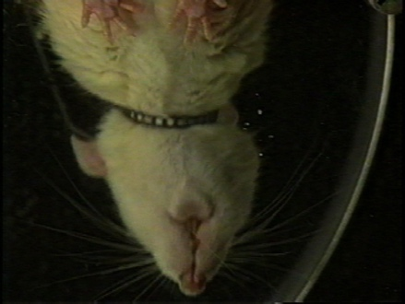
Taste Reactivity
A
B
C
Figure 1. Examples of different taste reactivity behaviors during experimental testing with 1.0 M NaCl.
Notes:
TP, LTP, MM, PL, LF
G, CR, FF, HS

Slide 11
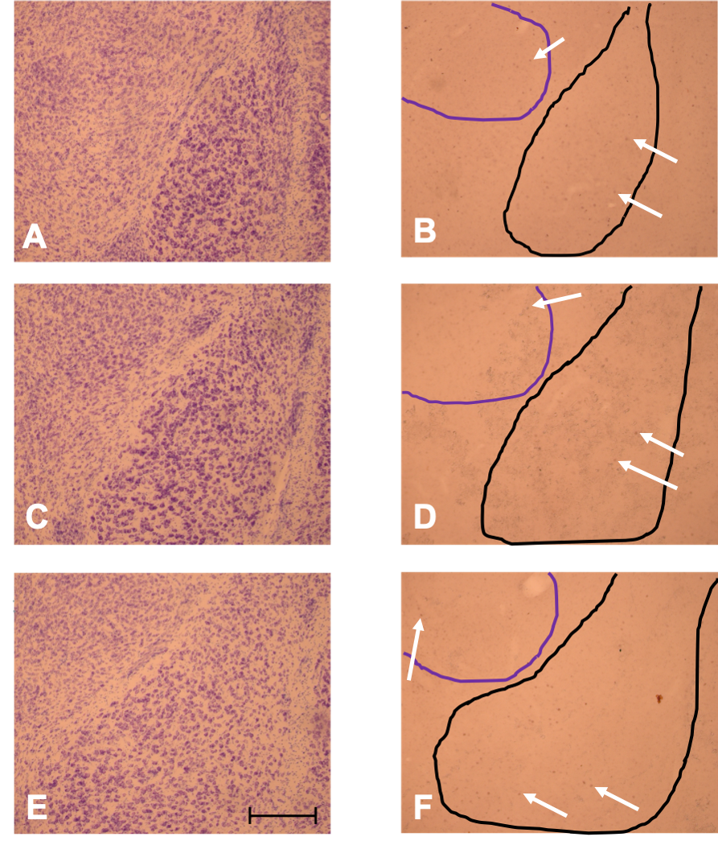
Neuron Counts
Figure 2. Nissl-stained and Fos-stained rat brain tissue used to count activated neurons in the amygdala.
500 µm

Slide 12
Data Analysis
Unpaired t-tests were used to analyze the following data:
Taste Reactivity
Fos Immunohistochemistry
Ingestive vs Aversive
Individual types of behaviors
Total overall behaviors
Behaviors during the first minute
Total overall Fos stained neurons
Total neurons in CeA
Total neurons in BLA
L and R sides of the brain
Caudal, middle, and rostral portions of the amygdala

Slide 13
Results – Taste Reactivity
Figure 3. Mean number of ingestive and aversive taste reactivity behaviors in sodium-deprived and control group rats (p > 0.05).

Slide 14
Results – Neural Activity
Figure 4. Mean number of Fos neurons in subsections of the amygdala in sodium-deprived and control group rats.

Slide 15
Discussion
Hypothesis unsupported:
No difference in taste reactivity behaviors between sodium-deprived and control rats
No difference in neuron counts in the amygdala between sodium-deprived and control rats

Slide 16
Discussion
Taste reactivity results largely unanticipated
Lundy (2008) suggests increase in consumption of sodium after deprivation
Guerra (2019) reports data supporting the hedonic value hypothesis
Possible Explanations
Hyperactivity in some rats
Examining the wrong region of the brain
Novel 1.0 M NaCl elicited fear response (Douglass et al., 2017)

Slide 17
Future Experiments
Expand sample size
Focus on reticular formation
Increase concentration beyond 1.0 M NaCl
Further studies needed to clarify amygdala’s role in taste perception

Slide 18
Acknowledgements
Thank you:
Dr. King
Stetson Biology Department

Slide 19
Literature Cited
Contreras R.J. and Frank M. 1979. Sodium deprivation alters neural responses to gustatory stimuli. The Journal of General Physiology 73(5): 569-594.
Curtis K.S., Krause E.G., Contreras R.J. 2001. Altered NaCl taste responses precede increased NaCl ingestion during Na⁺ deprivation. Physiology & Behavior 72(5): 743-749.
Douglass A.M., Kucukdereli H., Ponserre M., Markovic M., Gründemann J., Strobel C., Alcala Morales P.L., Conzelmann K., Lüthi A., Klein R. 2017. Central amygdala circuits modulate food consumption through a positive-valence mechanism. Nature Neuroscience 20(10): 1384-94.
Grill H.J. and Norgren R. 1978. The taste reactivity test. I. mimetic responses to gustatory stimuli in neurologically normal rats. Brain Research 143(2): 263-279.
Guerra. 2019. Sodium deprivation in Wistar rats leads to predominantly ingestive taste reactivity behaviors elicited by intra-oral infusion of 1.0M NaCl. Stetson Showcase.
Lin J.Y., Roman C., Arthurs J., Reilly S. 2012. Taste neophobia and c-fos expression in the rat. Brain Research 1448: 82-88.
Lundy, R.F. 2008. Gustatory hedonic value: Potential function for forebrain control of brainstem taste processing. Neuroscience and Biobehavioral Reviews 32(8): 1601-1606.
Pastuskovas C.V., Cassell D.M., Johnson A.K., Thunhorst R.L. 2003. Increased cellular activity in rat insular cortex after water and salt ingestion induced by fluid depletion. American Journal of Physiology - Regulatory, Integrative and Comparative Physiology 284(4): 1119-1125.
St John, S.J. 2017. The perceptual characteristics of sodium chloride to sodium-depleted rats. Chemical Senses 42(2): 93-103.

