Slide 1
Synchronous Air-Breathing as a Response to Hypoxia Exposure in Two Size Classes of Juvenile Armored Catfish, Pterygoplichthys disjunctivus
Abigail Crater
Advisor: Dr. Melissa Gibbs

Slide 2
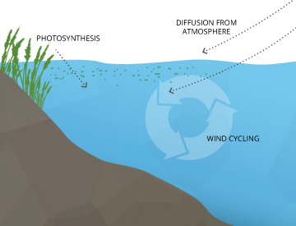
Dissolved Oxygen
Impacts feeding habits, and energy expenditure of marine organisms as well as water quality management.
Low DO → Hypoxia
Levels are decreasing globally (1-7%).
Causes for decrease:
Anthropogenic activities
Natural conditions of the environment
Climate change
https://www.fondriest.com/environmental-measurements/parameters/water-quality/dissolved-oxygen/

Slide 3
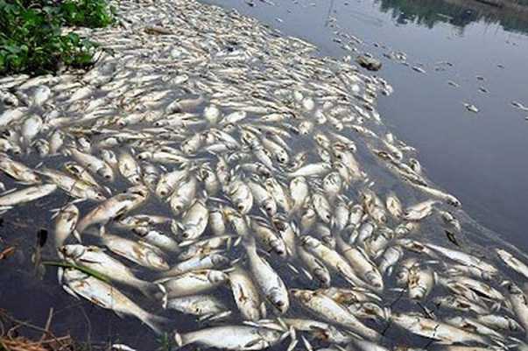
Hypoxia in Fish
Aerobic respiration is driven by the oxygen gained from DO in the water.
Hypoxia in fish is defined as the partial pressure of oxygen at which physiological functions are hindered.
Can disrupt the physiological homeostasis of fish.
Air-Breathing is an example of a coping mechanism.
https://www.sunstar.com.ph/article/166864

Slide 4
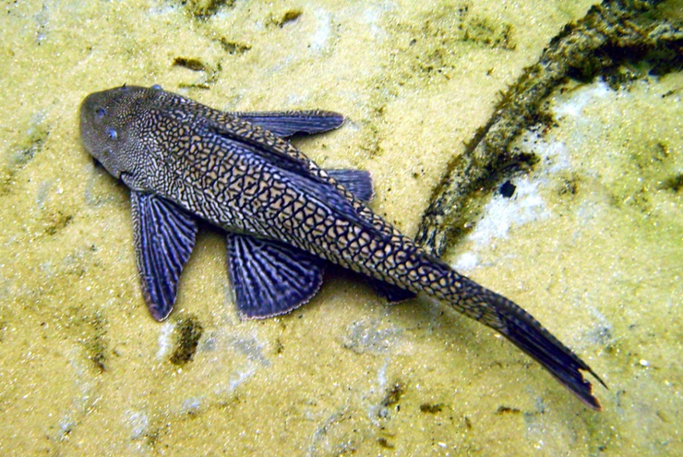
Armored Catfish (Pterygoplichthys disjunctivus)
M. Gibbs

Slide 5
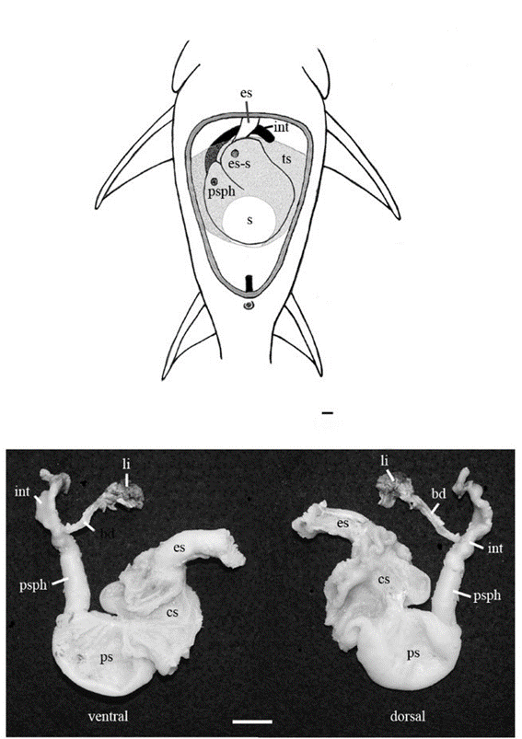
Armored Catfish & Air-Breathing
Gibbs & Groff
Can breathe air directly with their Air-Breathing Organ (ABO).
ABO evolved from:
Changes in the gastrointestinal tract (stomach or intestines),
Increase in surface area of the oral cavity,
Vascularization of the swim bladder
Likely evolved from the hypoxic conditions of the flooded forests of the Amazon, where armored catfish originate.
Facultative air-breathers (only when in low DO)

Slide 6
Air-Breathing Behavior
One observed air-breathing behavior: Synchronicity
Occurs when individuals swim up to breathe air in a group or in rapid succession.
Caused by predation pressure because group air-breathing reduces an individual’s risk of being preyed upon.
Influenced by aggression by more dominant individuals.
Little lab research on this behavior in various degrees of DO.

Slide 7
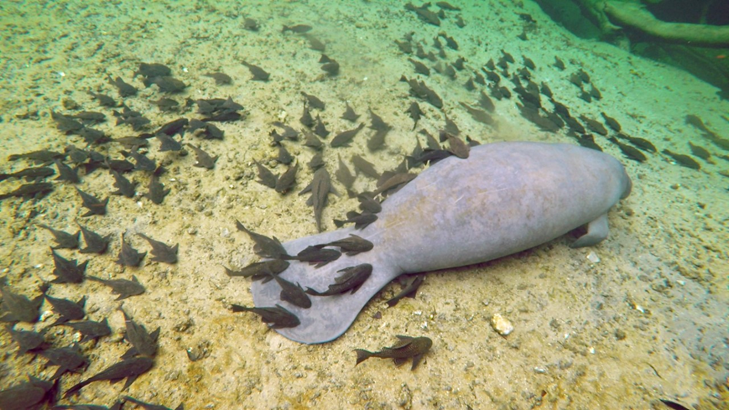
Armored Catfish in Blue Spring
In 1998, P. disjunctivus was found to be an invasive species in Blue Spring, FL.
Juvenile armored catfish are not in the hypoxic spring run of Blue Springs. Why???
Is this because smaller catfish are more vulnerable to hypoxia and predation???

Slide 8
Size Matters
In fish, mass-specific metabolic rate ↓ as size ↑
Smaller individuals will have a higher metabolic rate and require more oxygen than larger individuals.
Smaller armored catfish need to surface more often under hypoxic conditions.
Remember: group air-breathing is driven by the more dominant (larger) individuals.
Smaller armored catfish may not be in Blue Spring because the adjoining St. Johns River is safer.
https://www.jstor.org/stable/24321983?seq=4#metadata_info_tab_contents

Slide 9
Hypotheses
I hypothesized that smaller juvenile armored catfish would exhibit a greater amount of synchronous behavior than the larger juveniles.
I hypothesized that the overall amount of synchronous behavior would decrease as the water became more normoxic.

Slide 10
Methods
Observe 2 size classes of armored catfish under different DO levels.
Small juveniles: average size - 7 cm SL
Medium juveniles: average size - 16 cm SL
2 home tanks and 2 test tanks.
3 sources of water.
DO levels in test tanks changed daily (large adult armored catfish, air bubbler).
3 ranges of DO:
Low: 0.5-3.0 mg O₂/L
Medium: 3.1-6.0 mg O₂/L
High: 6.1-9.0 mg O₂/L
DO measured with a YSI Multiparameter Probe.

Slide 11
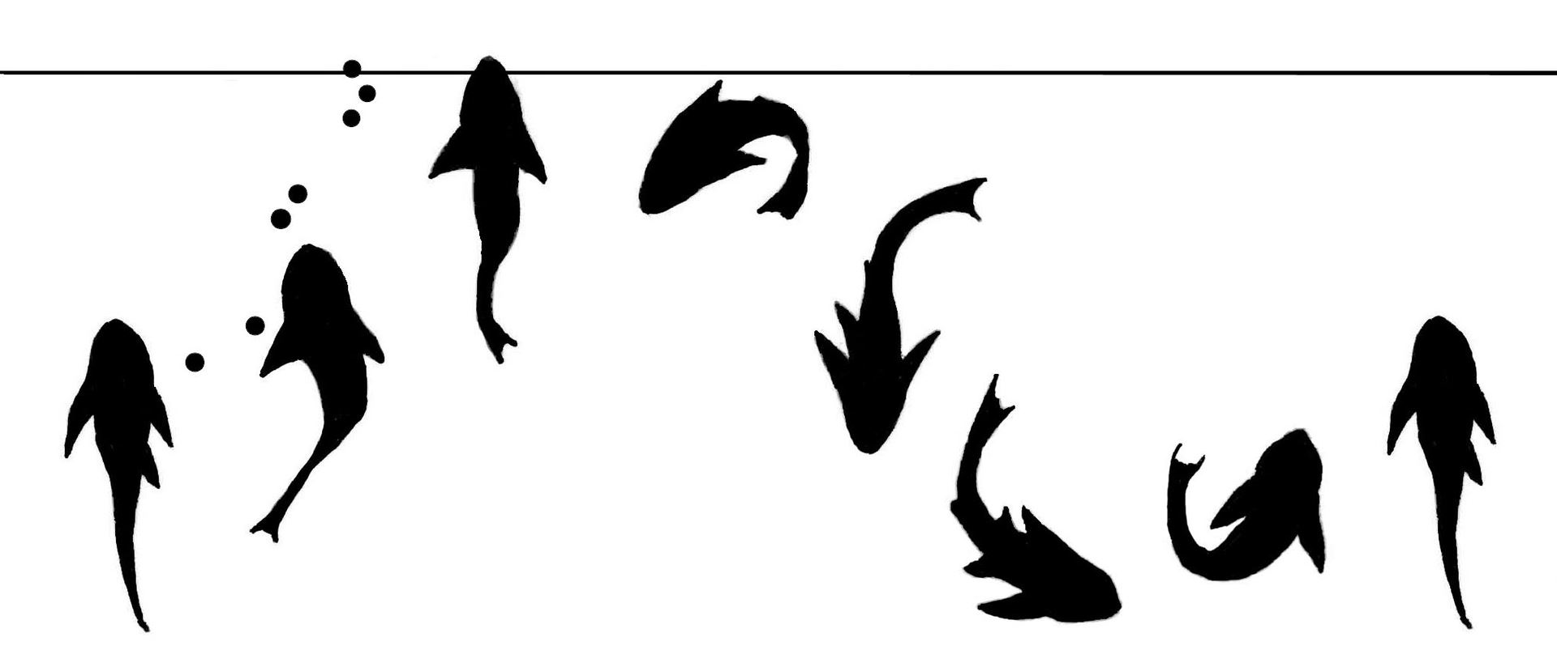
Each group (small vs. medium) in test tank for 30 minutes then swap test tanks for another 30 minutes.
Video recorded with a GoPro7.
Tally air breaths in 1 minute intervals.
Coefficient of Dispersion (CD).
One sample t-test to test if the average CD for each size class was statistically different from one.
All CDs plotted against DO to find the proportion of variance (R²) values.
Regression analysis.

Slide 12
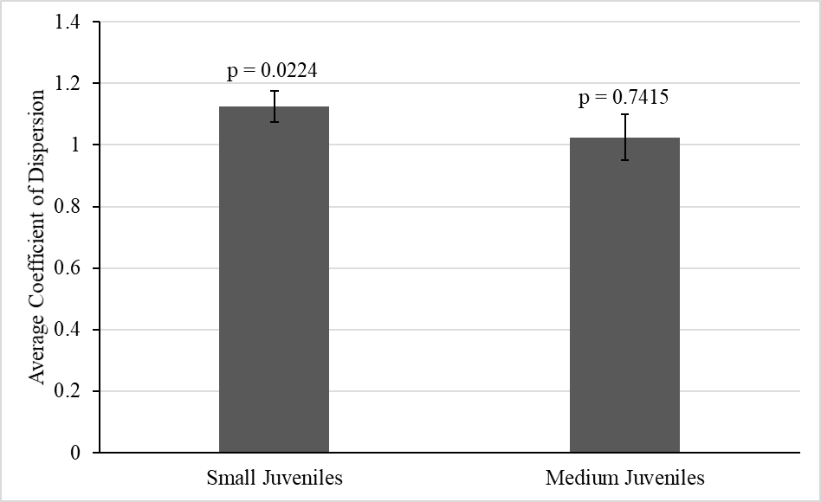
Results
*
Small Juveniles:
CD values significantly higher than 1.
Medium Juveniles:
CD values not significantly different than 1.

Slide 13
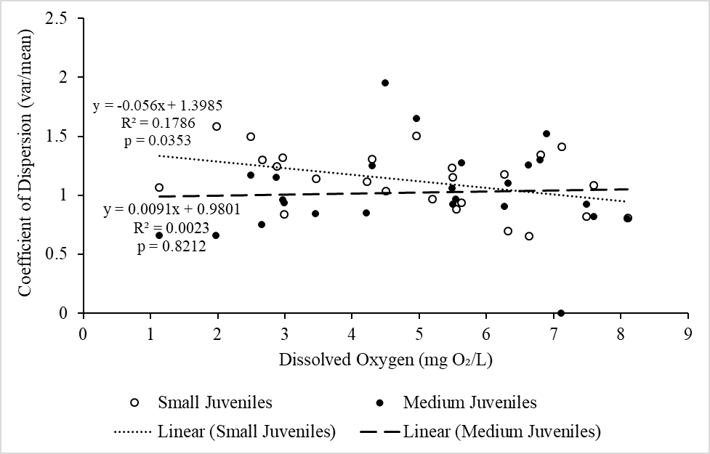
Results
*
Small Juveniles:
Significant negative relationship between CD values and DO levels.
Medium Juveniles:
No significant relationship between CD values and DO levels.

Slide 14
Conclusion
These results supported my 1st hypothesis that the smaller juvenile armored catfish would demonstrate greater levels of synchronous behavior than the medium juvenile armored catfish.
Small juveniles demonstrated synchronous air-breathing behavior.
Medium juveniles demonstrated uniform air-breathing behavior (no synchronicity).

Slide 15
Conclusion
The inconsistency in the trends between the small and medium juvenile armored catfish with DO levels does not support my 2nd hypothesis that the amount of synchronous behavior would decrease for both size classes as the water became more normoxic.
However, this further supports my hypothesis that smaller catfish would exhibit more synchronicity than larger catfish.

Slide 16
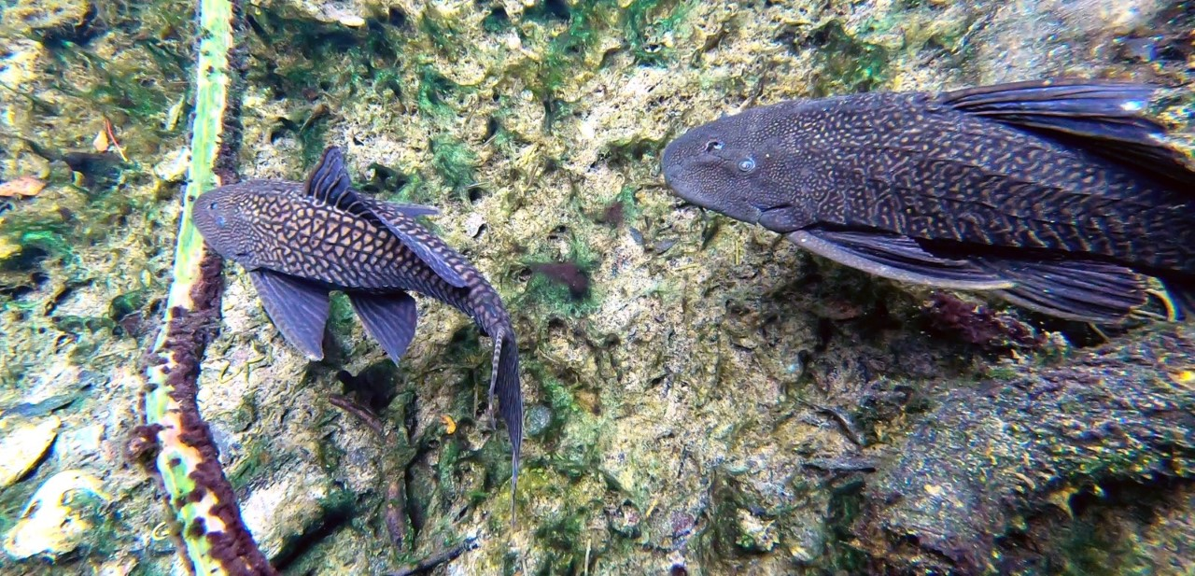
Overall
Synchronous air-breathing is led by dominant fish, but the smaller armored catfish are more vulnerable to changes in DO than larger armored catfish, which may be why smaller juveniles are not found in the hypoxic Blue Spring.

Slide 17
Limitations
Differences in fish behavior between fish in the lab and fish in the field.
Possible DO threshold that we did not meet.
Differences in water sources may or may not have affected the results.
Fish death!

Slide 18
Acknowledgements
I thank Dr. Gibbs for being a great research advisor.
I thank the Stetson University Department of Biology.

Slide 19
Literature Cited
Aboagye, D. L., & Allen, P. J. (2018) Effects of acute and chronic hypoxia on acid–base regulation, hematology, ion, and osmoregulation of juvenile American paddlefish. Journal of Comparative Physiology.B, Biochemical, Systemic, and Environmental Physiology, 188(1): 77-88.
Castanheira, M. F., Herrera, M., Costas, B., Conceição, L.,E.C., & Martins, C. I. M. (2013) Can we predict personality in fish? Searching for consistency over time and across contexts. PLoS One, 8(4): 1-9.
Chapman, L., & Chapman, C. (1994) Observations on synchronous air breathing in Clarias liocephalus. Copeia, 1994(1): 246-249.
Chen, Y., Yu, H., Cheng, Y., Cheng, Q., & Li, D. (2018) A hybrid intelligent method for three-dimensional short-term prediction of dissolved oxygen content in aquaculture. PLoS One, 13(2): 1-17.
Da Cruz, A. L., Da Silva, H. R., Lundstedt, L., Schwantes, A. R., Moraes, G., Klein, W., & Fernandes, M. N. (2013) Air-breathing behavior and physiological responses to hypoxia and air exposure in the air-breathing Loricariid fish, Pterygoplichthys anisitsi. Fish Physiology and Biochemistry, 39(2): 243-56.
Friedrich, J., Janssen, F., Aleynik, D., Bange, H. W., Boltacheva, N., Çagatay, M. N., … Wenzhöfer, F. (2014) Investigating hypoxia in aquatic environments: Diverse approaches to addressing a complex phenomenon. Biogeosciences, 11(4): 1215.
Gibbs, M. A., & Groff, B. W. (2014) Patterns of aerial respiration by Pterygoplichthys disjunctivus (Loricariidae) in Volusia Blue Spring, Florida. Florida Scientist, 77(2), 53-68.
Herbert, N. A., Skjæraasen, J., E., Nilsen, T., Salvanes, A. G. V., & Steffensen, J. F. (2011) The hypoxia avoidance behaviour of juvenile Atlantic cod (Gadus morhua L.) depends on the provision and pressure level of an O₂ refuge. Marine Biology, 158(4): 737-746.
Irby, I. D., Friedrichs, M. A. M., Da, F., & Hinson, K. E. (2018) The competing impacts of climate change and nutrient reductions on dissolved oxygen in Chesapeake Bay. Biogeosciences, 15(9), 2649-2668.
Killen, S. S., Esbaugh, A. J., Martins, N. F., Rantin, F. T., & McKenzie, D. J. (2017) Aggression supersedes individual oxygen demand to drive group air-breathing in social catfish. Journal of Animal Ecology, 87(1): 223-234.
Kramer, D., & Graham, J. (1976) Synchronous Air Breathing, A Social Component of Respiration in Fishes. Copeia, 1976(4), 689-697.
MacCormack, T. J., McKinley, R. S., Roubach, R., Almeida-Val, V., & Al, E. (2003) Changes in ventilation, metabolism, and behaviour, but not bradycardia, contribute to hypoxia survival in two species of Amazonian armoured catfish. Canadian Journal of Zoology, 81(2): 272-280.
Nilsson, G. E., Östlund-Nilsson, S. (2008) Does size matter for hypoxia tolerance in fish? Biological Reviews, 83: 173-189.
Scott, G. R., Matey, V., Mendoza, J., Gilmour, K. M., Perry, S. F., Almeida-val, V., & Val, A. L. (2017) Air breathing and aquatic gas exchange during hypoxia in armoured catfish. Journal of Comparative Physiology.B, Biochemical, Systemic, and Environmental Physiology, 187(1): 117-133.
Spietz, R. L., Williams, C. M., Rocap, G., & Horner-Devine, M. (2015) A dissolved oxygen threshold for shifts in bacterial community structure in a seasonally hypoxic estuary. PLoS One, 10(8): 1-18
Stehfest, K. M., Carter, C. G., McAllister, J. D., Ross, J. D., & Semmens, J. M. (2017) Response of Atlantic salmon Salmo salar to temperature and dissolved oxygen extremes established using animal-borne environmental sensors. Scientific Reports (Nature Publisher Group), 7: 1-10.
Work, K., Gibbs, M., Peters, B., & French, L. (2010). Fish Assemblage Variability in a Florida Spring. Southeastern Naturalist, 9(4), 649–672.

