Slide 1
Deactivating the WntA gene in Vanessa cardui using CRISPR-cas9 Technology
Aamani Thulluru
Stetson University
Biology

Slide 2
Diverse Butterfly Wing color and Patterning

Slide 3
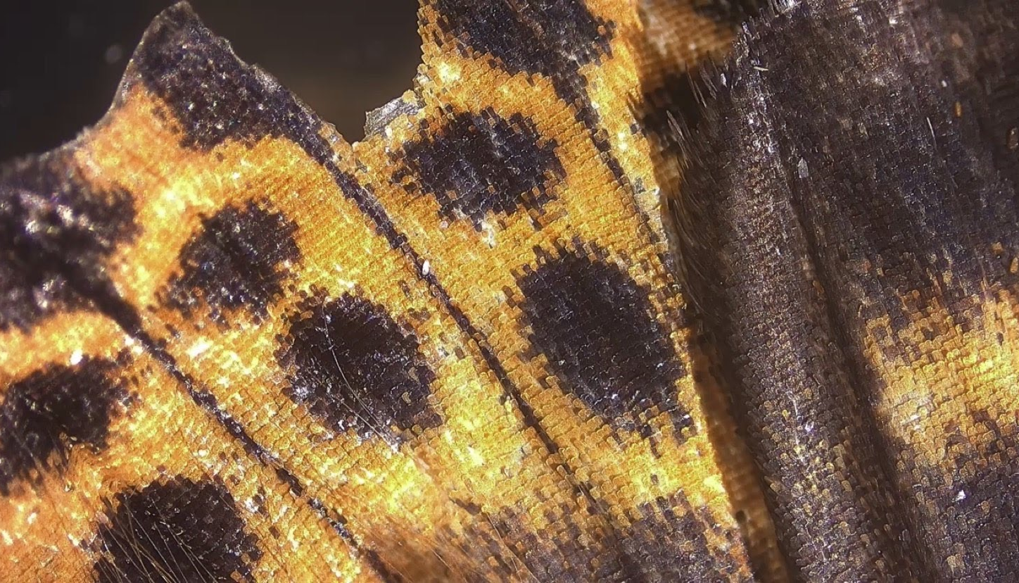
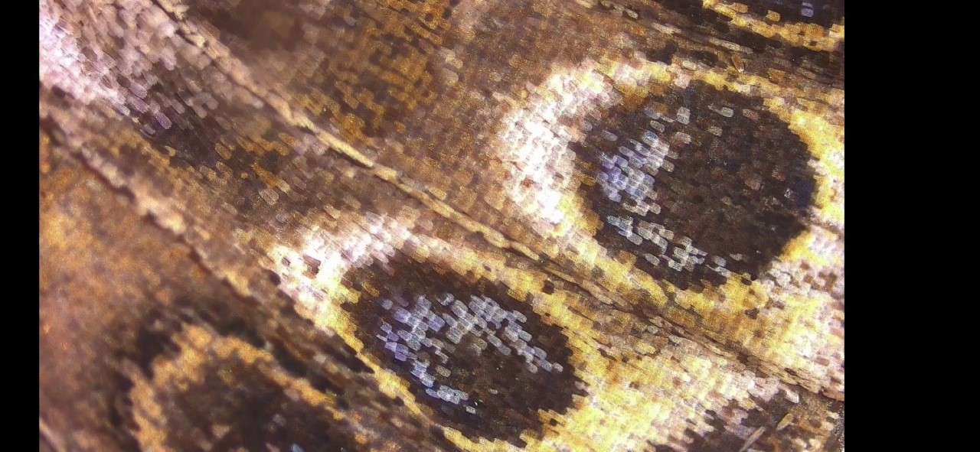
Butterfly Wing Colors
Butterfly wings are made up of scales
Scale color is derived from chemical pigments (yellow, orange, black) or structural shape (iridescent blue)

Slide 4
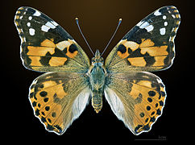
Vanessa Cardui
Vanessa cardui are painted lady butterflies
Exist everywhere except S. America and Antarctica
Scientists are interested in investigating genes that regulate wing patterning, color, and eyespots
Using drugs to inhibit gene products/proteins (Serfas and Carroll 2005)
Recently, using gene editing tool to deactivate specific genes (Mazo-Vargas et al. 2017)

Slide 5
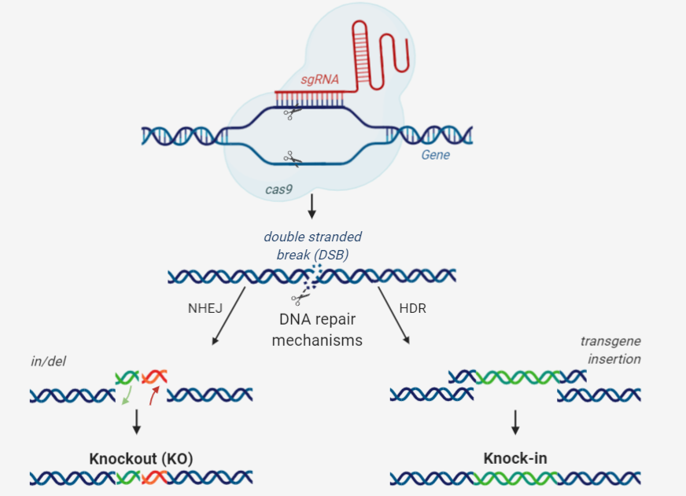
Studying gene function in Organisms through Gene editing Technique: CRISPR
CRISPR: Clustered Regularly Interspaced Short Palindromic Repeats
Effective, cheap, and faster than previous gene editing tools
Isolated as an adaptive immune system in bacteria to cut viral DNA and prevent viral infection
Adapted by scientists to make specific nucleotide change in desired gene
Use sgRNA and cas9 to make double-stranded break (DSB)
Cellular DNA repair of DSB leads to
Gene knockout (KO)
Knock-in

Slide 6
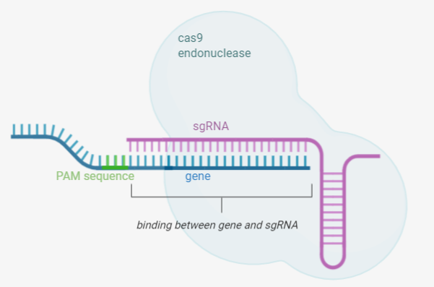
Programming CRISPr-cas9 to desired gene
Easily customizable to different genes of interest through sgRNA design
single guide RNA (sgRNA)
100 nucleotides long
First 20 nucleotides is complementary to target sequence in gene
Next to PAM sequence (NGG) in gene, which helps target cas9 to desired gene sequence
Binds to cas9 endonuclease to find and cut the target site in gene

Slide 7
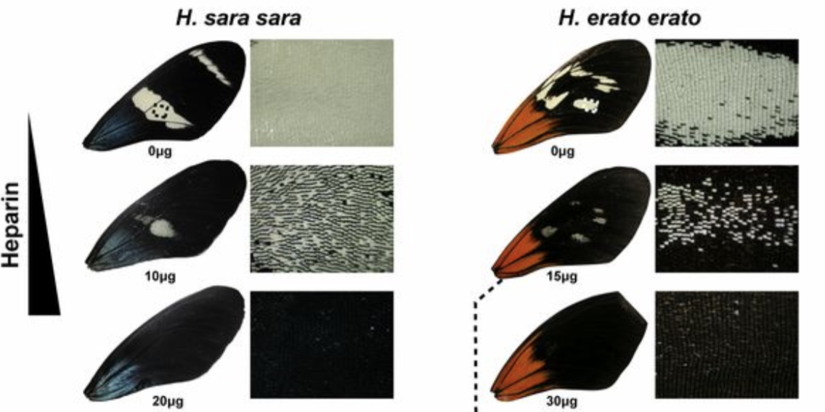
WntA role in butterFly wing color and patterning
Martin et al. 2012
Pharmacological inhibition of Wnt ligand using heparin in Heliconius butterflies
Expansion of black pigmentation in forewing
No effect on iridescence or red color
WntA regulates pattern formation and variation
WntA gene codes for Wnt ligand
WntA has a role in wing patterning in V. cardui and in other butterfly species, like: Junonia coenia, Pararge aegeria, Heliconius erato demophoon, H. sara sara, Agraulis vanillae, and Danaus plexippus (Mazo-Vargas et al. 2017)

Slide 8
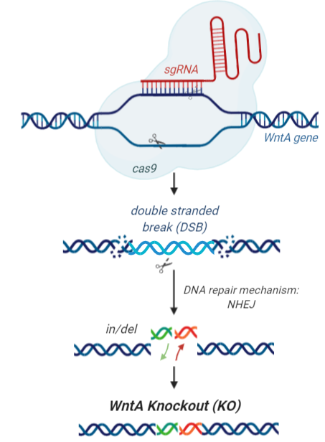
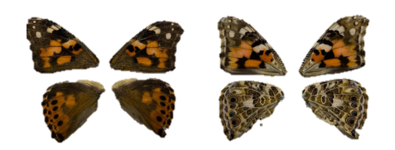
EXPERIMENTAL GOAL:
Investigating WntA gene function in V. cardui butterfly wing color and patterning through deactivation of WntA gene by CRISPR-cas9 gene editing technology
HYPOTHESIS:
Microinjection of CRISPR-cas9 system (cas9 + sgRNAs targeting WntA gene) into V. cardui eggs will result in mutant individuals with reduced ommochrome, or yellow-orange pigmentation and with deletions of nucleotides in the WntA gene in the area surrounding the guide RNAs.
Inject cas9/guideRNAs into eggs
Assay for wing colors (black, orange, etc) and pattern

Slide 9
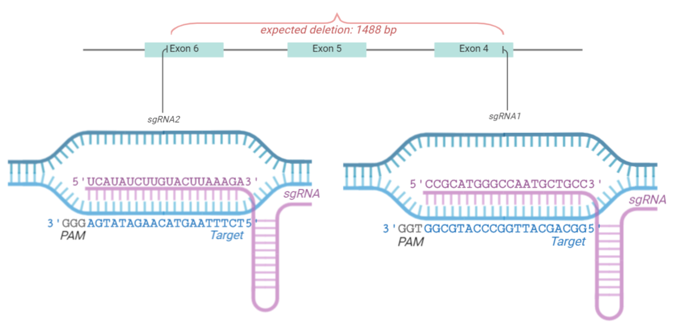
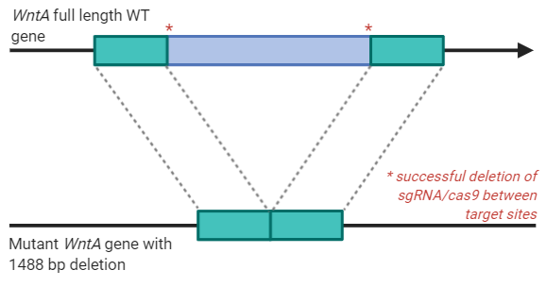
Methods: Step 1. DESIGNING GUIDE RNAs TO WntA
WntA
Exon 4
Exon 6
Exon 4
Exon 6

Slide 10
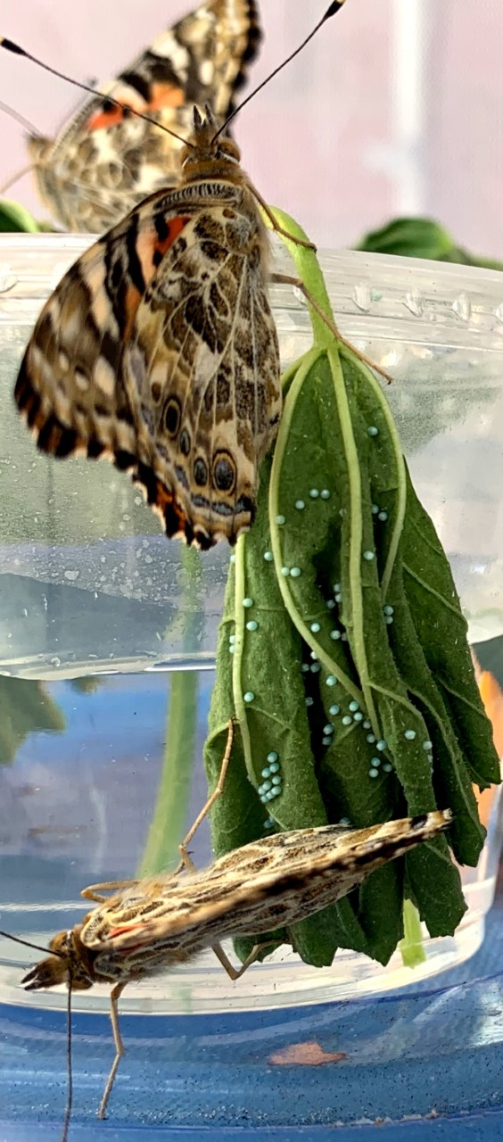
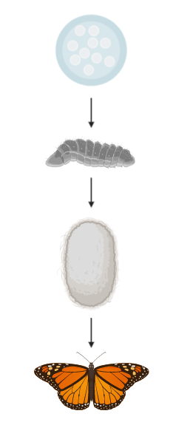
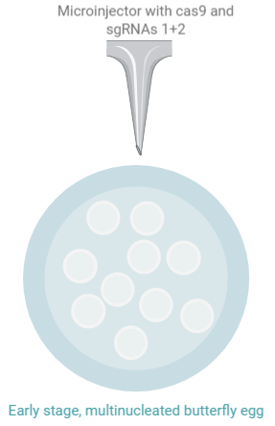
Methods
Step 3. Rearing
Step 2. Microinjecting sgRNAs and cas9 (500 eggs)
Collect eggs on leaves
3. Wing Phenotypic Analysis

Slide 11
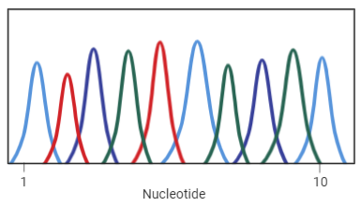
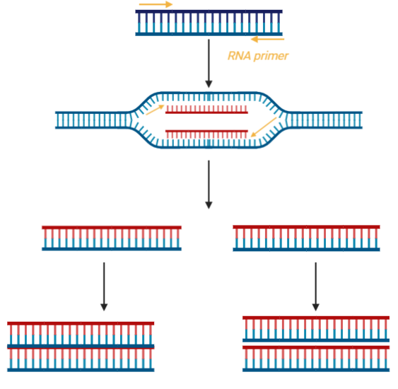
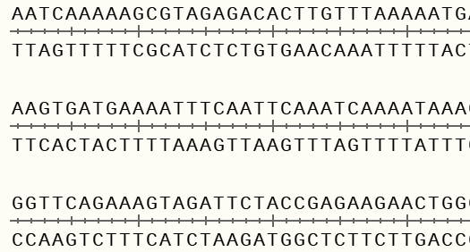
Methods
Screening for mutants through molecular analyses (20 larva caterpillars and 150 butterflies)
4. Polymerase Chain Reaction
5. DNA gel electrophoresis of PCR Product
6. DNA Sequencing
WntA gene
primers
Longer DNA fragments
Short DNA fragments
Amplifies a DNA sequence of WntA gene between two primers
Separates DNA fragments by size:
wild-type - 2100 bp
deletion mutant - 300 bp
Determines what nucleotide is at each position and yields sequence

Slide 12
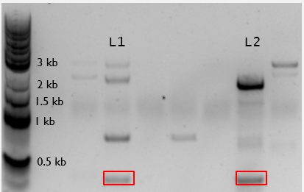
DNA Mutation Analysis of Larval WNTA gene
Gel electrophoresis of PCR product of larval WntA gene
DNA ladder
WT
Mutants 1 and 2 had approximately 1480 nucleotides deleted
DNA sequence alignment of wild-type reference gene to wild-type and mutant DNA sequencing results
--- indicates deleted nucleotides

Slide 13
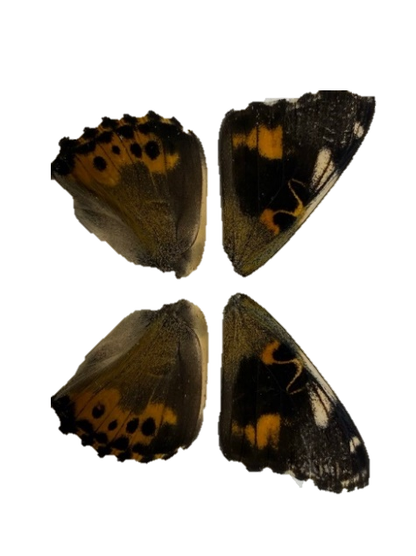
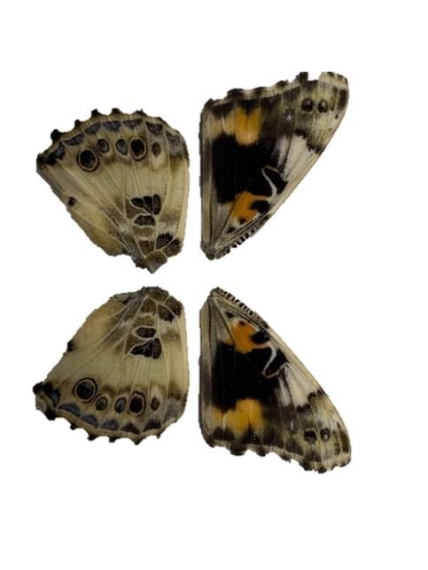
Butterfly Mutant 1
WING Phenotypic Analysis of Mutant Butterflies
Gel electrophoresis of PCR product of phenotypic mutant butterfly WntA gene
6-1
Wild Type
6-2
DNA sequence alignment of wild-type reference gene to wild-type and mutant DNA sequencing results
--- indicates deleted nucleotides
Yellow and orange pigmentation decreased and black pigmentation increased in the mutant butterfly. Different deletions between the guideRNAs occurred in the mutant butterfly; because we see two different bands and distinct deletions, this butterfly is a mosaic.

Slide 14
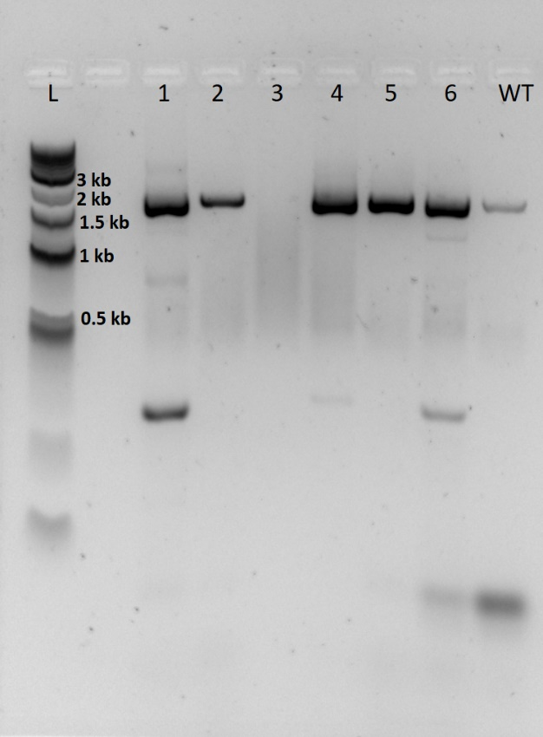
WING Phenotypic Analysis of Mutant Butterflies
Gel electrophoresis of PCR product of phenotypic mutant butterfly WntA gene
Butterfly mutant 2
2-1
Wild Type
DNA sequence alignment of wild-type reference gene to wild-type and mutant DNA sequencing results
--- indicates deleted nucleotides
Yellow and orange pigmentation decreased and black pigmentation increased in the mutant butterfly, but is not consistent on both wings, showing a mosaic phenotype. Smaller deletions occurred between the guideRNAs occurred in the mutant butterfly.

Slide 15
Discussion
Conclusion: hypothesis was supported
Observed mutant genotype (deletions) and phenotype (increased black pigmentation/decreased yellow-orange pigmentation) that differed from wild-type wings
Increase in melanisation in certain regions of fore- and hind-wing; supports findings from Mazo-Vargas study in 2017 even though we used sgRNAs which targeted a new area of the WntA gene
Inhibition of wnt ligand with heparin also showed similar increase in melanin in Heliconius species (Martin et al. 2012).
Challenges and possible errors
sgRNA1 was very close to sequencing primer; choose different primer for better sequencing results
Death of caterpillars and larvae during rearing and injection
Mosaic mutants make it difficult to analyze data

Slide 16
Further Research
Other sgRNAs
Different patterning genes
Knockout multiple patterning genes together
Using CRISPR to facilitate knock-in of genes (fluorescently GFP-tag WntA to visualize expression)

Slide 17
Acknowledgements
Stetson University Biology Department
Luisa Saad, Madisyn Harrison, Elinor Hackett, Justin Pinero
Dr. Heather Evans-Anderson
Dr. Lynn Kee

Slide 18
Literature Cited
Beldade P, Brakefield P. 2002. The genetics and evo–devo of butterfly wing patterns. Nature Reviews Genetics 3: 442-452.
Cong L, Ann Ran F, Cox D, Lin S, Barrito R, Habib N, Hsu P, Wu X, Jiang W, Marraffini L, Zhang F. 2013. Multiplex genome engineering using CRIPSR/Cas systems. Science 339: 819-823.
Li, X., Fan, D., Zhang, W., Liu, G., Zhang, L., Zhao, L., Fang, X., Chen, L., Dong, Y., Chen, Y. and Ding, Y. 2015. Outbred genome sequencing and CRISPR/Cas9 gene editing in butterflies. Nature Communications, 6(1), pp.1-10.
Livraghi L, Martin A, Gibbs M, Braak N, Arif S, Breuker C. 2017. CRISPR/Cas9 as the Key to Unlocking the Secrets of Butterfly Wing Pattern Development and Its Evolution. Advances in Insect Physiology.
Martin, A., Papa, R., Nadeau, N.J., Hill, R.I., Counterman, B.A., Halder, G., Jiggins, C.D., Kronforst, M.R., Long, A.D., McMillan, W.O. and Reed, R.D. 2012. Diversification of complex butterfly wing patterns by repeated regulatory evolution of a Wnt ligand. Proceedings of the National Academy of Sciences, 109(31), pp.12632-12637.
Martin, A., Reed, R.D. 2014. Wnt signaling underlies evolution and development of the butterfly wing pattern symmetry systems. Developmental Biology, 395(2), pp.367-378.
Mazo-Vargas A, Concha C, Livraghi L, Massardo D, Wallbank R, Zhang L, Papador J, Martinez-Najera D, Jiggins C, Kronforst M, Breuker C, Reed R, Patel N, McMillan W, Martin A. 2017. Macroevolutionary shifts of WntA function potentiate butterfly wing-pattern diversity. PNAS 114: 10701-10706.
Özsu, N., Chan, Q.Y., Chen, B., Gupta, M.D. and Monteiro, A. 2017. Wingless is a positive regulator of eyespot color patterns in Bicyclus anynana butterflies. Developmental Biology, 429(1), pp.177-185.
Santos D, Wynant N, Van de Brande S, Verdonckt TW, Mingels L, Peeters P, Kolliopoulou A, Swevers L, Vanden Broeck J. 2018. Insights into RNAi-based antiviral immunity in Lepidoptera: acute and persistent infections in Bombyx mori and Trichoplusiani cell lines. Scientific Reports 8: 2423.
Serfas M, Carroll C. Pharmacologic approaches to butterfly wing patterning: Sulfated polysaccharides mimic or antagonize cold shock and alter the interpretation of gradients of positional information. 2005. Developmental Biology 278: 416- 424.
Zhang L, Martin A, Perry W, van der Burg K, Matsuoka Y, Monteiro A, Reed R. 2017. Genetic Basis of Melanin Pigmentation in Butterfly Wings. Genetics 205: 1537-1550.
Zhang L, Reed R. 2016. Genome editing in butterflies reveals that spalt promotes and Distal-less represses eyespot colour patterns. Nature Communications 7: 11769.
Zhang L, Reed R. 2017. A Practical Guide to CRISPR/Cas9 Genome Editing in Lepidoptera. In: Sekimura T., Nijhout H. (eds) Diversity and Evolution of Butterfly Wing Patterns. Springer, Singapore.
Zhang L, Mazo-Vargas A, Reed R. 2017. Single master regulatory gene coordinates the evolution and development of butterfly color and iridescence. PNAS 114: 10707-10712.

Slide 19
questions

