Slide 1
QEP Topic Selection Survey

Slide 2
Response Demographics

Slide 3
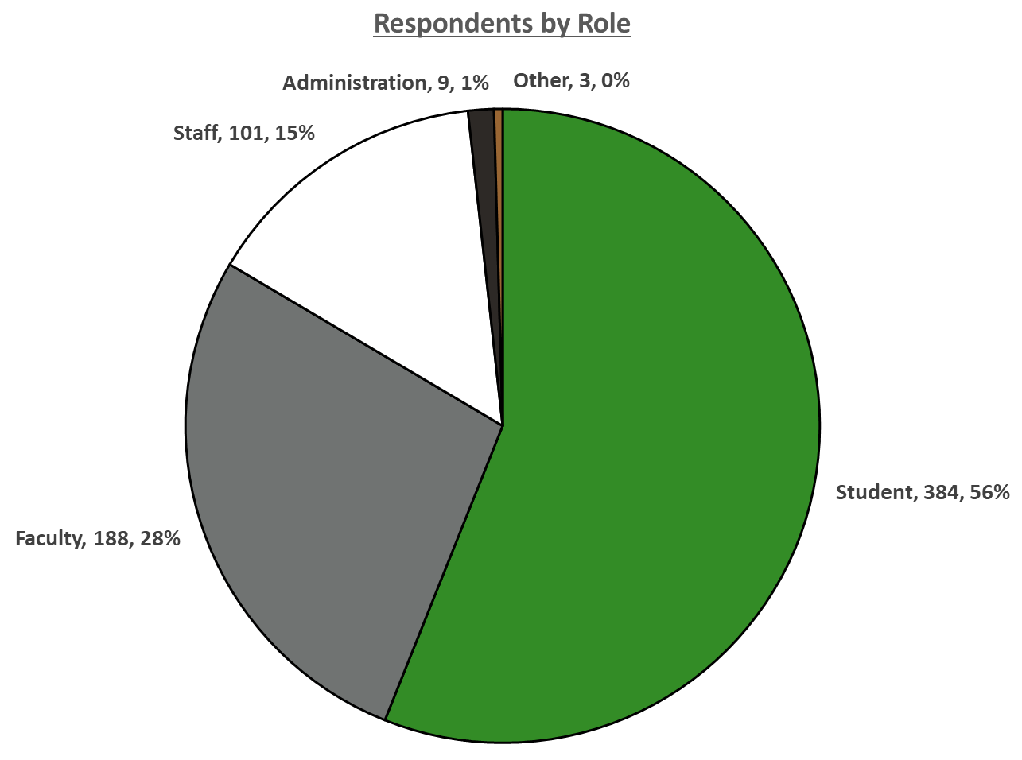
Respondent Roles
Note: Respondents may not have answered all questions, so response rates per item will be different. A respondent had to answer at least 1 question beyond identifying their role to be included in the analysis.

Slide 4
Quick Look at Rank Order of Broad Topics
Means, Top-Rated, and Rank Order

Slide 5
Rank Order Broad Topics
Topics were categorized into broader items and presented to the respondents for ranking
Respondents were given a randomized list and forced to rank items 1 – 4
  If a respondent did not touch the rating scale, no response was recorded.
Responses = 534

Slide 6
Topic Rating
Means, Top-Rated, and Rank Order

Slide 7
Mean Topic Rating
Respondents rated items on a scale of 0 – 100, with an option of N/A
The default rating was set to 50, so if a respondent did not move the scale, it was recorded as a 50
Responses = 681
Top-Rated Topics
The percentage of ratings at or above 90

Slide 8
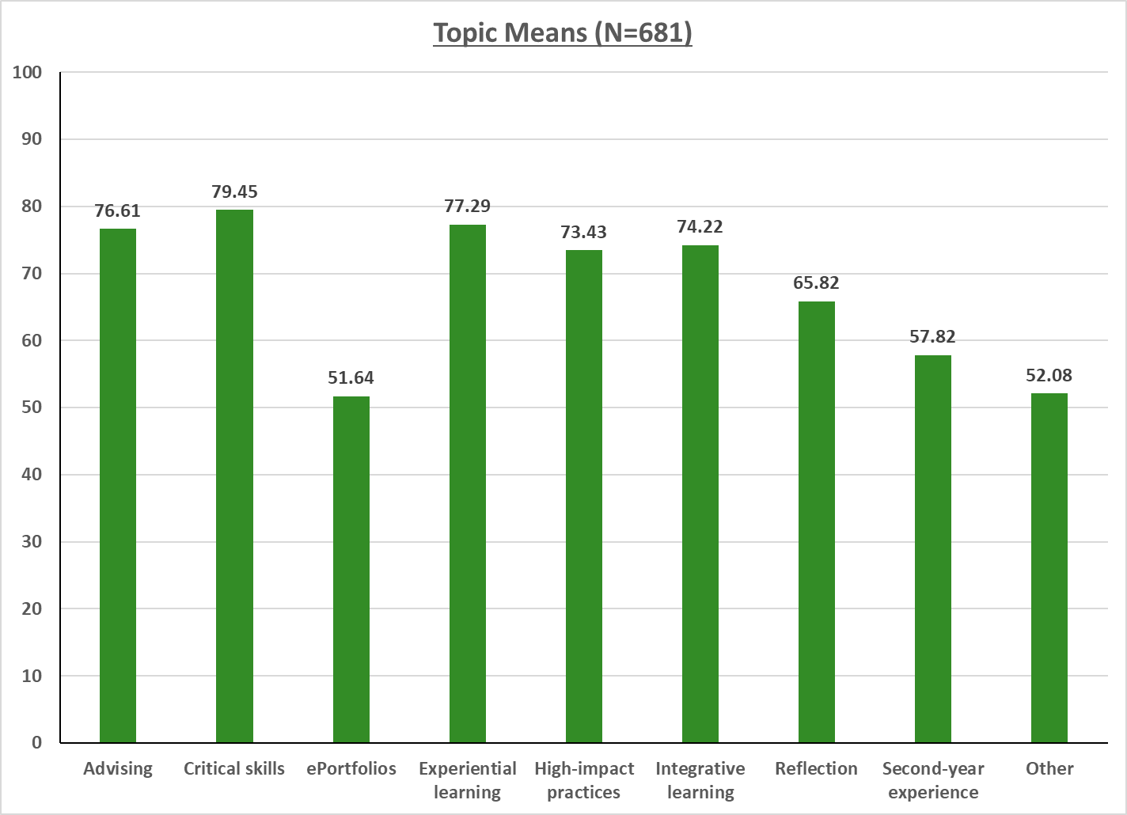

Slide 9
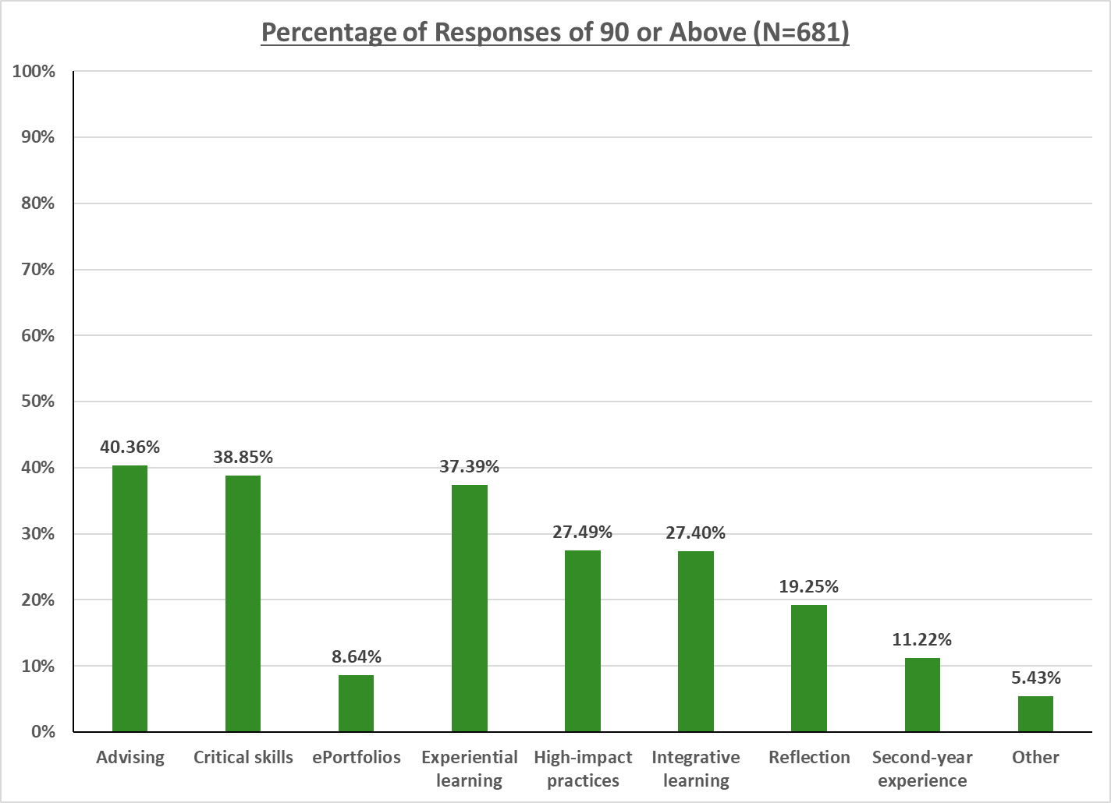

Slide 10
Rank Order Topic
Topic ratings were rank ordered, with ties being given equivalent ranks, e.g., rating of 100, 100, 95, 90 would be 1, 1, 3, 4
Responses = 681

Slide 11
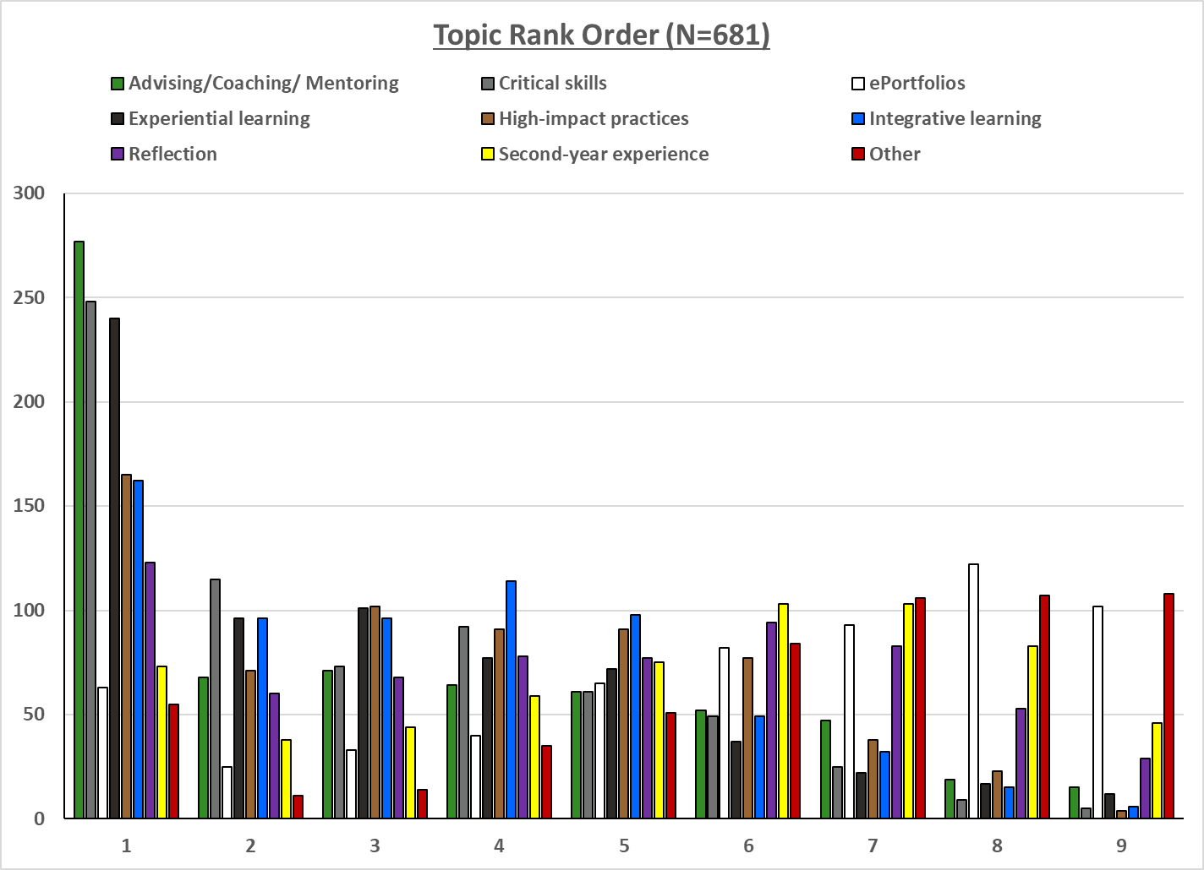

Slide 12
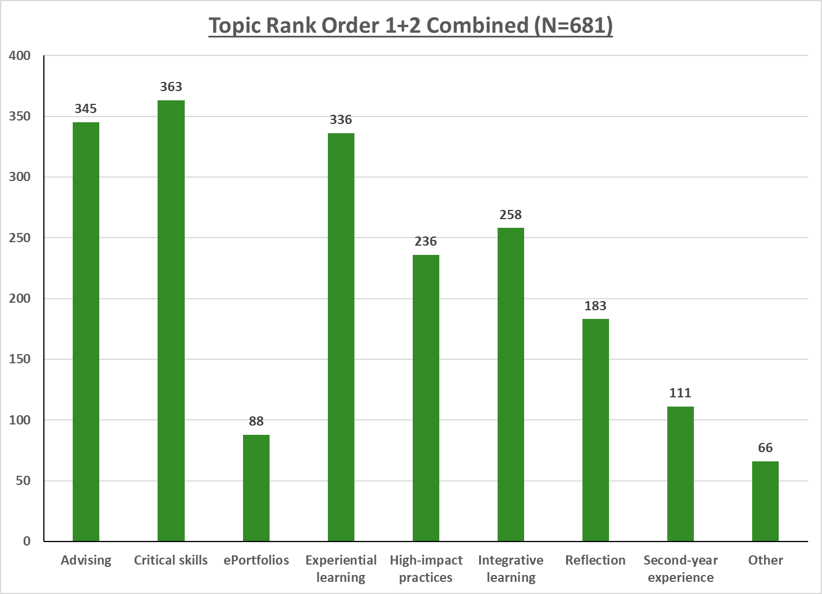

Slide 13
Critical Skills Ranking
Critical Thinking
Information Literacy
Integrative Learning
Quantitative Reasoning
Speaking
Writing

Slide 14
Rank Order Critical Skills
Respondents were given a randomized list and forced to rank items 1 – 7
  If a respondent did not touch the rating scale, no response was recorded.
Responses = 618

Slide 15
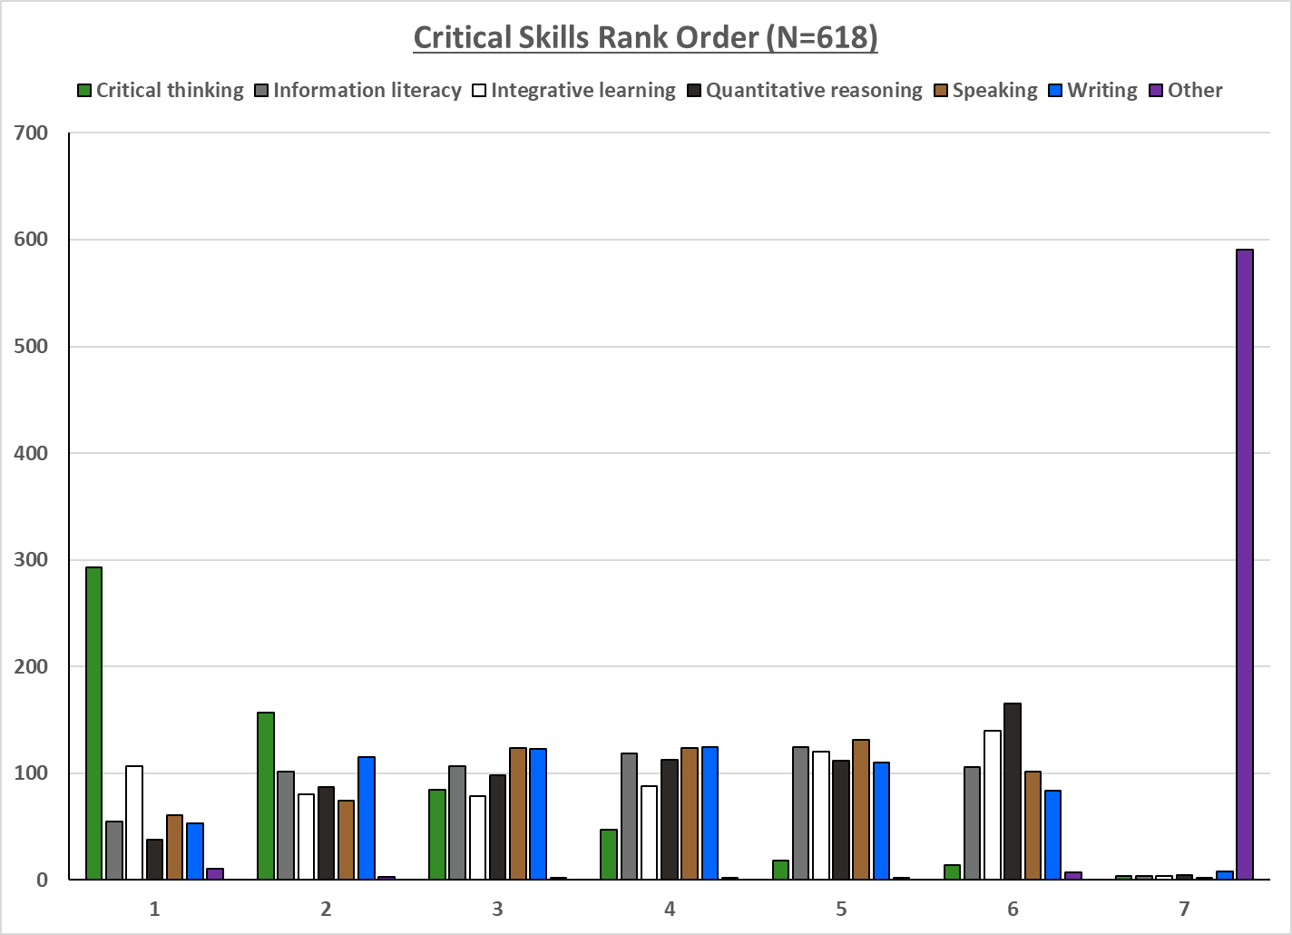

Slide 16
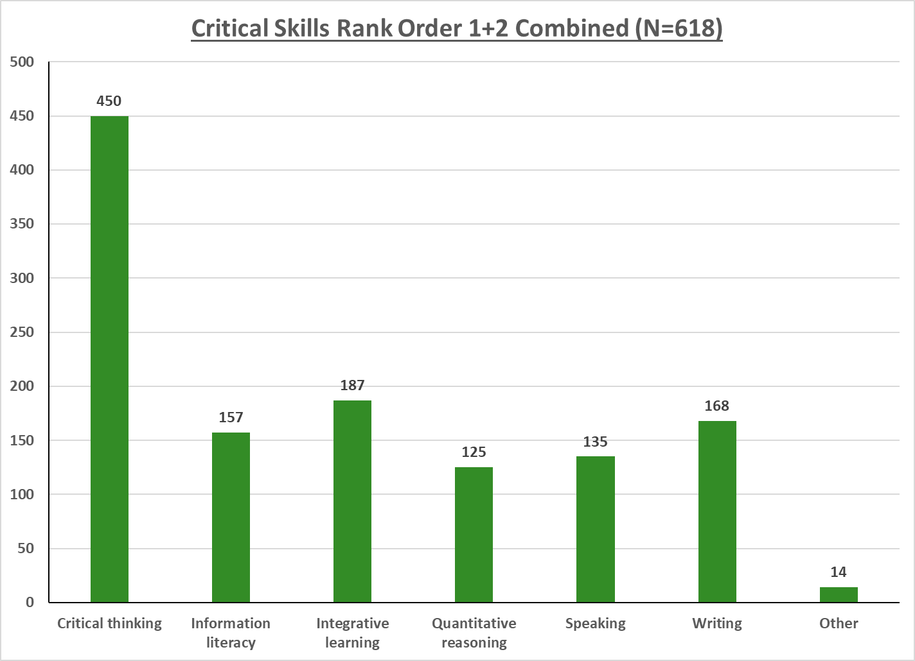

Slide 17
High Impact Practice Ranking
Capstone Courses and Projects
Common Intellectual Experiences
Diversity/Global Learning
ePortfolios
First-Year Experiences
Collaborative Assignments and Projects
Learning Communities
Service/Community-Based Learning
Undergraduate Research
Writing-Intensive Courses
Internships

Slide 18
Rank Order High Impact Practices
Respondents were given a randomized list and forced to rank items 1 – 12
  If a respondent did not touch the rating scale, no response was recorded.
Responses = 609

Slide 19
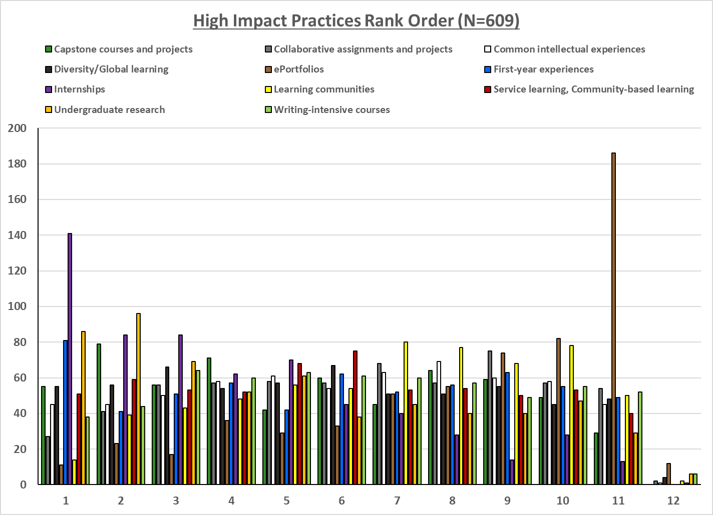
Note: “Other” has been removed from this chart because it was almost entirely ranked #12, and when included, makes the graph very challenging to read

Slide 20
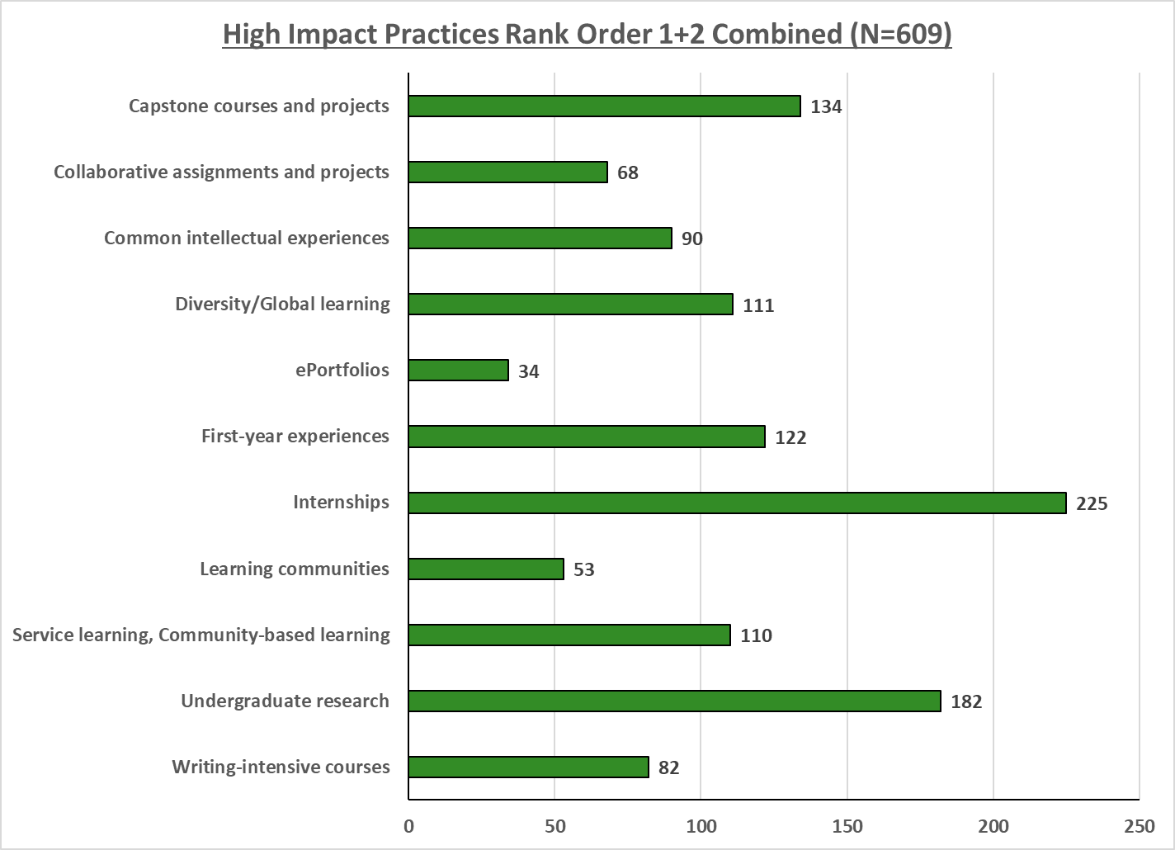
Note: “Other” has been removed from this chart because it was almost entirely ranked #12, and when included, makes the graph very challenging to read

Slide 21
Broad Topic Ranking
Advising/Coaching/Mentoring
Critical & Intellectual Skills
High Impact Practices
Integrative Learning

Slide 22
Rank Order Broad Topics
Topics were categorized into broader items and presented to the respondents for ranking
Respondents were given a randomized list and forced to rank items 1 – 4
  If a respondent did not touch the rating scale, no response was recorded.
Responses = 534

Slide 23
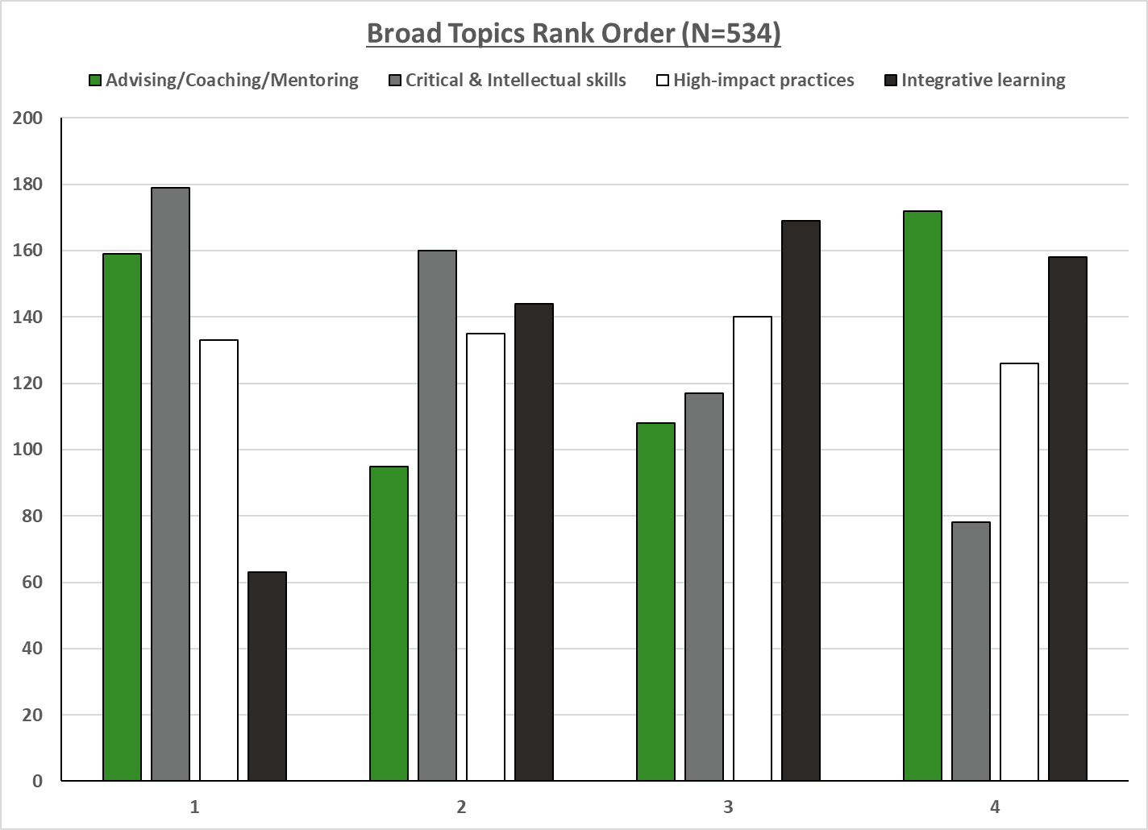

Slide 24
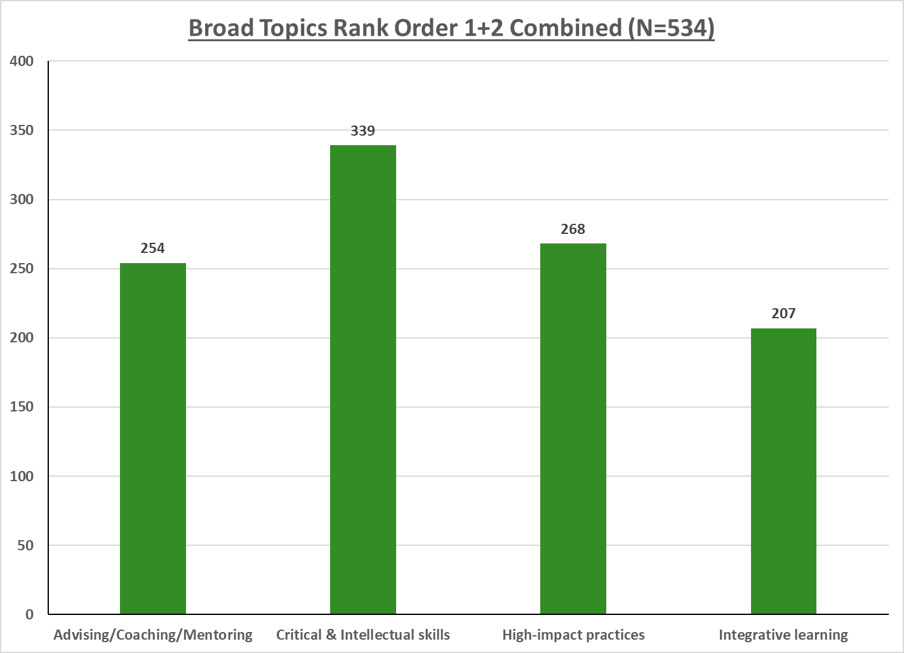

Slide 25
Summary by Role
Mean Ratings and Top 1+2 Combined Rankings
Frequency distributions not provided for “Other” due to fewer than 5 responses

Slide 26
Topic Rating
Means, Top-Rated & Rank Order

Slide 27
Mean Topic Ratings by Group
Respondents rated items on a scale of 0 – 100, with an option of N/A
The default rating was set to 50, so if a respondent did not move the scale, it was recorded as a 50
Top Rated Topic by Group
The percentage of ratings at or above 90
Response Rates:
Faculty = 188
Student = 384
Staff = 97
Administration = 9

Slide 28
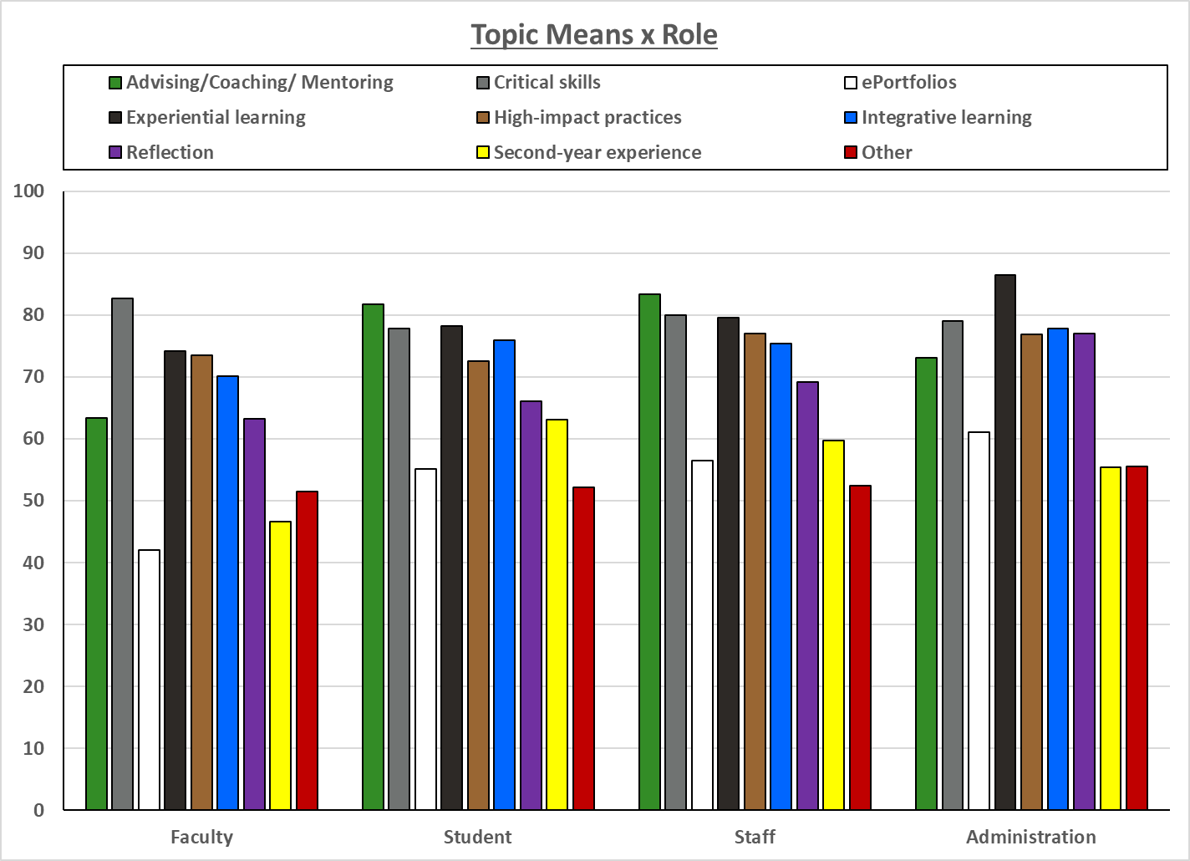

Slide 29
Combined 1+2 Rank Order Topic x Role
Topic ratings were rank ordered, with ties being given equivalent ranks, e.g., rating of 100, 100, 95, 90 would be 1, 1, 3, 4
Response Rates
  Students = 384
  Faculty = 188
  Staff = 97
  Administration = 9

Slide 30
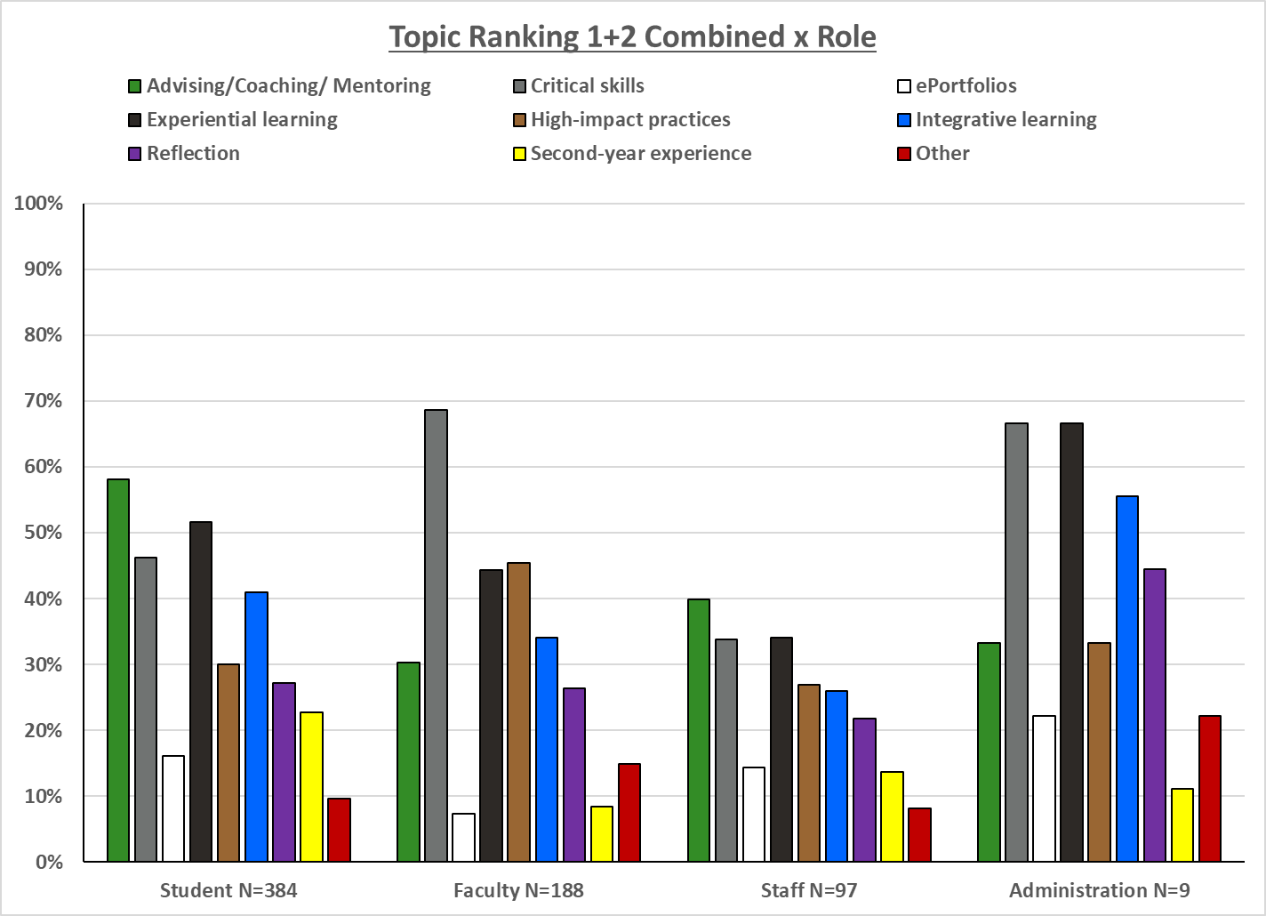

Slide 31
Critical Skills Ranking
Critical Thinking
Information Literacy
Integrative Learning
Quantitative Reasoning
Speaking
Writing

Slide 32
Combined 1+2 Rank Order Critical Skills x Role
Respondents were given a randomized list and forced to rank items 1 – 7
  If a respondent did not touch the rating scale, no response was recorded.
Responses
  Students = 337
  Faculty = 182
  Staff = 89
  Administration = 8

Slide 33
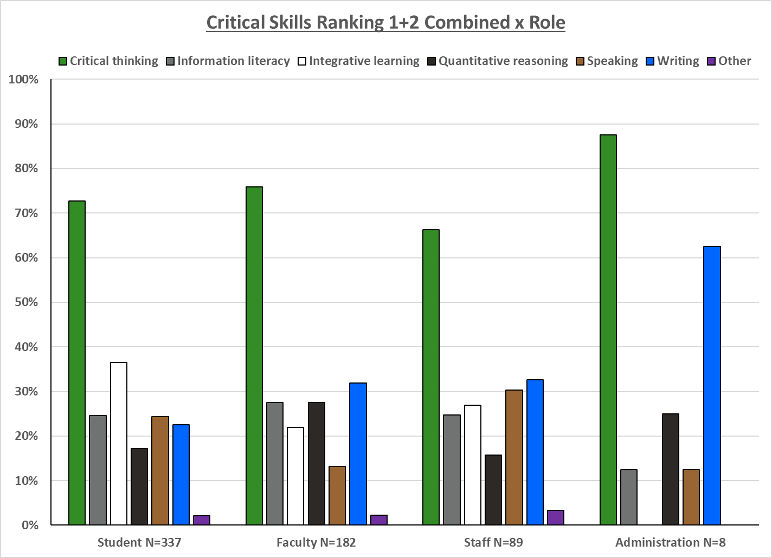

Slide 34
High Impact Practice Ranking
Capstone Courses and Projects
Common Intellectual Experiences
Diversity/Global Learning
ePortfolios
First-Year Experiences
Collaborative Assignments and Projects
Learning Communities
Service/Community-Based Learning
Undergraduate Research
Writing-Intensive Courses
Internships

Slide 35
Combined 1+2 Rank Order High Impact Practices x Role
Respondents were given a randomized list and forced to rank items 1 – 12
  If a respondent did not touch the rating scale, no response was recorded.
Responses
  Students = 332
  Faculty = 182
  Staff = 85
  Administration = 8

Slide 36
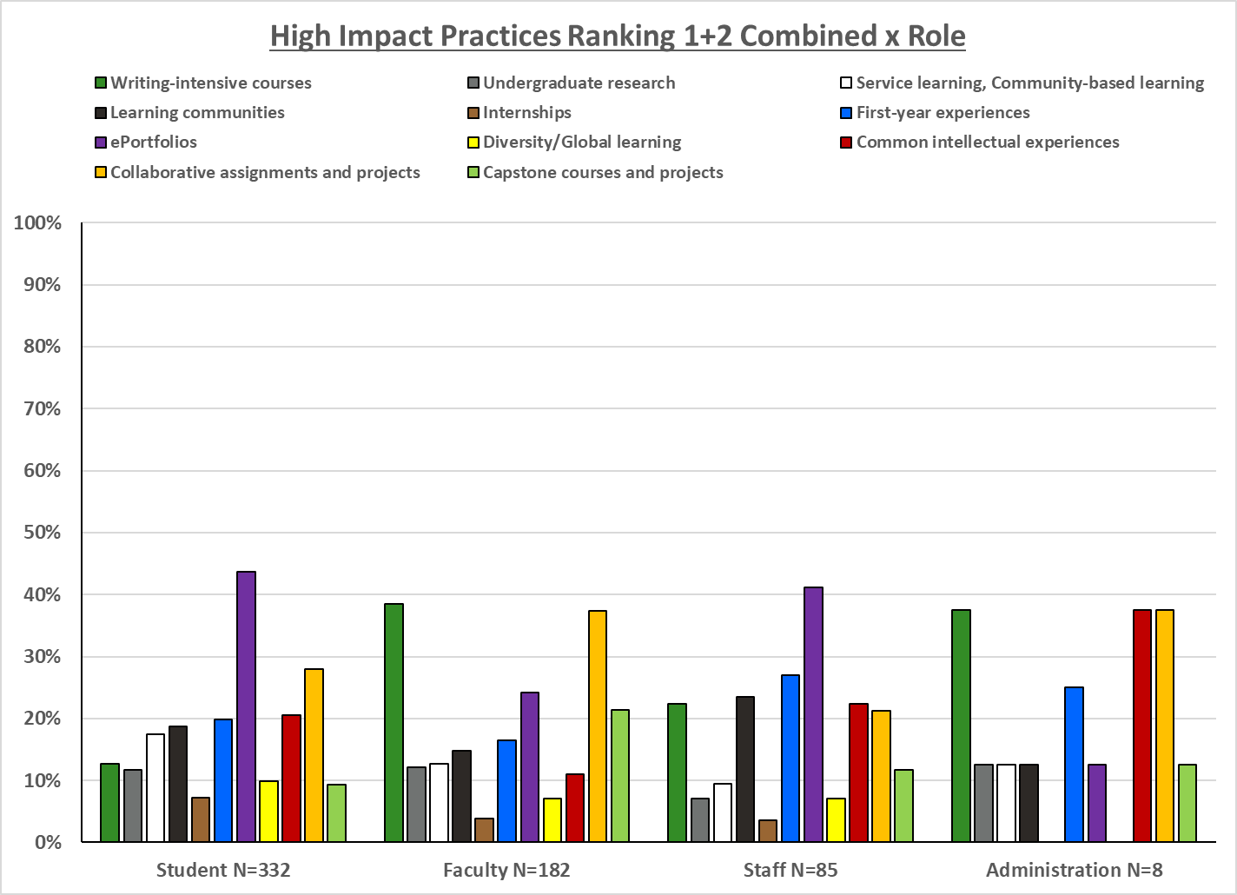

Slide 37
Broad Topic Ranking
Advising/Coaching/Mentoring
Critical & Intellectual Skills
High Impact Practices
Integrative Learning

Slide 38
Combined 1+2 Rank Order Broad Topics x Role
Topics were categorized into broader items and presented to the respondents for ranking
Respondents were given a randomized list and forced to rank items 1 – 4
  If a respondent did not touch the rating scale, no response was recorded.
Responses
  Students = 272
  Faculty = 172
  Staff = 80
  Administration = 8

Slide 39
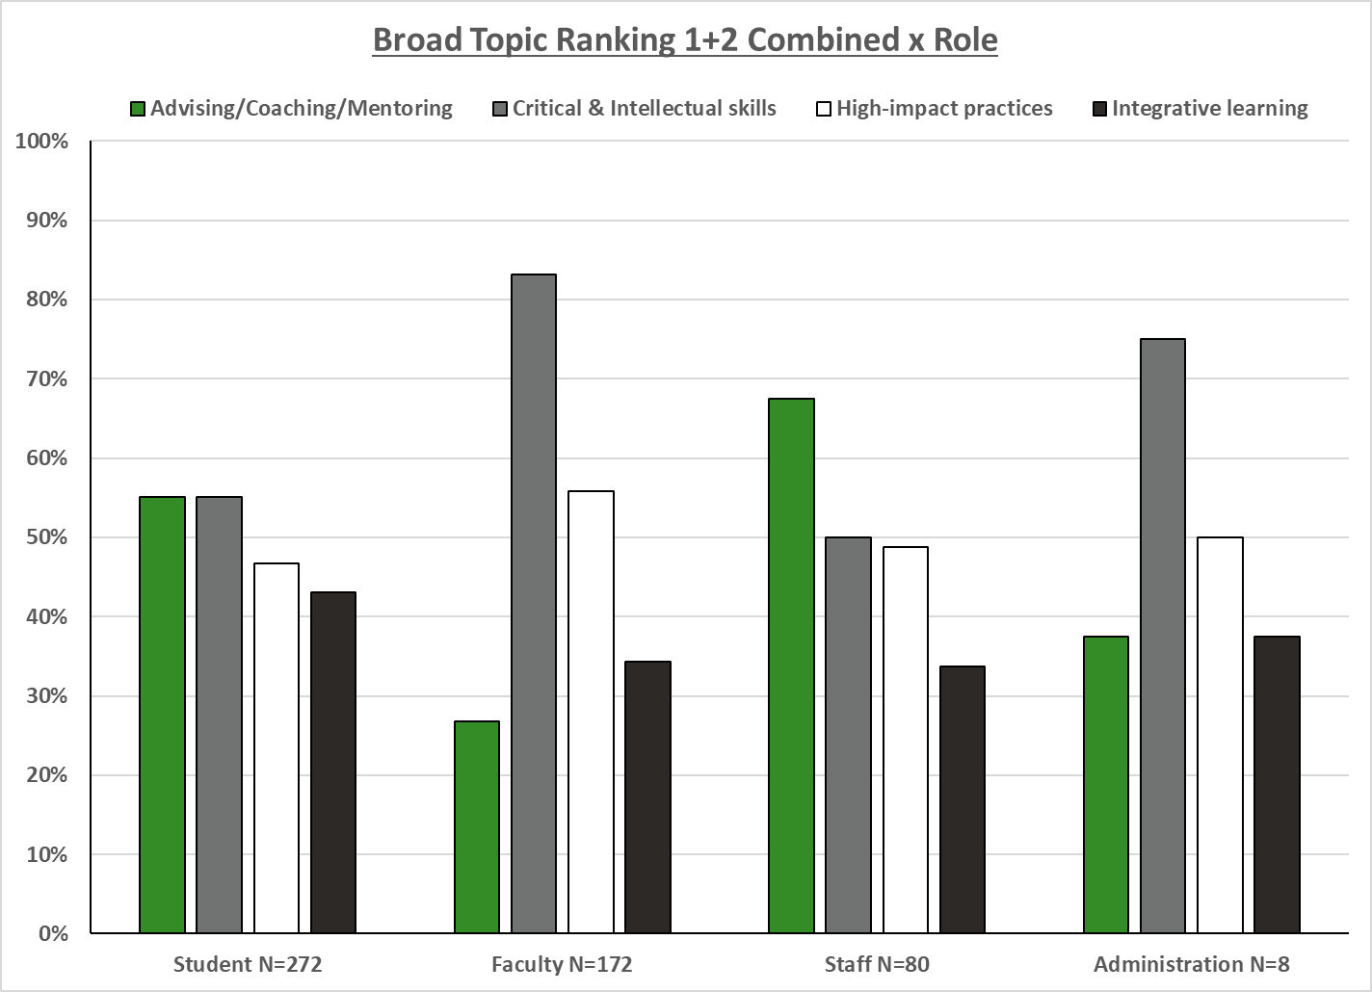

Slide 40
Details by Role
Full Frequency Distributions of Rankings
Frequency distributions not provided for “Other” due to fewer than 5 responses

Slide 41
Topic Rating
Rank Order

Slide 42
Rank Order Topic – Students
Topic ratings were rank ordered, with ties being given equivalent ranks, e.g., rating of 100, 100, 95, 90 would be 1, 1, 3, 4
Responses = 384

Slide 43
Rank Order Topic - Faculty
Topic ratings were rank ordered, with ties being given equivalent ranks, e.g., rating of 100, 100, 95, 90 would be 1, 1, 3, 4
Responses = 188

Slide 44
Rank Order Topic - Staff
Topic ratings were rank ordered, with ties being given equivalent ranks, e.g., rating of 100, 100, 95, 90 would be 1, 1, 3, 4
Responses = 97

Slide 45
Rank Order Topic - Administration
Topic ratings were rank ordered, with ties being given equivalent ranks, e.g., rating of 100, 100, 95, 90 would be 1, 1, 3, 4
Responses = 9

Slide 46
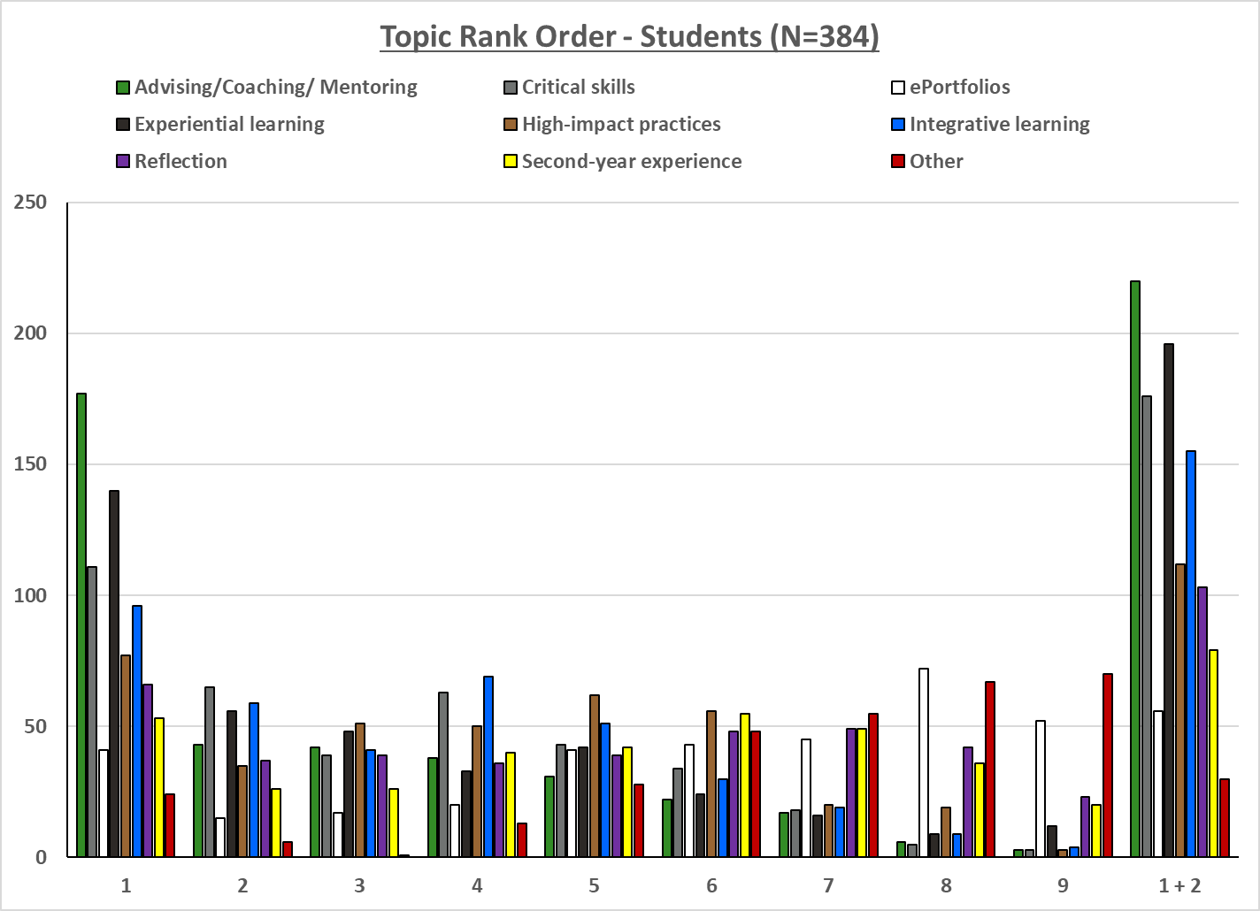

Slide 47
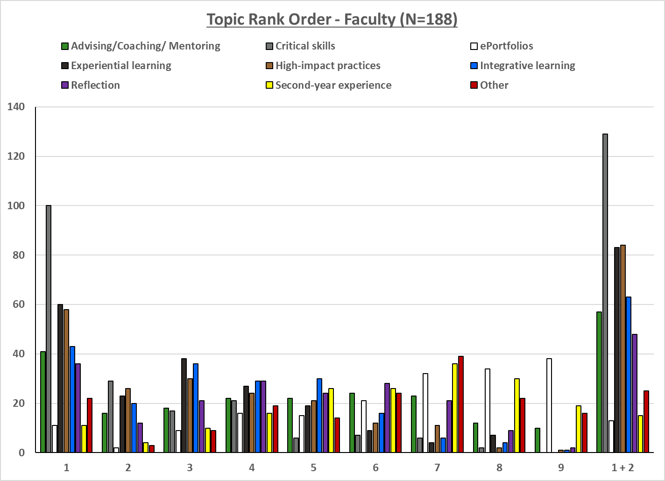

Slide 48
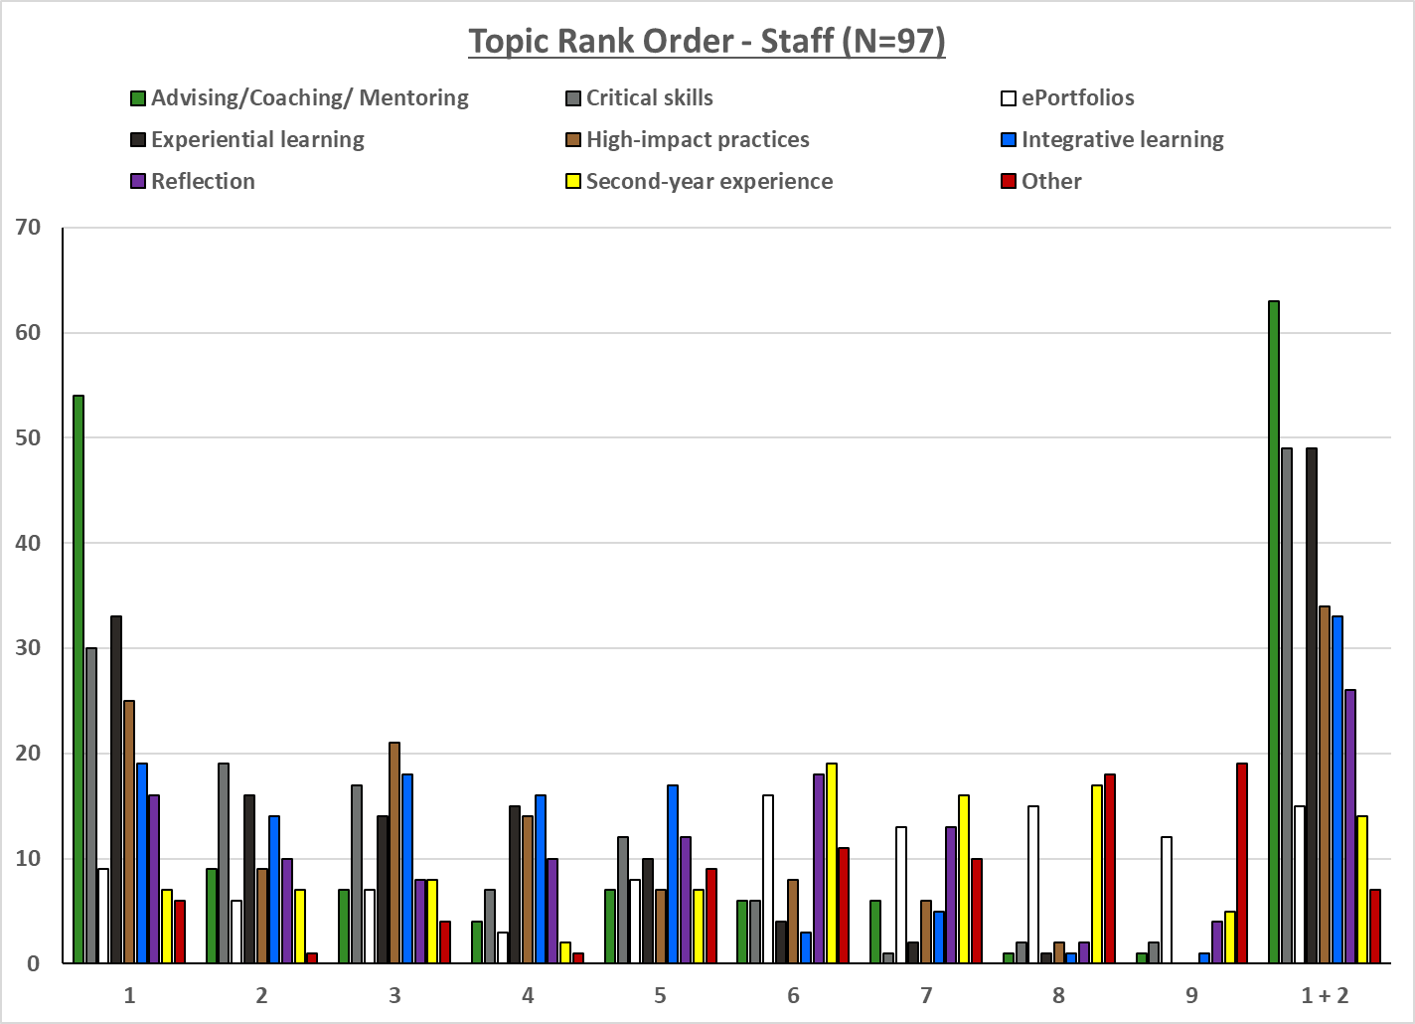

Slide 49
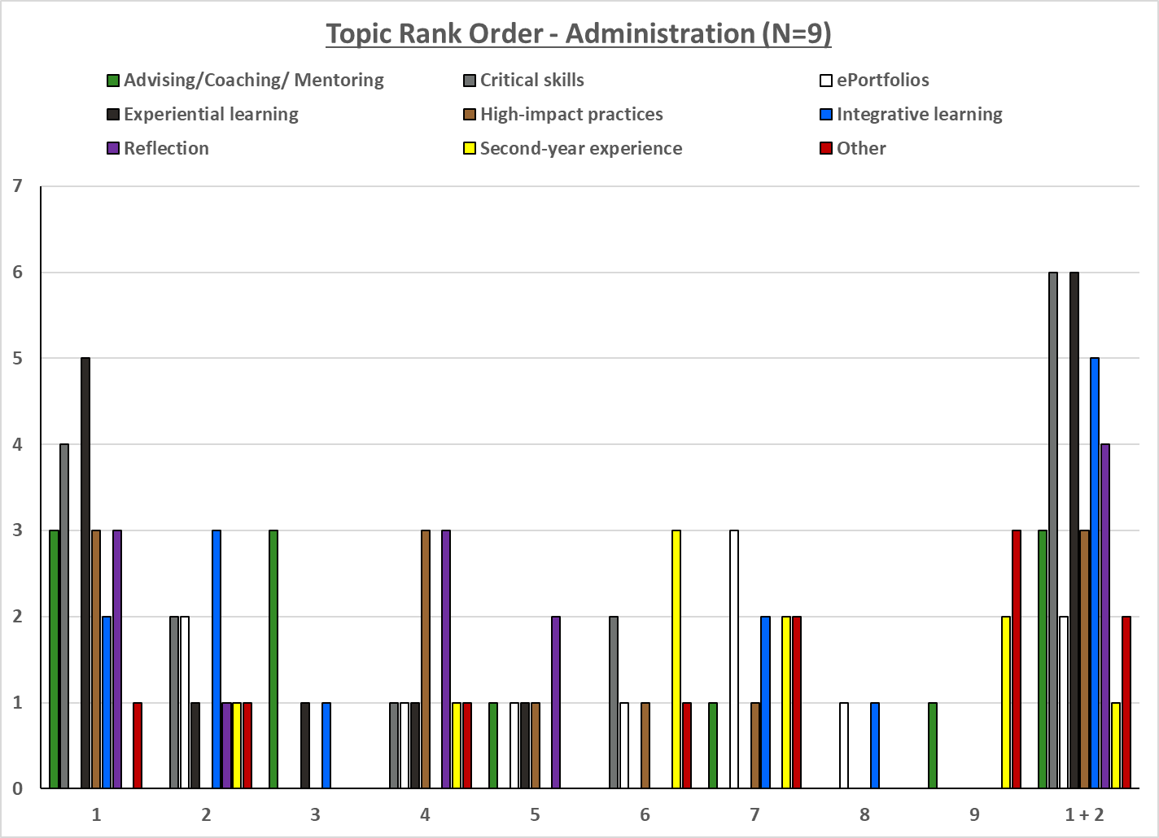

Slide 50
Critical Skills Ranking
Critical Thinking
Information Literacy
Integrative Learning
Quantitative Reasoning
Speaking
Writing

Slide 51
Rank Order Critical Skills - Students
Respondents were given a randomized list and forced to rank items 1 – 7
  If a respondent did not touch the rating scale, no response was recorded.
Responses = 337

Slide 52
Rank Order Critical Skills - Faculty
Respondents were given a randomized list and forced to rank items 1 – 7
  If a respondent did not touch the rating scale, no response was recorded.
Responses = 182

Slide 53
Rank Order Critical Skills - Staff
Respondents were given a randomized list and forced to rank items 1 – 7
  If a respondent did not touch the rating scale, no response was recorded.
Responses = 89

Slide 54
Rank Order Critical Skills - Administration
Respondents were given a randomized list and forced to rank items 1 – 7
  If a respondent did not touch the rating scale, no response was recorded.
Responses = 8

Slide 55
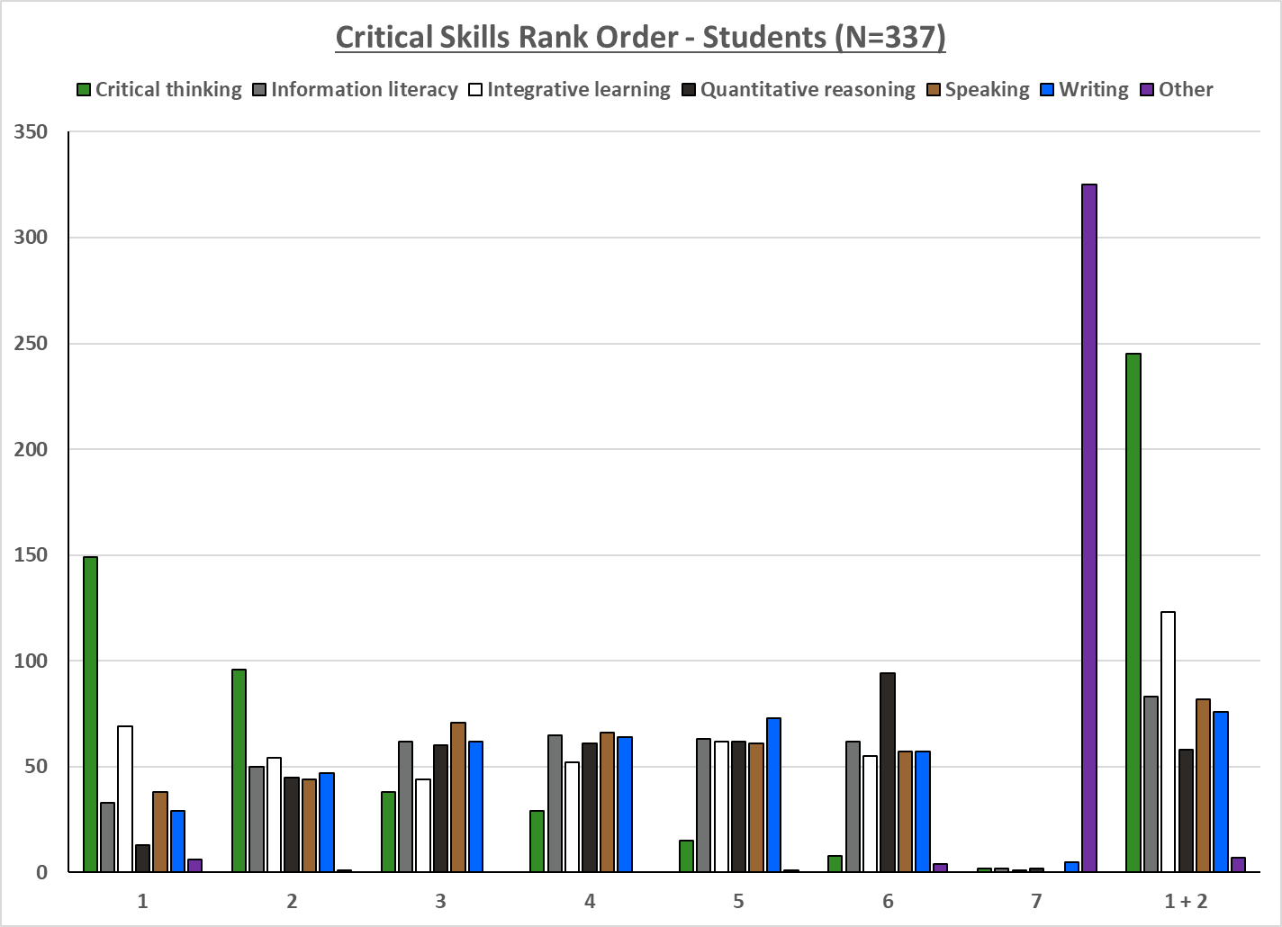

Slide 56
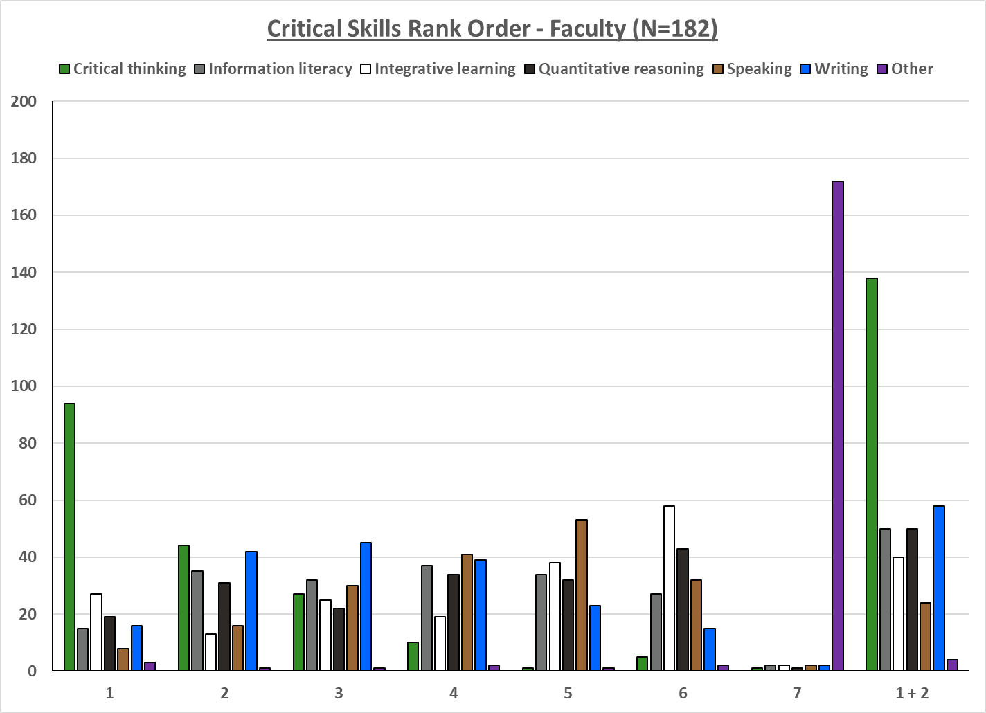

Slide 57
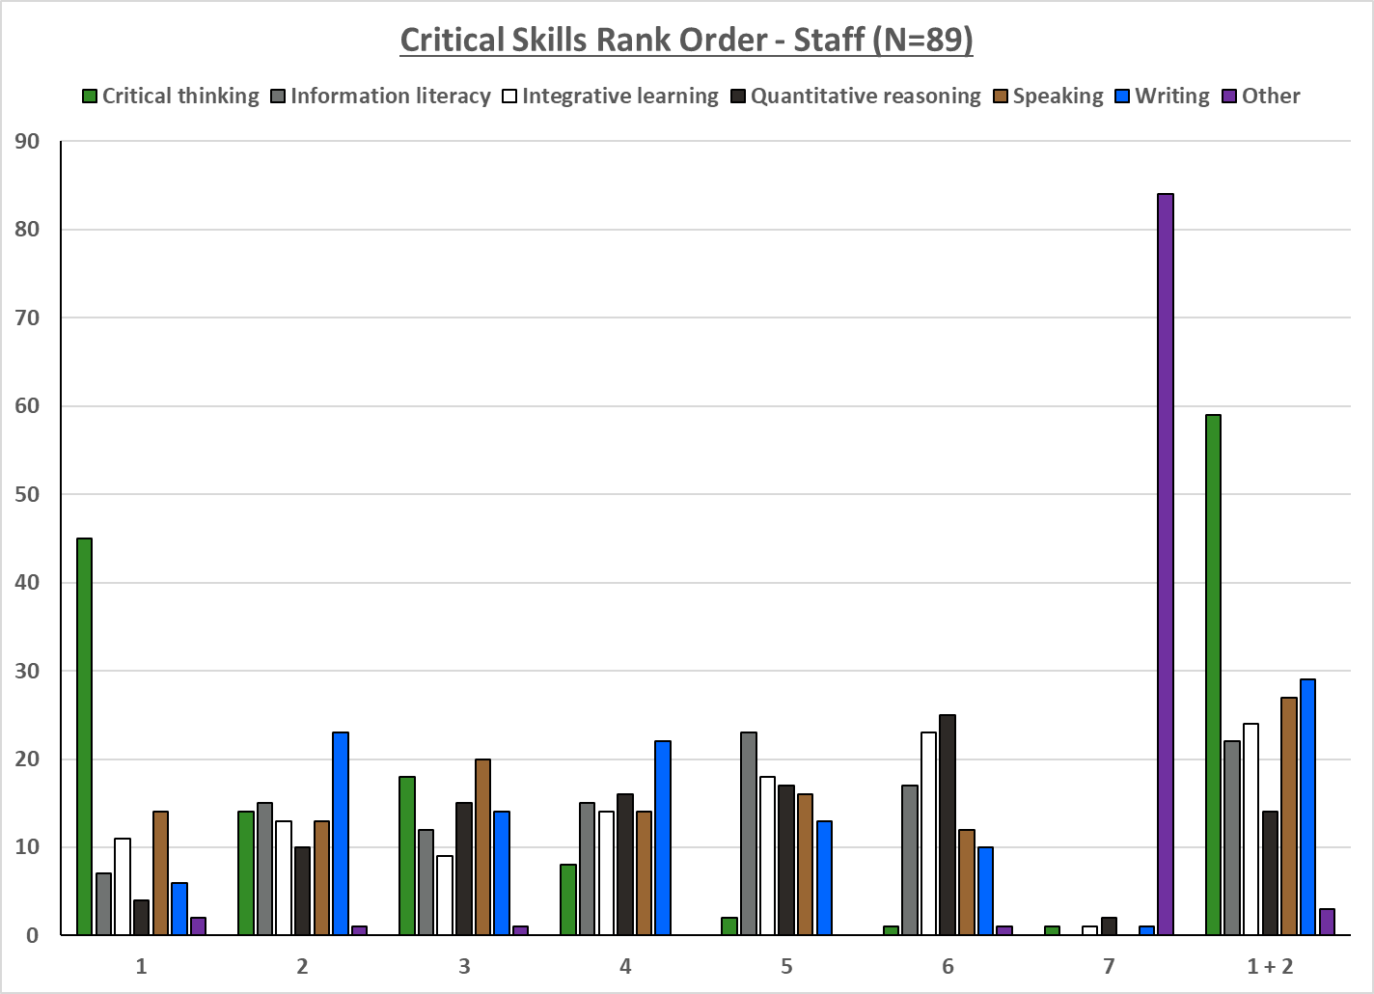

Slide 58
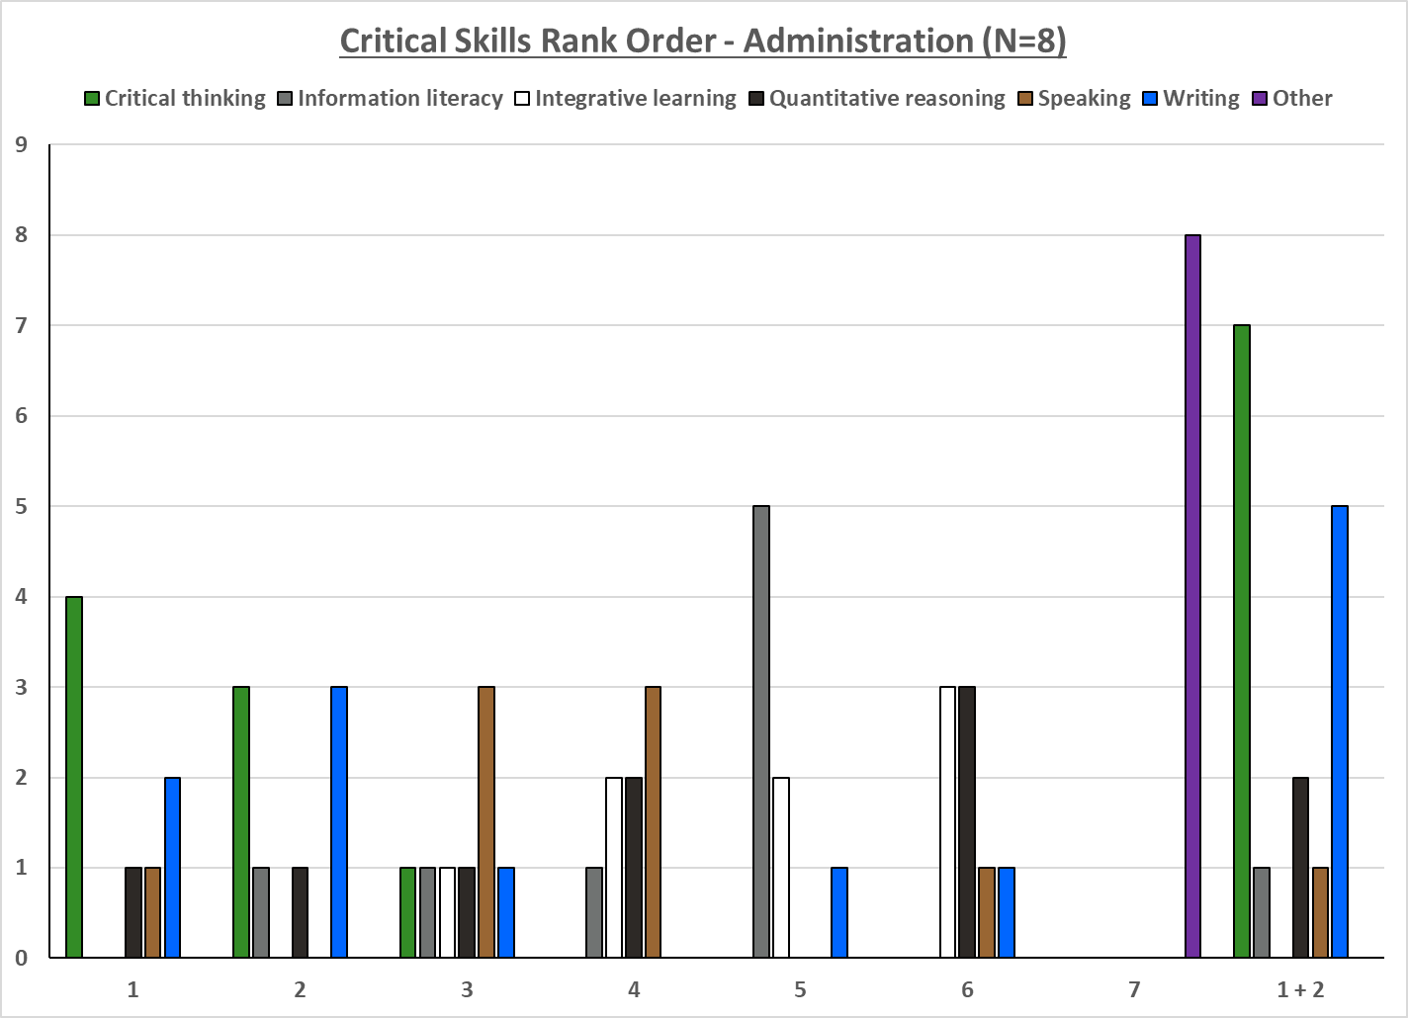

Slide 59
High Impact Practice Ranking
Capstone Courses and Projects
Common Intellectual Experiences
Diversity/Global Learning
ePortfolios
First-Year Experiences
Collaborative Assignments and Projects
Learning Communities
Service/Community-Based Learning
Undergraduate Research
Writing-Intensive Courses
Internships

Slide 60
Rank Order High Impact Practices - Student
Respondents were given a randomized list and forced to rank items 1 – 12
  If a respondent did not touch the rating scale, no response was recorded.
Responses = 332

Slide 61
Rank Order High Impact Practices - Faculty
Respondents were given a randomized list and forced to rank items 1 – 12
  If a respondent did not touch the rating scale, no response was recorded.
Responses = 182

Slide 62
Rank Order High Impact Practices - Staff
Respondents were given a randomized list and forced to rank items 1 – 12
  If a respondent did not touch the rating scale, no response was recorded.
Responses = 85

Slide 63
Rank Order High Impact Practices - Administration
Respondents were given a randomized list and forced to rank items 1 – 12
  If a respondent did not touch the rating scale, no response was recorded.
Responses = 8

Slide 64
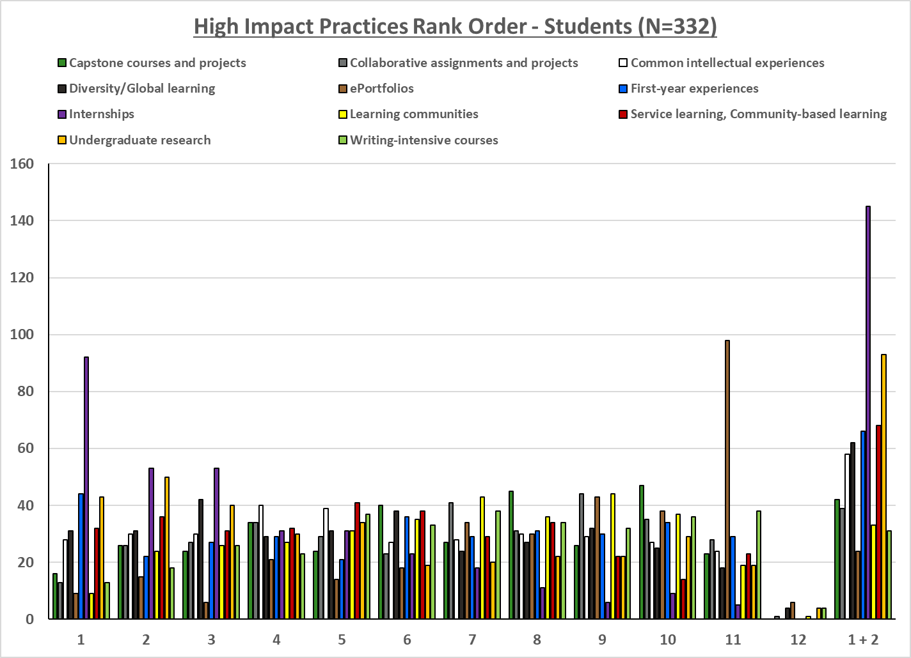
Note: “Other” has been removed from this chart because it was almost entirely ranked #12, and when included, makes the graph very challenging to read

Slide 65
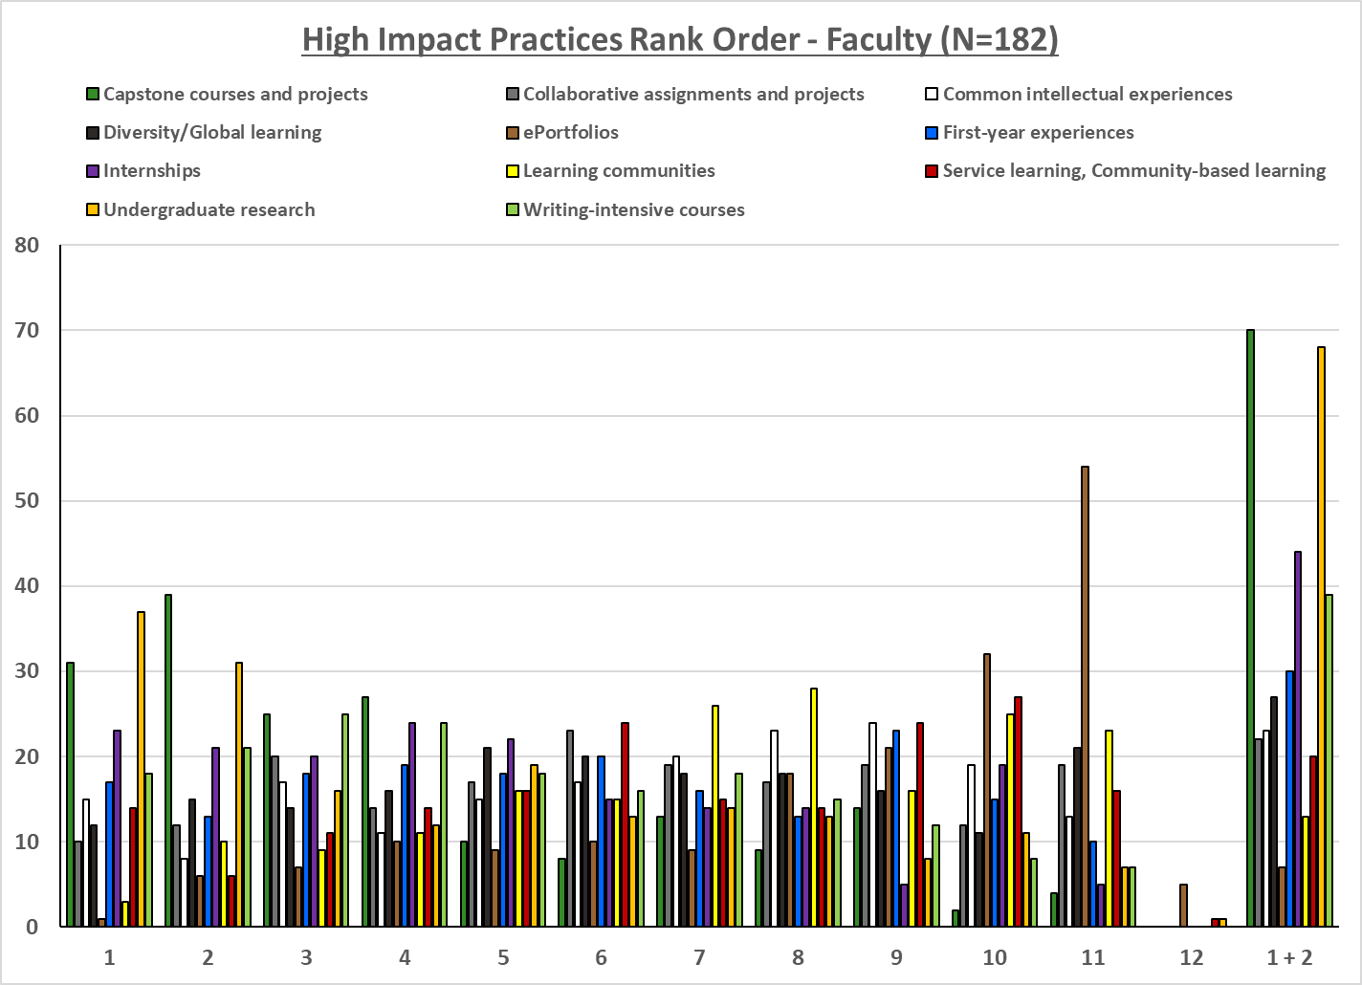
Note: “Other” has been removed from this chart because it was almost entirely ranked #12, and when included, makes the graph very challenging to read

Slide 66
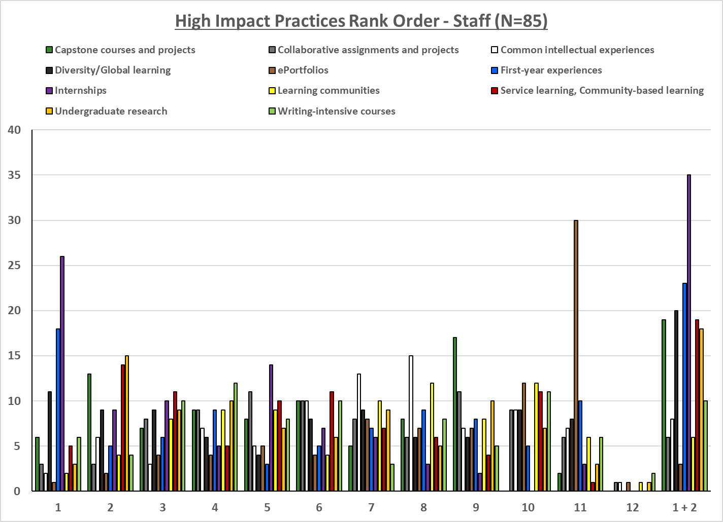
Note: “Other” has been removed from this chart because it was almost entirely ranked #12, and when included, makes the graph very challenging to read

Slide 67
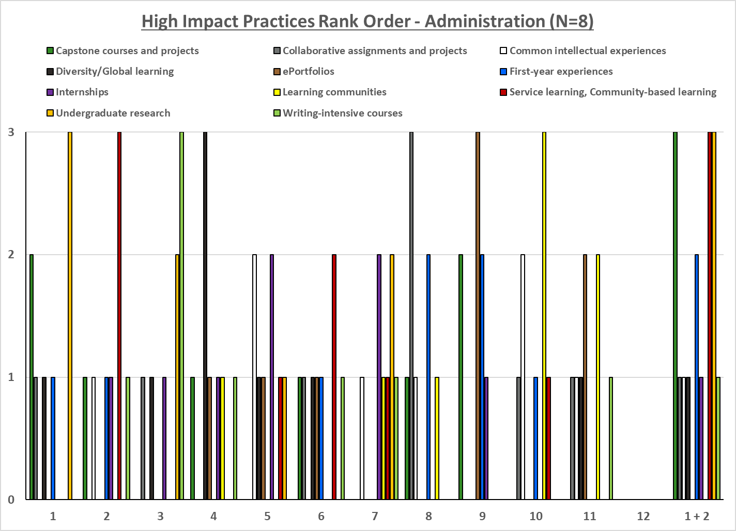
Note: “Other” has been removed from this chart because it was almost entirely ranked #12, and when included, makes the graph very challenging to read

Slide 68
Broad Topic Ranking
Advising/Coaching/Mentoring
Critical & Intellectual Skills
High Impact Practices
Integrative Learning

Slide 69
Rank Order Broad Topics - Students
Topics were categorized into broader items and presented to the respondents for ranking
Respondents were given a randomized list and forced to rank items 1 – 4
  If a respondent did not touch the rating scale, no response was recorded.
Responses = 272

Slide 70
Rank Order Broad Topics - Faculty
Topics were categorized into broader items and presented to the respondents for ranking
Respondents were given a randomized list and forced to rank items 1 – 4
  If a respondent did not touch the rating scale, no response was recorded.
Responses = 172

Slide 71
Rank Order Broad Topics - Staff
Topics were categorized into broader items and presented to the respondents for ranking
Respondents were given a randomized list and forced to rank items 1 – 4
  If a respondent did not touch the rating scale, no response was recorded.
Responses = 80

Slide 72
Rank Order Broad Topics - Administration
Topics were categorized into broader items and presented to the respondents for ranking
Respondents were given a randomized list and forced to rank items 1 – 4
  If a respondent did not touch the rating scale, no response was recorded.
Responses = 8

Slide 73
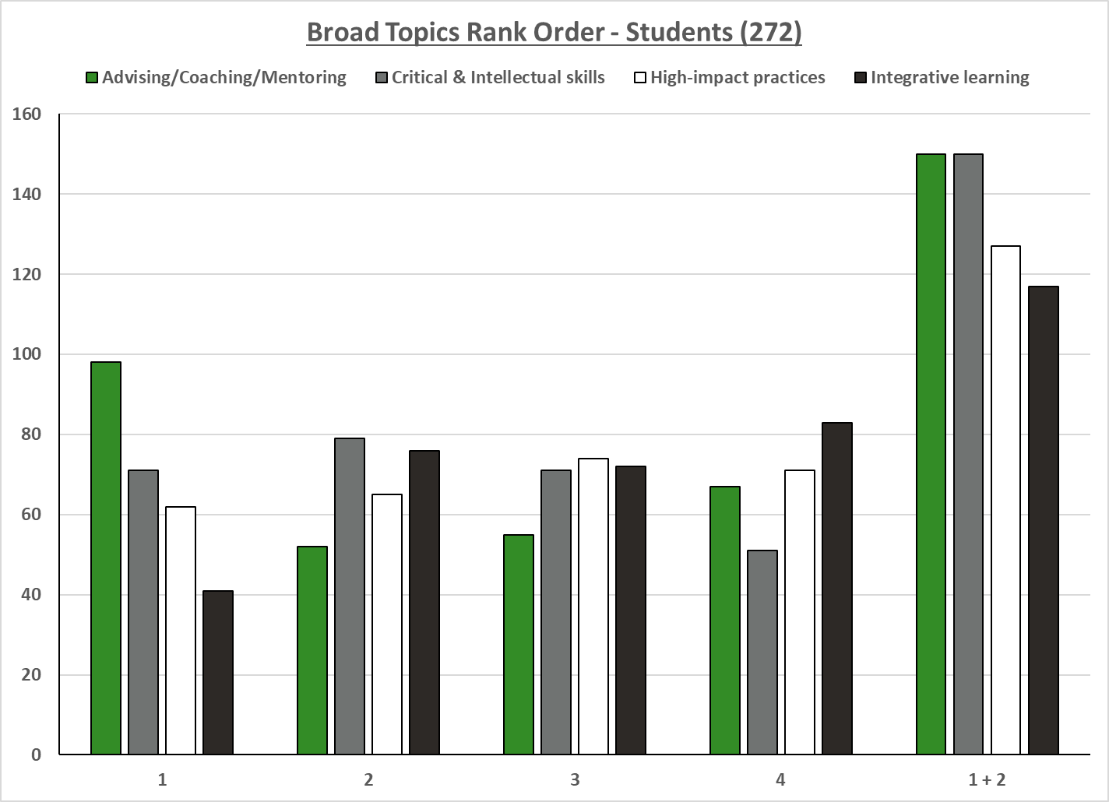

Slide 74
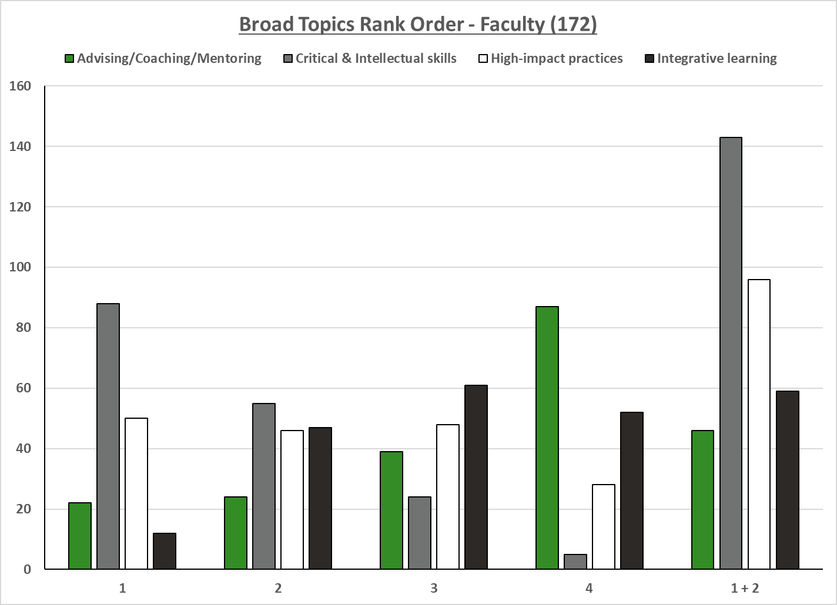

Slide 75
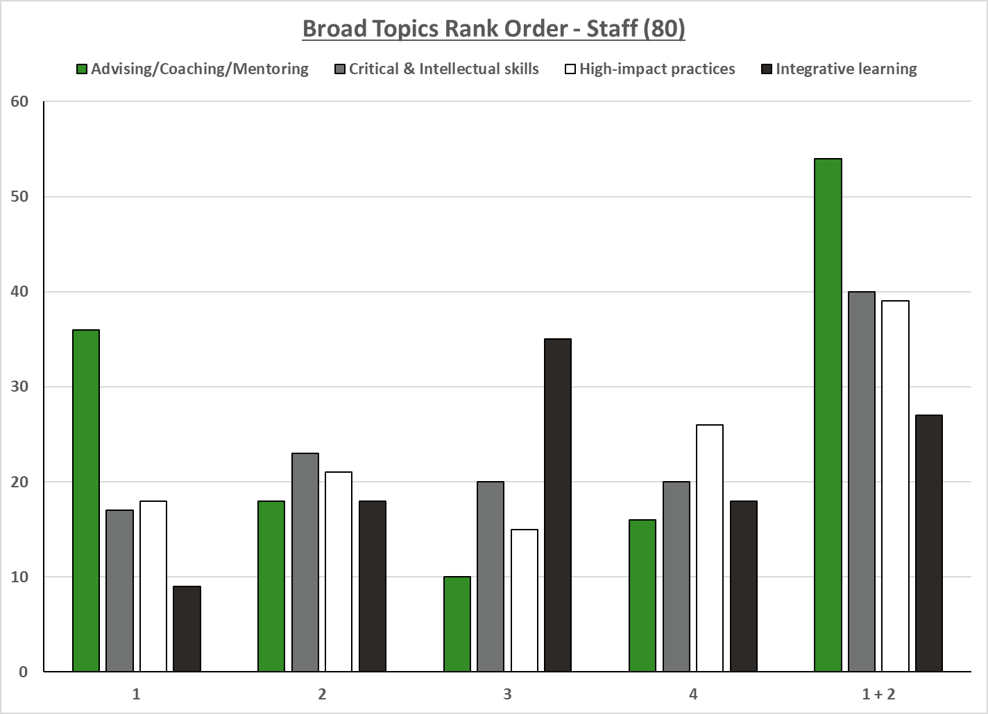

Slide 76
