Slide 1
Syllogisms:
Cornerstones of Legal Arguments

Slide 2
Objectives
Become familiar with syllogistic legal argument.
Appreciate the importance of “grounding” premises in a syllogism.

Slide 3
Introduction to Syllogisms
To be useful, legal argument must be persuasive
Persuasiveness requires
Logos
Pathos
Ethos

Slide 4
Persuasiveness Requires
Logos
Syllogistic argument
A syllogism is a systematic and ordered set of statements
The statements are connected by rational inferences
Pathos
Affective appeal of argument
Ethos
Speaker’s or writer’s credibility

Slide 5
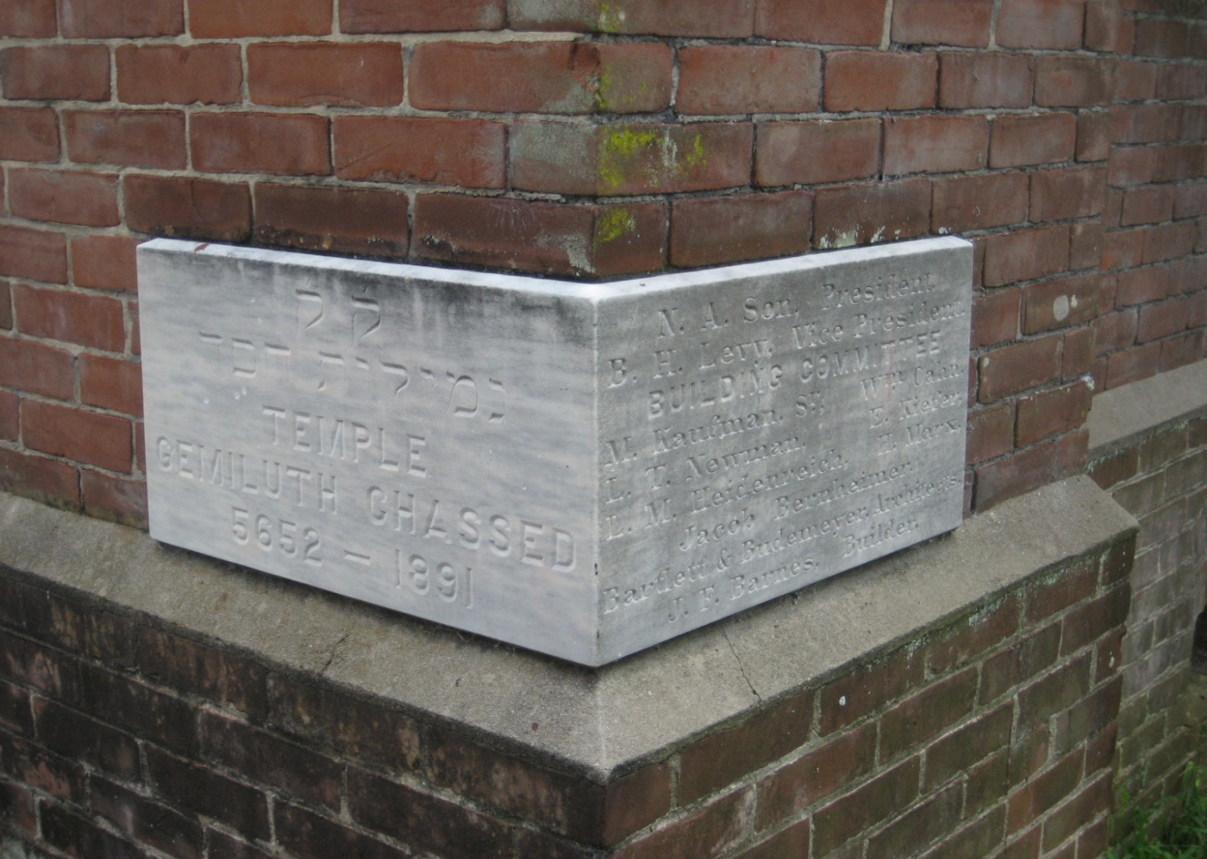
Syllogism as Cornerstone of Legal Argument

Slide 6
Parts of a Syllogism
Major premise: Broad statement of general applicability
Minor premise: Narrower statement of particular applicability
Conclusion: Logical consequence of the major and minor premises

Slide 7
Classic Example
1. All men are mortal.
2. Socrates is a man.
3. Therefore, Socrates is mortal.
A=B, B=C, A=C
Transitivity

Slide 8
Power of Syllogisms
Conclusion is compelling
The opponent must attack the premise, not the conclusion

Slide 9
Legal Arguments as Syllogisms
Major premise = statement of law
Minor premise = application of law to specific facts
Conclusion = derived from premises

Slide 10
Example of Syllogism
Major
The law criminalizes conduct when that conduct arises from an act, omission, or possession.
Minor
Defendant’s conduct does not constitute an act, omission, or possession.
Conclusion
Therefore, the law will not criminalize defendant’s conduct.

Slide 11
So What Are You Really Doing?
Setting forth the law, and then applying it to the facts.
Essentially the same as
IRAC
CRAC
CREAT
TREAT

Slide 12
Practice Question
Assume that the Rays played the Red Sox last night. Matt Garza struck David Ortiz out numerous times. Garza generally takes an extremely long time in the locker room after games. Ortiz, knowing this, stood outside the locker room with his gun poised waiting for Garza to come into his line of sight. Ortiz believed that the gun was not loaded and that the safety was on. When Garza walked out of the Rays locker room Ortiz pointed his gun at him and yelled that if Garza ever threw another sinker it will be the last ball Garza would ever throw. Upton, upon hearing the commotion, returned to the hallway (having previously left) and pulled the fire alarm in an attempt to distract Ortiz. Flinching because of the loud unexpected noise, Ortiz’s finger pressed on the trigger, shooting Garza at close range. Garza dies from his wound en route to the hospital. Should Ortiz be charged with a crime?

Slide 13
Applicable Law
Conduct becomes criminal when the events indicate
that there has been a (1) voluntary act, omission, or possession; (2) sufficient intent, and (3) causation.

Slide 14
Applicable Law
Focus on voluntary act
A voluntary act requires an exercise of will
An involuntary act is an actor’s bodily movement, omission, or possession that is not directed by conscious mental processes
Examples of involuntary acts
Physically coerced movements
Reflex
Muscular contraction or paralysis produced by disease (seizure (unless individual aware of potential to seize but chooses to place others at risk))
Unconsciousness

Slide 15
Syllogistic Response to Practice Question
Major
A voluntary act occurs when one’s actions are an expression of his free will; that is, his action is a result of a bodily movement that is the product of a conscious mental process. Actions that are the result of coercion, reflex, an unconscious state such as hypnosis and sleep, are not products of a conscious mental process and thus not voluntary.
Minor
Here when Ortiz fired his gun, he was not consciously aware that he was doing so because his actions were reflexive. His actions were reflexive because his pulling of the trigger was the result of an involuntary flinch in response to the fire alarm, and thus not the result of a conscious decision to pull the trigger.
Conclusion
Therefore, Ortiz did not voluntarily act when he pulled the trigger, shooting Garza.

Slide 16
Complete the Syllogism
Major
Actions that are the result of coercion, reflex, an unconscious state such as hypnosis and sleep, are not products of a conscious mental process and thus not voluntary.
Minor
Conclusion
Therefore, Ortiz did not voluntarily act.

Slide 17
Complete the Syllogism
Major
Actions that are the result of coercion, reflex, an unconscious state such as hypnosis and sleep, are not products of a conscious mental process and thus not voluntary.
Minor
Here Ortiz’s action was reflexive.
Conclusion
Therefore, Ortiz did not voluntarily act.

Slide 18
Complete the Syllogism
Major
Minor
Here, no one compelled Ortiz to act against his will.
Conclusion
Thus, Ortiz was not coerced into firing his weapon at the victim.

Slide 19
Complete the Syllogism
Major
An act is coerced when another compels the defendant to act against his will.
Minor
Here, no one compelled Ortiz to act against his will.
Conclusion
Thus, Ortiz was not coerced into firing his weapon at the victim.

Slide 20
Grounding the Premises
You must “ground” each premise.
Grounding means providing enough explanation of the premises to allow a particular target audience to understand why the premises are true.

Slide 21
Direct v. Indirect Grounding
Directly grounded premise = the premise states a true proposition that either cannot or need not be further explained.
Indirectly grounded premise = one that is shown to be true only by linking it to other premises, which are themselves directly or indirectly grounded.

Slide 22
Directly Grounded
All men are mortal.
Socrates is a man.
An actor acts involuntarily when his act is a result of an involuntary muscle contraction or paralysis, unless the actor is aware of his propensity for such contractions or paralysis.

Slide 23
Examples of Premises that Need Indirect Grounding
Criminalized conduct includes acts, omissions, and possessions.
Major premises need grounding through further explanation
Ortiz did not act voluntarily; instead his actions were reflexive.
Minor premises need grounding through linking the brute facts to the language of the law.

Slide 24
Indirect Grounding
Identify the ungrounded premise.
Link the ungrounded premises to premises that establish the veracity of the ungrounded premises.
Evaluate the new premises to see if they are directly grounded.

Slide 25
Grounding Major Premise
Synthesize rules of law from authorities covered in class.
Constitutions
Statutes
Case law
Regulations
Make certain synthesized rule captures the depth and detail of material covered in class

Slide 26
Grounding Minor Premises
Because a minor premise of a legal syllogism applies a legal principle to the facts of the case, the minor premise always includes some sort of factual assertion.
Ground factual propositions in brute facts.
Move beyond comments about the facts and conclusions drawn from the facts
incorporate the actual facts from the question

Slide 27
Basic Syllogism
Major
A voluntary act occurs when one’s actions are an expression of his free will; that is, his action is a result of a bodily movement that is the product of a conscious mental process.
Minor
Here when Ortiz fired his gun his actions were not the result of a conscious mental process.
Conclusion
Therefore, Ortiz did not voluntarily act when he pulled the trigger, shooting Garza.

Slide 28
Grounding Major Premises
Ungrounded major premise:
A voluntary act is an action that is a result of a bodily movement that is the product of a conscious mental process.

Slide 29
Grounding Major Premises
Grounded major premise
Actions that are the result of coercion, reflex, or an unconscious state such as hypnosis and sleep, are not products of a conscious mental process.

Slide 30
Grounding Premises
Grounded Major:
A voluntary act is an action that is a result of a bodily movement that is the product of a conscious mental process. Actions that are the result of coercion, reflex, or an unconscious state such as hypnosis and sleep, are not products of a conscious mental process.
Minor
Here, Ortiz’s actions were reflexive.
Conclusion
Therefore, his act was not the result of a conscious mental process and thus, his act was not voluntary.

Slide 31
Grounding Premises
Ungrounded premise
Here, Ortiz’s actions were reflexive.
Grounded premise
His actions were reflexive because his pulling of the trigger was the result of an involuntary flinch in response to the fire alarm, and thus not the result of a conscious decision to pull the trigger.

Slide 32
From Syllogism to Argument
Conduct is criminal when it involves (1) a voluntary act, omission, or possession; (2) sufficient intent; and (3) causation. A voluntary act occurs when one’s actions are an expression of his free will, that is, his action is a result of a bodily movement that is the product of a conscious mental process. Actions that are the result of coercion, reflex, or an unconscious state such as hypnosis and sleep, are not products of a conscious mental process.
Here, Ortiz’s actions were reflexive because his pulling of the trigger was the result of an involuntary flinch in response to the fire alarm, and thus not the result of a conscious decision to pull the trigger.
Since his action was reflexive, his action was not voluntary. Because his action was not voluntary, it was not criminal.

Slide 33
From Syllogism to Argument
Conduct is criminal when it involves (1) a voluntary act, omission, or possession; (2) sufficient intent, and (3) causation. Here only whether Ortiz’s act was voluntary is at issue because his conduct did not involve an omission or possession. A voluntary act occurs when one’s actions are an expression of his free will, that is, his action is a result of a bodily movement that is the product of a conscious mental process. Actions that are the result of coercion, reflex, or an unconscious state such as hypnosis and sleep, are not products of a conscious mental process.
Here, Ortiz’s actions were reflexive because his pulling of the trigger was the result of an involuntary flinch in response to the fire alarm, and thus not the result of a conscious decision to pull the trigger.
Therefore, his action was not voluntary. Since his action was not voluntary, it was not criminal.

Slide 34
Relationship to Analogies
Analogies help with legal reasoning.
Syllogisms are legal argument.
Analogies can support a premise, but do not provide the answer (the “so what”?).

Slide 35
Applicable Law
In People v. Decina, defendant knew he had epilepsy but continued to drive. While driving, defendant suffered an epileptic seizure and struck several children, killing them. The court held that since defendant was aware of his propensity to seize yet chose to drive, the defendant’s act of seizing while driving and striking the children was essentially a voluntary act.

Slide 36
Example of Analogical Support
Major
The conduct of individuals who are aware that they have involuntary responses to stimuli may be criminalized as voluntary acts when the individual’s involuntary response harms another. For example, in Decina, a driver who knew he was epileptic was criminally liable for harm caused to another when he had a seizure while driving and struck a group of pedestrians.
Minor
Unlike in Decina, where the defendant driver knew he was prone to seizures, here, Ortiz had no previous knowledge that he had a jumpy trigger finger.
Conclusion
Thus, Ortiz’s conduct was not voluntary and therefore may not be criminalized.

Slide 37
Review Objectives
Become familiar with syllogistic legal argument.
Appreciate the importance of “grounding” premises in a syllogism.

Slide 38
Practice
Identify syllogisms that appear in your case books.
Listen for syllogisms in your professors’ lectures.
Generate syllogistic arguments in response to practice questions.
Pair with a classmate and compare and contrast syllogistic responses to practice questions.
Practice grounding major premises by synthesizing rule structures for each topic you cover in your classes.
Practice grounding minor premises by linking facts from practice questions to the applicable legal tests.

