Slide 1
Building Reading Comprehension
Jeff Minneti
Associate Professor of Legal Skills and
Director of Academic Success
Stetson University College of Law
minneti@law.stetson.edu

Slide 2
Objectives
Understand the process of reading comprehension
Build reading comprehension
Link reading comprehension to learning

Slide 3
Understanding Reading Comprehension--Process
Reading comprehension = constructing meaning from text
  Cascade of skills
  Skills cascade draws upon verbal working memory

Slide 4
Build Reading Comprehension
Increase vocabulary
  Latin phrases
    Mens rea
    Res ipsa loquitor
  Legal terms
    Promissory estoppel
    Per stirpes
Efficiently construct meaning
  From word to sentence to paragraph to case or statute

Slide 5
Build Reading Comprehension
Increase vocabulary
  Decode word
    Pronounce word
  Define word
    Link word to previously learned material
    Incorporate word into understanding of concept
  Rehearse word in context
    Write it
    Use it in conversation

Slide 6
Build Reading Comprehension
Efficiently constructing meaning
  Requires that you actively engage the text
  Employ rhetorical reading strategies
    As you read, frequently step beyond the text
      Evaluate
      Synthesize
      Link meaning to purpose
      Appreciate the context
      Resolve confusion

Slide 7
Build Reading Comprehension
  Employ problematizing strategies
    Frequently question the text to set your expectations regarding the text’s content
      Ask questions
      Talk back
      Make predictions
      Hypothesize

Slide 8
Build Reading Comprehension
Avoid predominately relying on default reading strategies
  Highlighting or underlining
  Paraphrasing
  Margin notes
  Noting aspects of structure or specific detail
Beware of
  Overreliance on background knowledge
  Potential mismatches

Slide 9
Link Reading Comprehension to Learning
Blooms Taxonomy
Learning Theory

Slide 10
Link Reading Comprehension to Learning
Bloom’s Taxonomy
  Know
    Literal recall
    Regurgitation
  Comprehend
    Summarize
    Paraphrase
    Infer
    Draw conclusions
Bloom’s Taxonomy
  Apply to new situations
    Solve problems
  Analyze
    Identify patterns
    Make series of related inferences
  Synthesize
    Inductive thought (specific to general)
    Make predictions
    Relate knowledge from variety of areas
  Evaluate
    Make choices based on reasoned argument
    Compare and discriminate among ideas
    Assess value of theories, evidence
    Balance factors
    Identify logical fallacies

Slide 11
Link Reading Comprehension to Learning
Learning Theory
  Cognitivism—Information processing model
    Learning is link new information to previously learned information
    Linking bits of information together creates learning structures, called schemata.
    Schemata are most sturdy when
      Relationship between prior knowledge and new information is clear, precise, and detailed
      Such relationships arise when information is obtained from multiple sources
    Accessing information in schemata is recall; recall arises from memory trace
      Memory trace is strongest when
        Trace has multiple paths
        Trace familiar
      Seek to build automaticity with memory trace

Slide 12
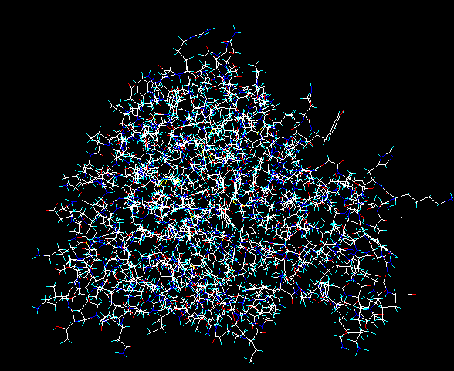
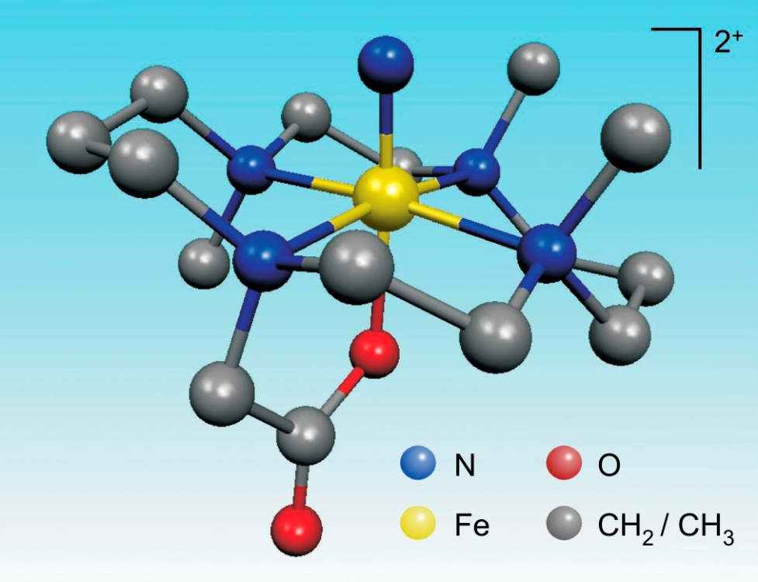
Schema Models

Slide 13
Link Reading Comprehension to Learning
Connecting Reading Comprehension and Cognitivism
  Engage in “pre-reading”
    Before you begin reading, access the schema you have on the topic by
  As you read, enhance the memory trace
    Employ rhetorical and problematizing strategies
    Transfer information into a new modality
  When you finish reading, reflect
    If there is material you do not understand, list your questions and make a plan for answering them

Slide 14
Link Reading Comprehension to Learning
Learning Theory
  Constructivism
    Learning arises from the student’s experience with the information, not from the instructor’s dissemination of information
    Learning environment is optimal when it provides
      Authentic experiences
      Collaborative experiences
      Problem solving opportunities

Slide 15
Link Reading Comprehension to Learning
Connecting Reading Comprehension to Constructivism
  Create authentic experiences
    Utilize rhetorical reading strategies
    Complete practice questions
    Collaborate with classmates

Slide 16
Review
Understand the process of reading comprehension
Build reading comprehension
Link reading comprehension to learning

Slide 17
Practice
View Critically Reading Cases presentation
Read and brief cases included on webpage
Develop reading comprehension with legal and non-legal texts

