Slide 1
Achieving Your Personal Best in Law School
Professor Jeff Minneti
asp@law.stetson.edu
727.562.7343
Stetson University College of Law
Notes:
Introductions
Myself and the group

Slide 2
Presentation Objectives
Provide an overview academic sessions at Orientation
Outline steps that lead to academic success
Acquaint you with Stetson’s Academic Success Program

Slide 3
Overview of Academic Sessions at Orientation
Analyzing and Responding to Client Issues
Mock Class

Slide 4
Overview of Academic Sessions at Orientation
Preparing for Life Beyond Law School
Mock Class Debriefing
Orientation 1.5 (Optional)
Critically reading and briefing cases
Discuss briefs for cases used in Orientation
Discuss other class preparation techniques
Classroom D Gulfport Campus
Date and time vary by Orientation session

Slide 5
Steps that Lead to Academic Success
Step 1: Cast a vision for success
Step 2: Prepare a plan to achieve the vision
Step 3: Execute the plan

Slide 6
Step 1: Cast a Vision
Vision—defines success

Slide 7


Slide 8
Step 1: Cast a Vision
Questions to consider

Slide 9
Step 1: Cast a Vision
Academic Goals
Defining personal best
Mastering the law, legal analysis, and a marketable skill set
Passing the bar
Relational Goals
Build bridges with faculty and students
Contribute to campus and community life

Slide 10
Step 2: Prepare a Plan to Achieve your Vision
Keep in mind
Law school may be significantly different from your undergraduate experience or other graduate work
Substantive differences
Procedural differences

Slide 11
Step 2: Prepare a plan
Keep in Mind. . .
Substantive differences
Class goals
Social architect
Interplay between positive law and social norms
Master doctrine of law

Slide 12
Step 2: Prepare a Plan
Keep in Mind. . .
Substantive differences
Reading material
Court opinions
Statutes
Constitutions
Law review articles
Legal research materials

Slide 13
Keep in Mind. . .
Substantive Differences
Skills Developed
Critical Reading
Critical Thinking
Organization and Process of Legal Material
Synthesis of Legal Material
Application of Legal Material
Evaluation of Application
Oral and Written Articulation items listed above
Time and stress management

Slide 14
Keep in Mind. . .
Procedural Differences
Socratic method
Discussion
Use information to solve problems you have never seen before
Assessment largely based on written expression with a single event exam
Most learning takes place outside of class

Slide 15
Keep in Mind. . .
If grades form part of your vision—Be REAL
Reported on 4.0 scale
Mandatory mean 2.9-3.10 for first-year required courses
Be aware of what grades represent (and what they do not represent)
Strive for personal best

Slide 16
Keep in Mind. . .
Law School Relationships
Professors, attorneys, and judges
Members of section and class
Study groups
Upperclassmen
Non-law trained people

Slide 17
Prepare a Plan to Achieve your Vision
How does my description of law school differ from your other educational experiences?

Slide 18
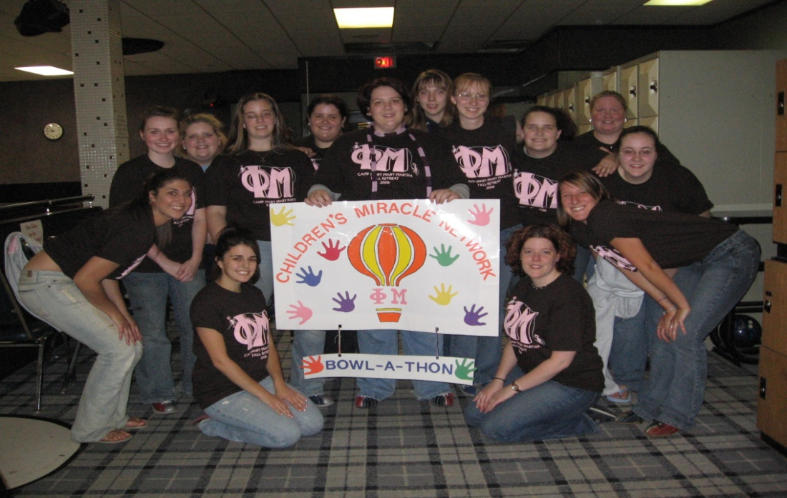
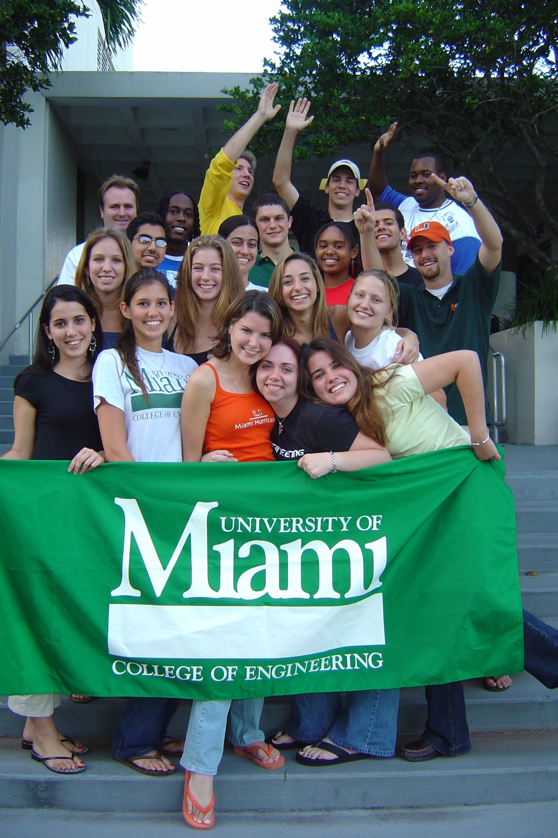


Slide 19
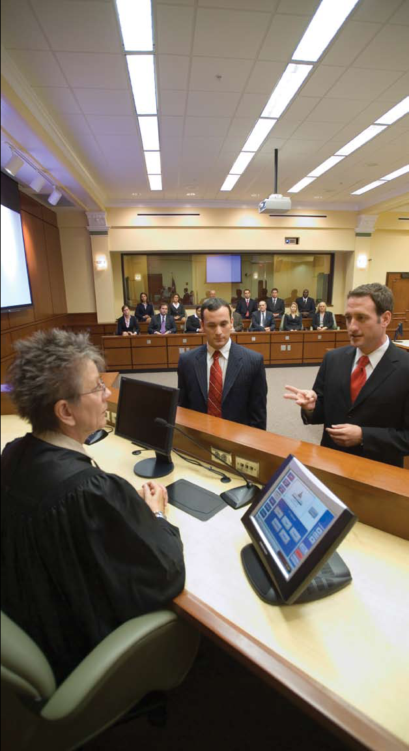

Slide 20
Execute your Plan
Allow learning theory to shape how you study
Self-directed learning
Learning preferences

Slide 21
Execute Your Plan
Self-Directed learning =
3 Phases of Learning
Forethought
Performance
Reflection

Slide 22
Phases of Learning
Forethought
Think about what you are going to learn
Think about what you already know about that information

Slide 23
Phases of Learning
Forethought
Think about how you are going to learn it
A. Read it
B. Brief it
C. Talk about it
D. All of the above
Think about how much time you have to learn it
Clock it

Slide 24
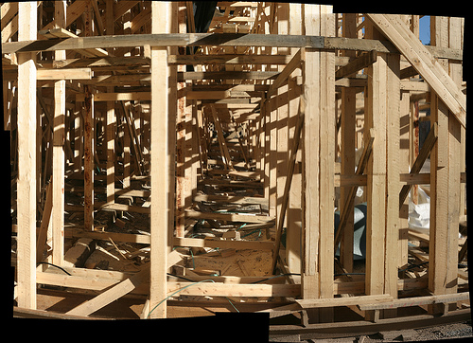
Scaffolding: Build on What You Know

Slide 25
Phases of Learning
Performance
The act of learning
Active, engaged activity
Connect with prior learning; expand connections
Regularly check for understanding
Practice questions
Study group

Slide 26
Phases of Learning
Performance:
Default reading strategies
Highlighting
Underlining
Paraphrasing
Problematizing strategies
Questioning
Hypothesizing
Synthesizing
Rhetorical strategies
Connect to purpose
Connect to prior knowledge
Evaluate

Slide 27
Phases of Learning
Reflection
Assess whether your performance was effective
Modify learning process to enhance outcome

Slide 28
Execute your Plan
Learning Preferences
The way you concentrate, process, absorb, and retain new and difficult information
Examples
Visual, Auditory, Kinesthetic
Analytic, Global
Individual, social learner
Authority, non authority

Slide 29


Learning Preferences

Slide 30
Execute your Plan
Learning preferences
Deal with the mismatch between your learning preferences and the presentation of content in class
Be flexible
Be proactive
Be intentional

Slide 31
Steps to Success
Step 1: Cast a vision for success
Step 2: Prepare an action plan
Step 3: Execute the plan

Slide 32
Why does it matter?
Complex world, with complex problems
Lawyers are trained problem solvers

Slide 33


Complex world; Complex Problems

Slide 34

Complex World; Complex Problems

Slide 35
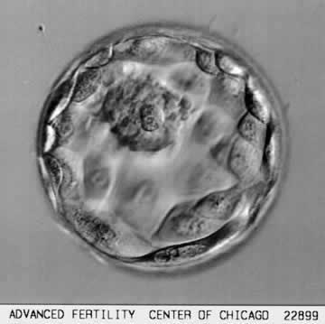
Complex World; Complex Problems

Slide 36
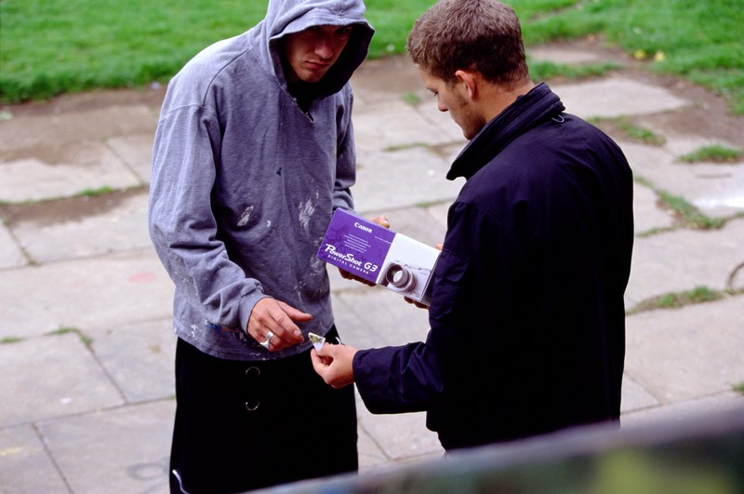

Complex World; Complex Problems

Slide 37


Complex World; Complex Problems

Slide 38
Stetson’s Academic Success Program
Vision
Help you achieve academic success in law school and pass the bar
Goals
Equip you with the skills necessary to competently and independently master the material taught in your law school classes and acquired in your professional lives
Enhance your execution of legal analysis
Nurture your motivation to learn

Slide 39
Academic Success Program
Academic Success Workshops
Assist with transition into law school
Provide instruction on academic skills
Enrollment criteria
152 or lower on highest LSAT
English as a second language
Out of higher education for 10 years or more

Slide 40
Academic Success Program
Academic Success Workshop
Details
Tuesday 10:30-12:00
(Sections 1-2)
Tuesday 5-6 pm (Section 5)
Wednesday 3:10-4:30
(Sections 3-4)
1 Credit; pass/fail
Limited to 25 registered students
To Register, send an email to
asp@law.stetson.edu.
Indicate your name and section number

Slide 41
Academic Success Program: Courses Beyond the First Semester
Midpoint course
offered in Spring semester to second-semester students who struggle on first-semester exams
Advanced Critical Thinking
elective course offered during to upper level students

Slide 42
Academic Success Program
Need not enroll in a course to obtain assistance
Schedule individual meeting
Review case briefs, outlines, etc
Discuss exam preparation and performance strategies
asp@law.stetson.edu
727.562.7343

Slide 43
Presentation Objectives
Provide an overview academic sessions at Orientation
Outline steps that lead to academic success
Cast a vision
Prepare a plan
Execute the plan
Acquaint you with Stetson’s Academic Success Program

