Slide 1
Academic Success Program
Presents
Ready or Not, Here It Comes:
Effective Outlining Strategies for
Before, During, and After Class
Email Us:
asp@law.stetson.edu

Slide 2

Feel Bombarded?
R&W
TORTS
CONTRACTS

Slide 3
OBJECTIVES
Learn Like A Champion!
Define “Outlining”
Identify Content and Formats
  Before Class: Class Assignments & Preparation
  During Class: Deciphering What’s Important
  After Class: Synthesizing Your Notes
Practical Exercise in Outlining

Slide 4
DEFINITION
“OUTLINING” – Creating a document that represents information covered in an entire class over the course of the semester.
CONTENT:
  Vocabulary
  Rules
  Policy
  Examples and Non-Examples
    Cases
    Hypotheticals
  Unanswered Questions

Slide 5
Two Types Of Outlines
1. “ACTIVE”
2. “FINAL”
CASE DRIVEN
  Case Briefs
  In-Class Notes
  20-100 pages
  Think Daily Details!
RULE DRIVEN
  Synthesized & Manageable < 10%
  Examples and Non-Examples
  Think Black-Letter Law!

Slide 6
Getting Started: Before Class
Decide on a Method: Handwrite v. Computer
Decide on a Template:
  Table of Contents
  Class Syllabus – Assignments
  Commercial Outline
Recreate Template in an editable document
Save Two Skeleton Copies

Slide 7
BEFORE CLASS: ACTIVE OUTLINING
  Context –Focus on Relevant Subject Matter
  Organization
Case Briefs:
  Case Name, Rule, Facts, Reasoning, Holding, Policy
  Questions: Include Unresolved Questions/Concepts
  **Practical Tip: AGREE or DISAGREE?

Slide 8
DURING CLASS: ACTIVE OUTLINING
Decide Method of Note-Taking: Hand v. Computer
Two Most Common Fears of Students:
  Note-Taking: All or Nothing
  Getting Called On: The Socratic Method

Slide 9
During Class: Practical Tips on
What’s Important
Verbal Cues:
  Hypotheticals
  Professor’s Own Words
    Rules
    Conclusions
    Rationales & Public Policy
  Repetition
  Reference to Authored Book or Article
  Last Two Weeks of Class
Physical Cues:
  Timing
  Illustrations
  Excitement
  Watch Professor’s Eyes

Slide 10
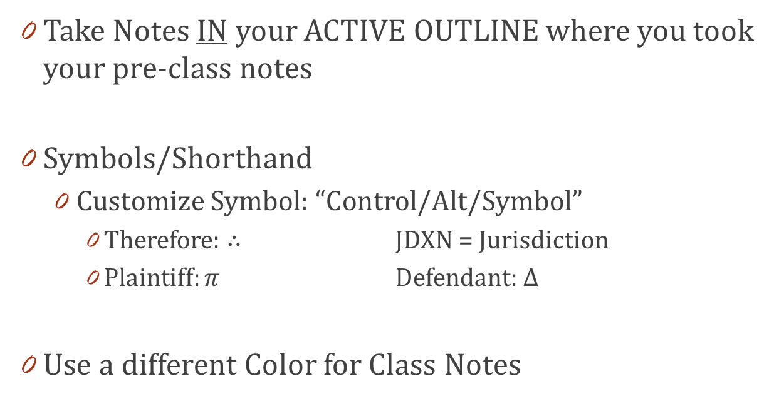
During Class: Practical Tips
Take Notes IN your ACTIVE OUTLINE where you took your pre-class notes
Symbols/Shorthand
  Customize Symbol: “Control/Alt/Symbol”
    Therefore: ∴ JDXN = Jurisdiction
    Plaintiff: $π$ Defendant: ∆
Use a different Color for Class Notes

Slide 11
POST-CLASS: FINAL EXAM OUTLINING
When to Create
  Daily v. Topic Completion
What to Include
  RULES, Policy, Examples or Non-Examples
                Cases (brief fact to jog memory)
                Hypotheticals
Where
  SECOND TOC/Syllabus Document created
Why
  Manageable document to prepare for finals
How
  Traditional Outline, Case Comparison Chart, Flow Chart

Slide 12

Examples & Practice
HANDOUTS:
Case Driven Outlines
Rule Driven Outline
Case Comparison Chart
Practice Question

Slide 13
Office Hours and Email
Prof. Minneti Nina L. Hayden, Esq.
Mondays 3:00pm-5:00pm Mondays 12:00pm-1:30pm
Wednesdays 11:00am-12:00pm Tuesdays 4:30pm-6:00pm
Thursdays 12:00pm-1:30pm
Kathryn J. Pelham, Esq.
Tuesdays 12:30pm-2:00pm
Thursdays 4:30pm-6:00pm **Tampa Law Center
Fridays 12:30pm-2:00pm
asp@law.stetson.edu

Slide 14
NEXT WORKSHOP:
Practice Makes Perfect: Reading and Responding to Essay Questions
Learn Like
a Champion
Today
Wednesday, October 17th from 12pm-1pm (A)
OR
Tuesday, October 30th
from 5pm-6pm (F)

